Slide 1
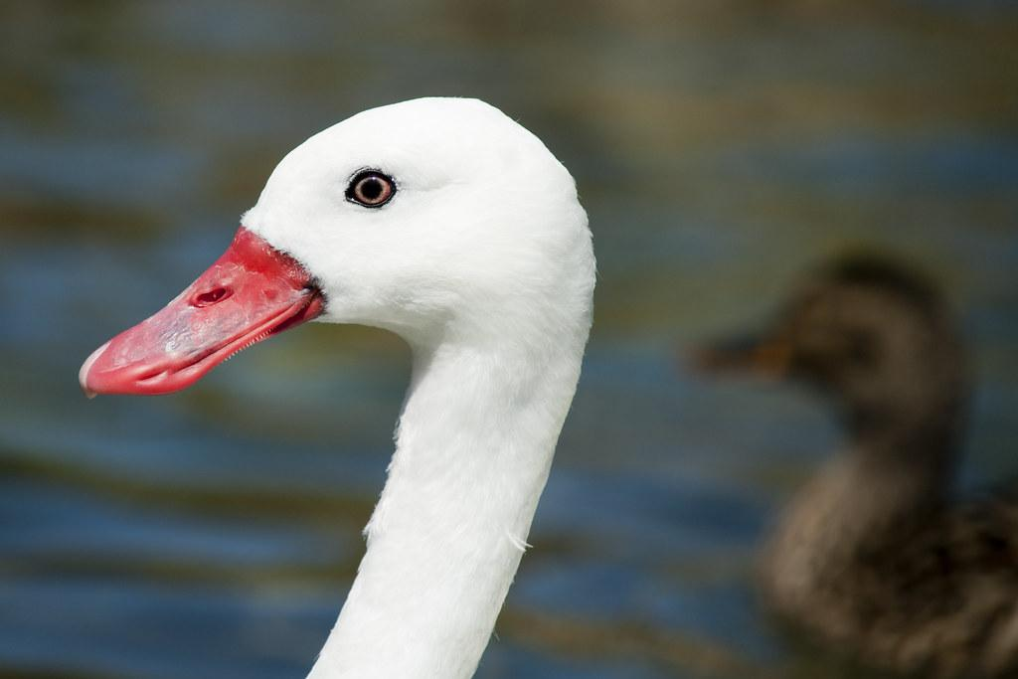
UGLY DUCKLING PROJECT
Ugly duckling project

Slide 2
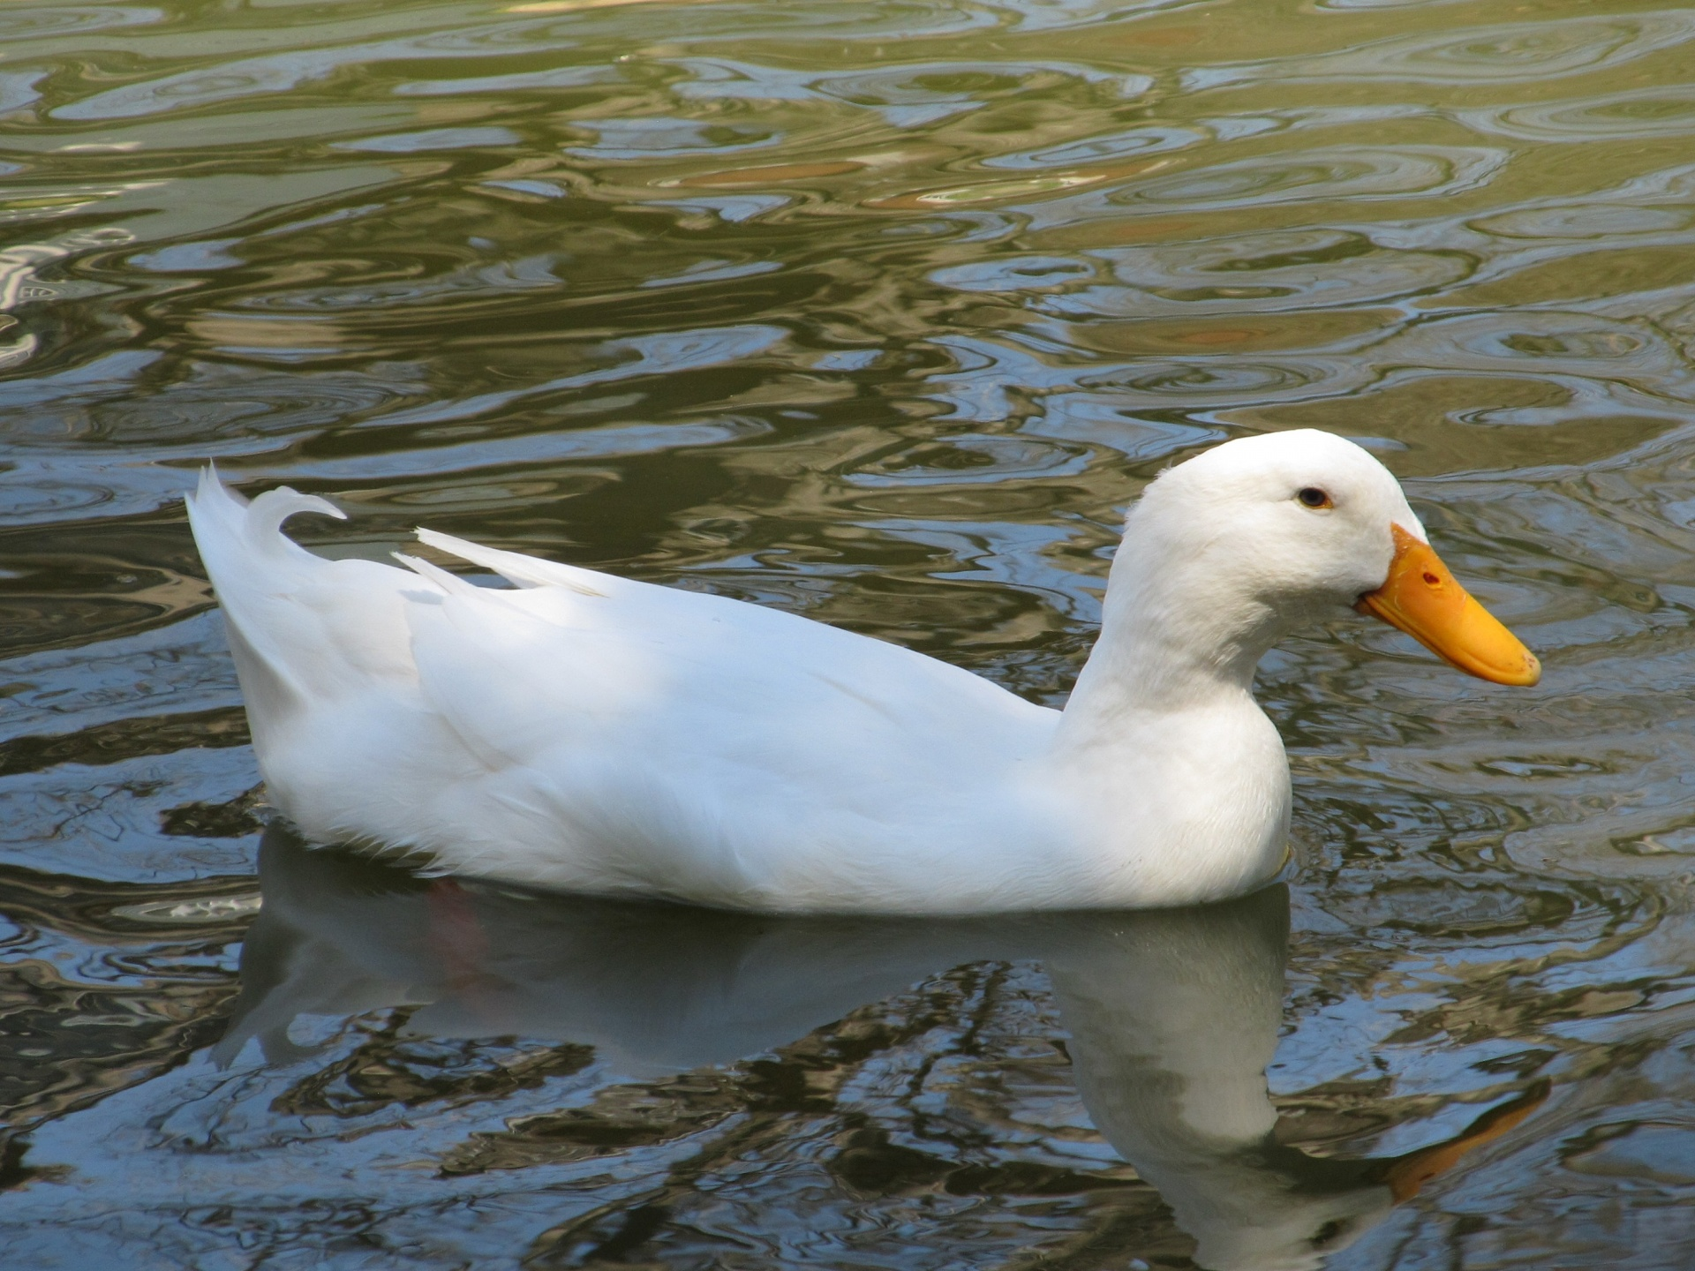
What animal is it?

Slide 3
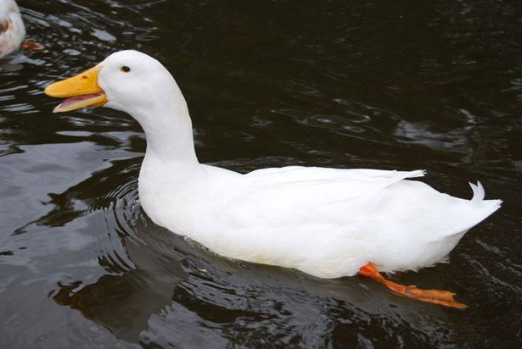
It is a DUCK.

Slide 4
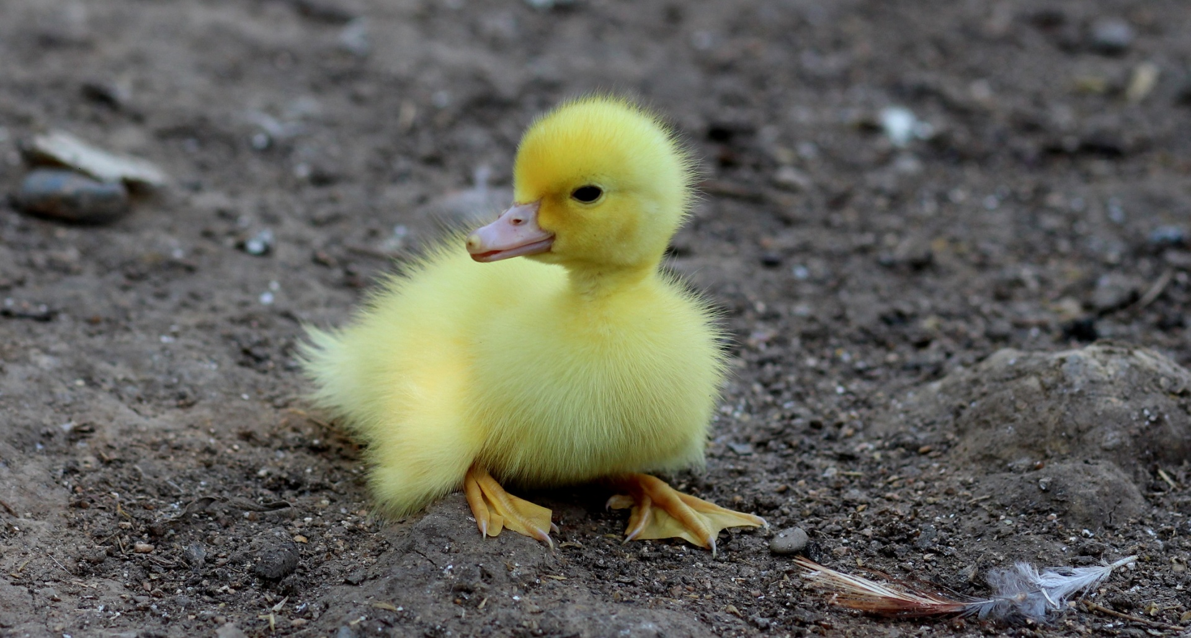
What animal is this?

Slide 5
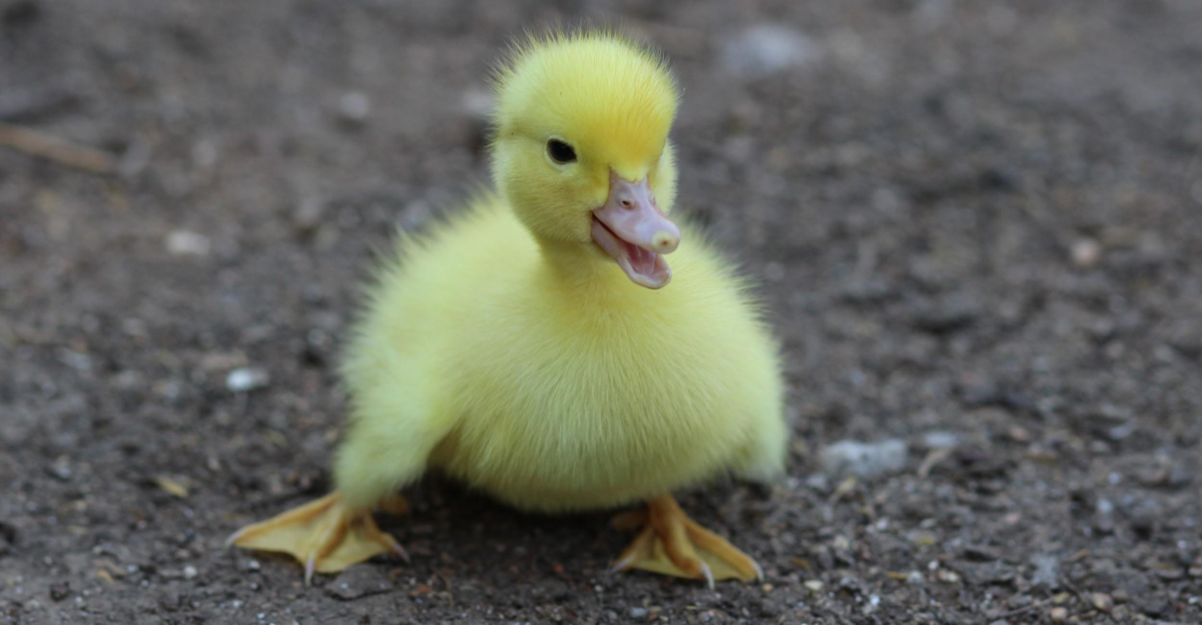
It is a DUCKLING.

Slide 6
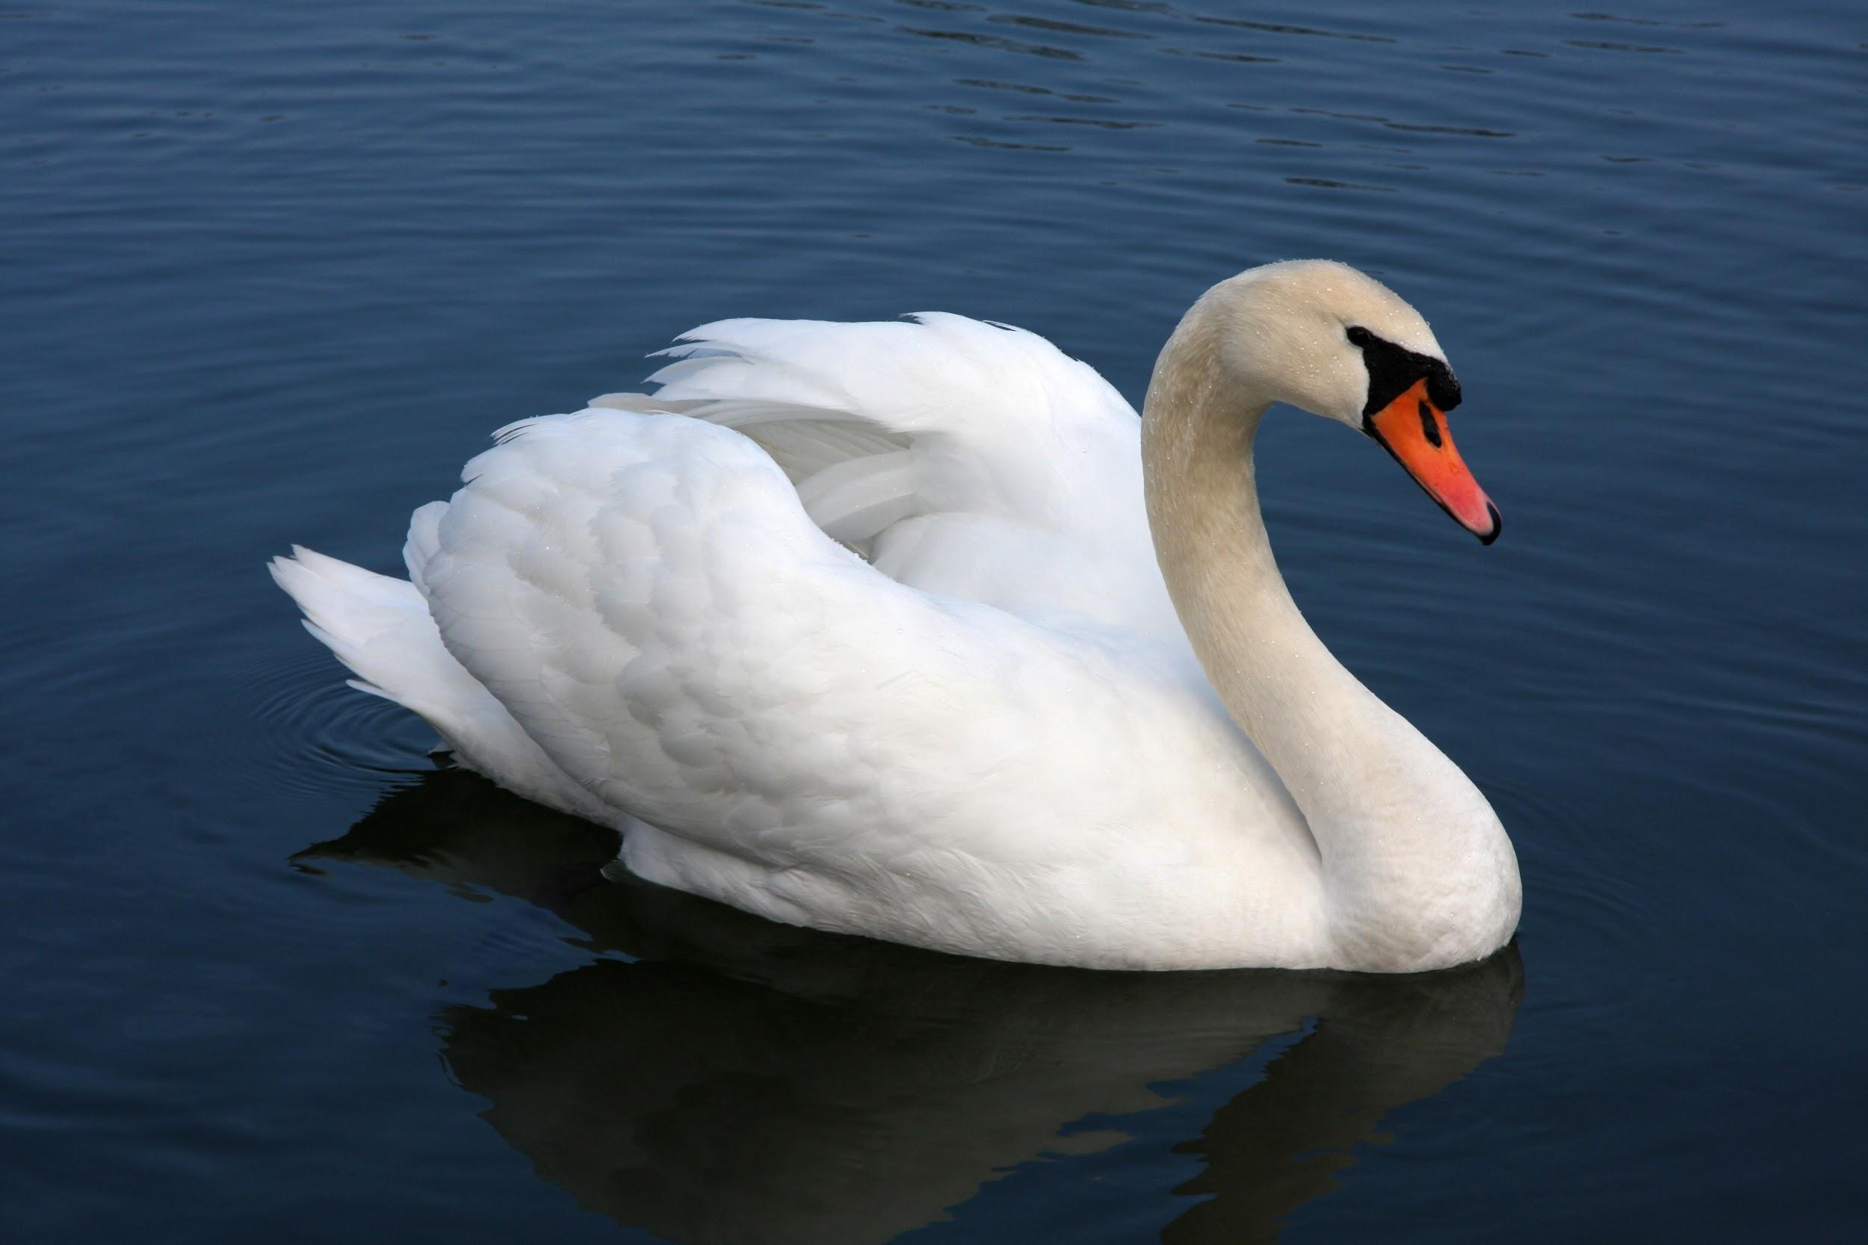
What is this?

Slide 7
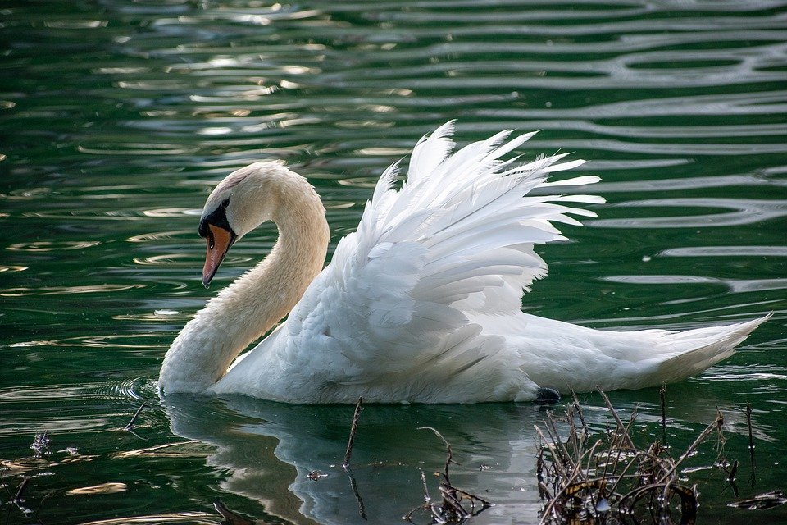
It is a SWAN.

Slide 8
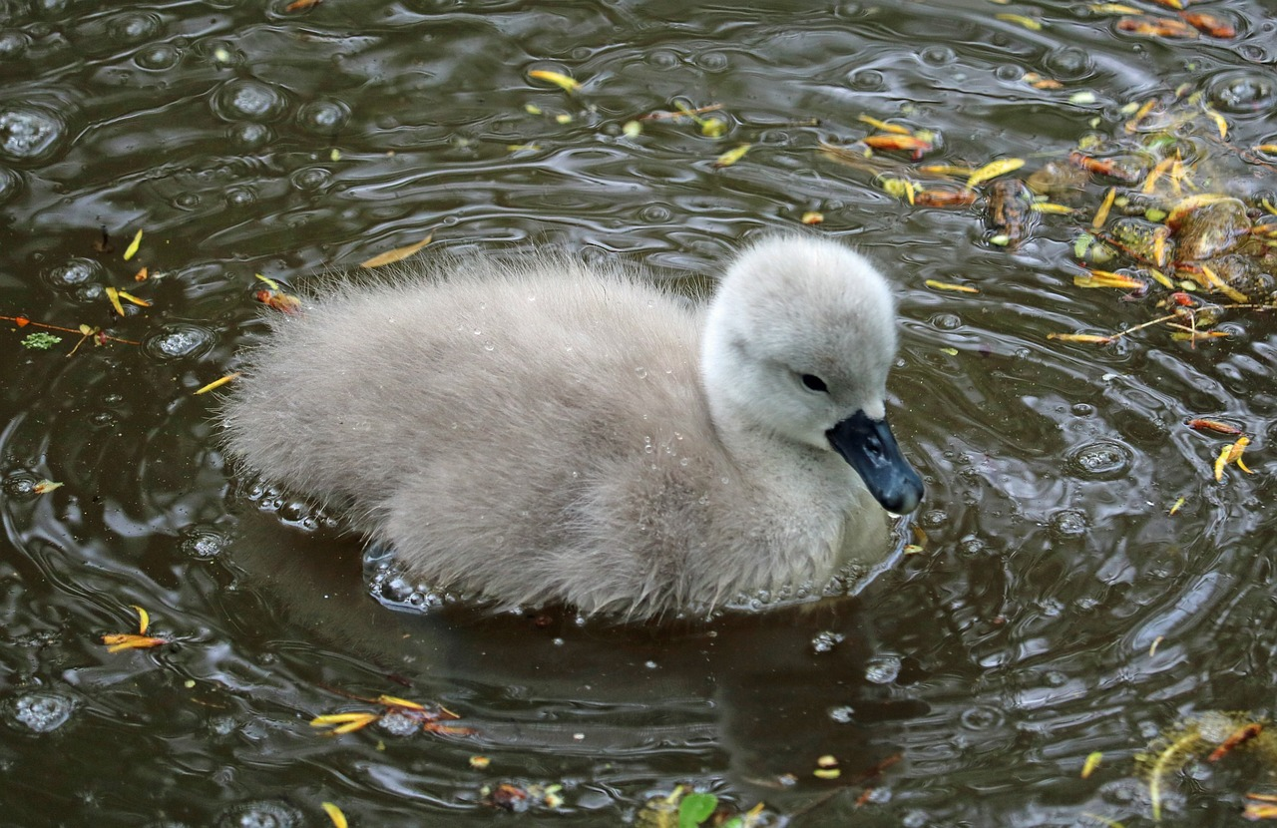
What is this?

Slide 9
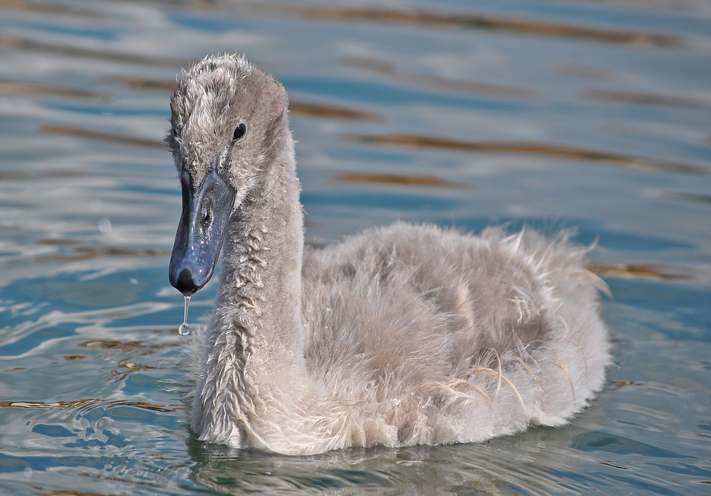
It is a CYGNET.

Slide 10
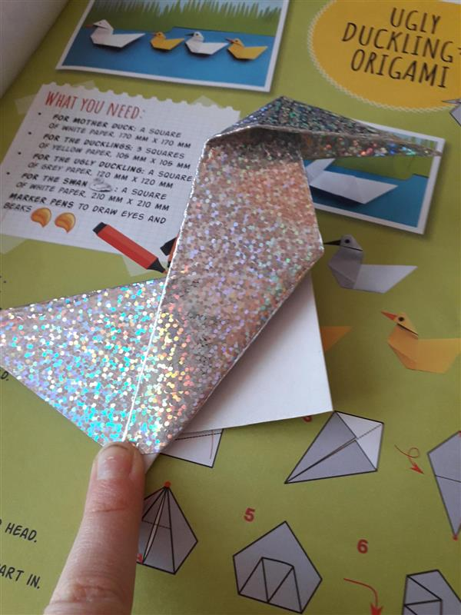
Matylda´s origami

Slide 11
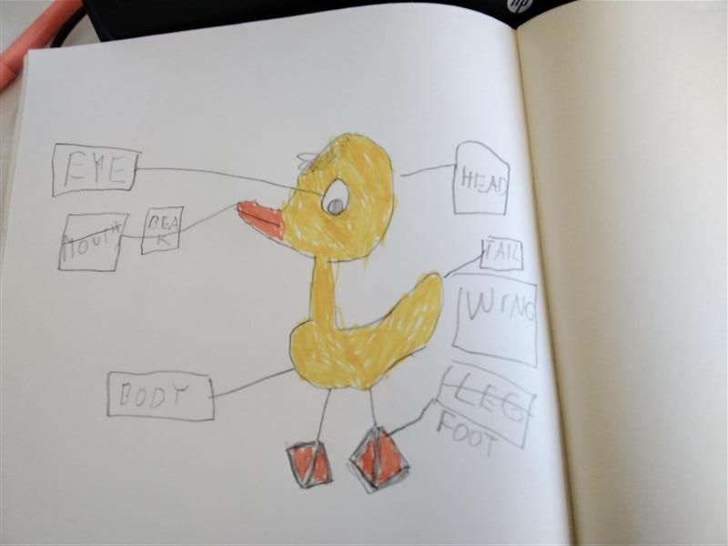
parts of the duckling´s body by Jindra

Slide 12
parts of the duckling´s body by Maty

Slide 13
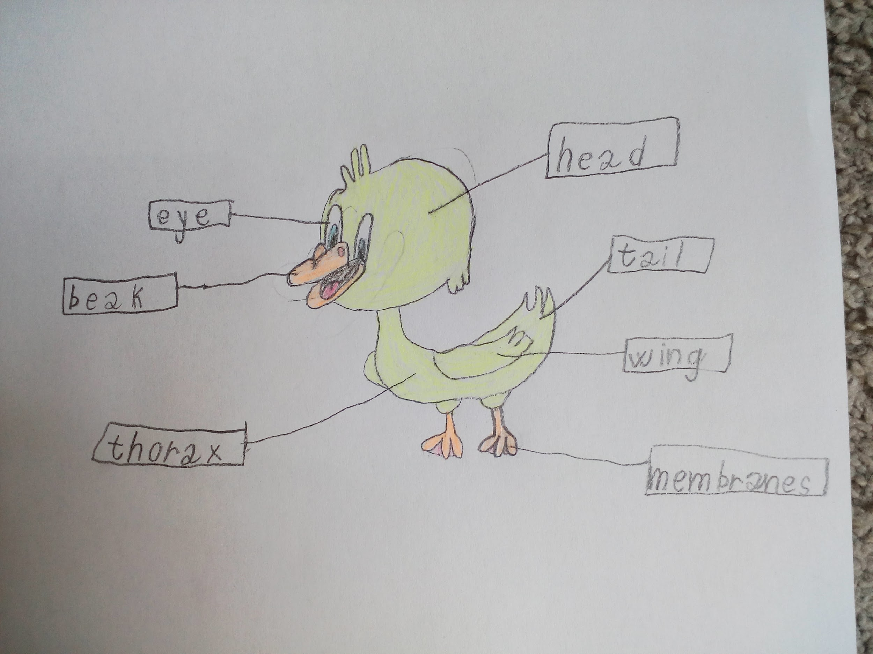
Parts of the dukling´s body by EVE

Slide 14
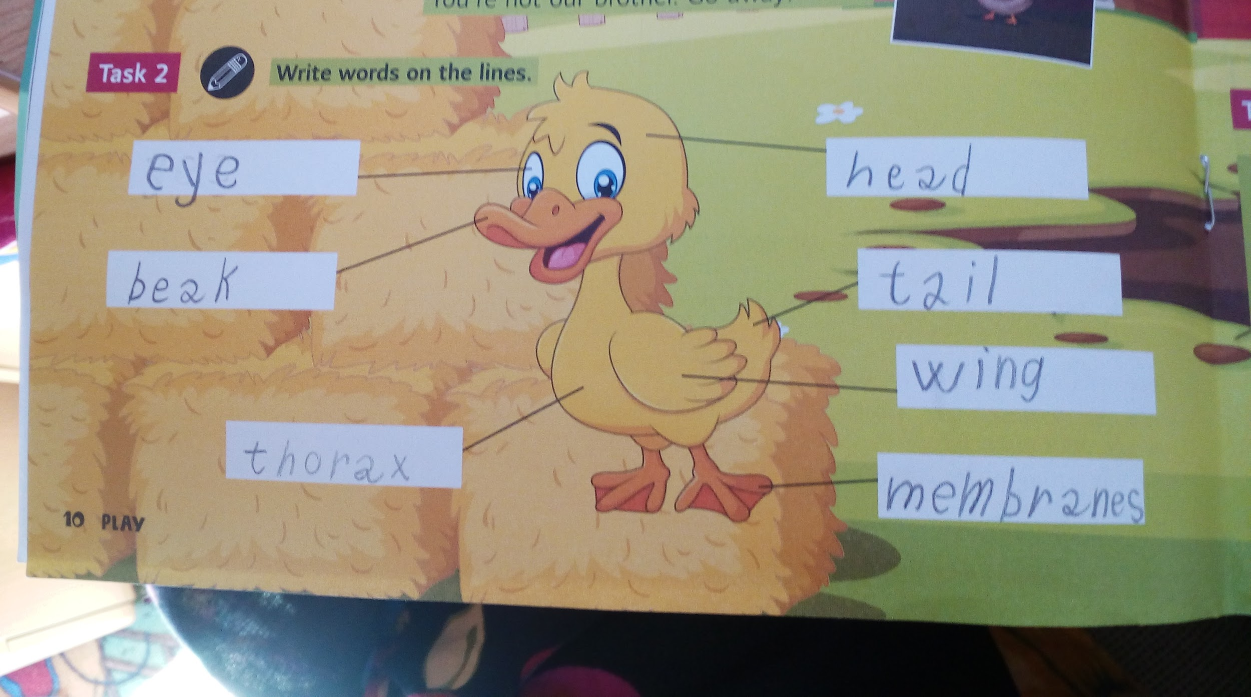
body parts by EVE again

Slide 15
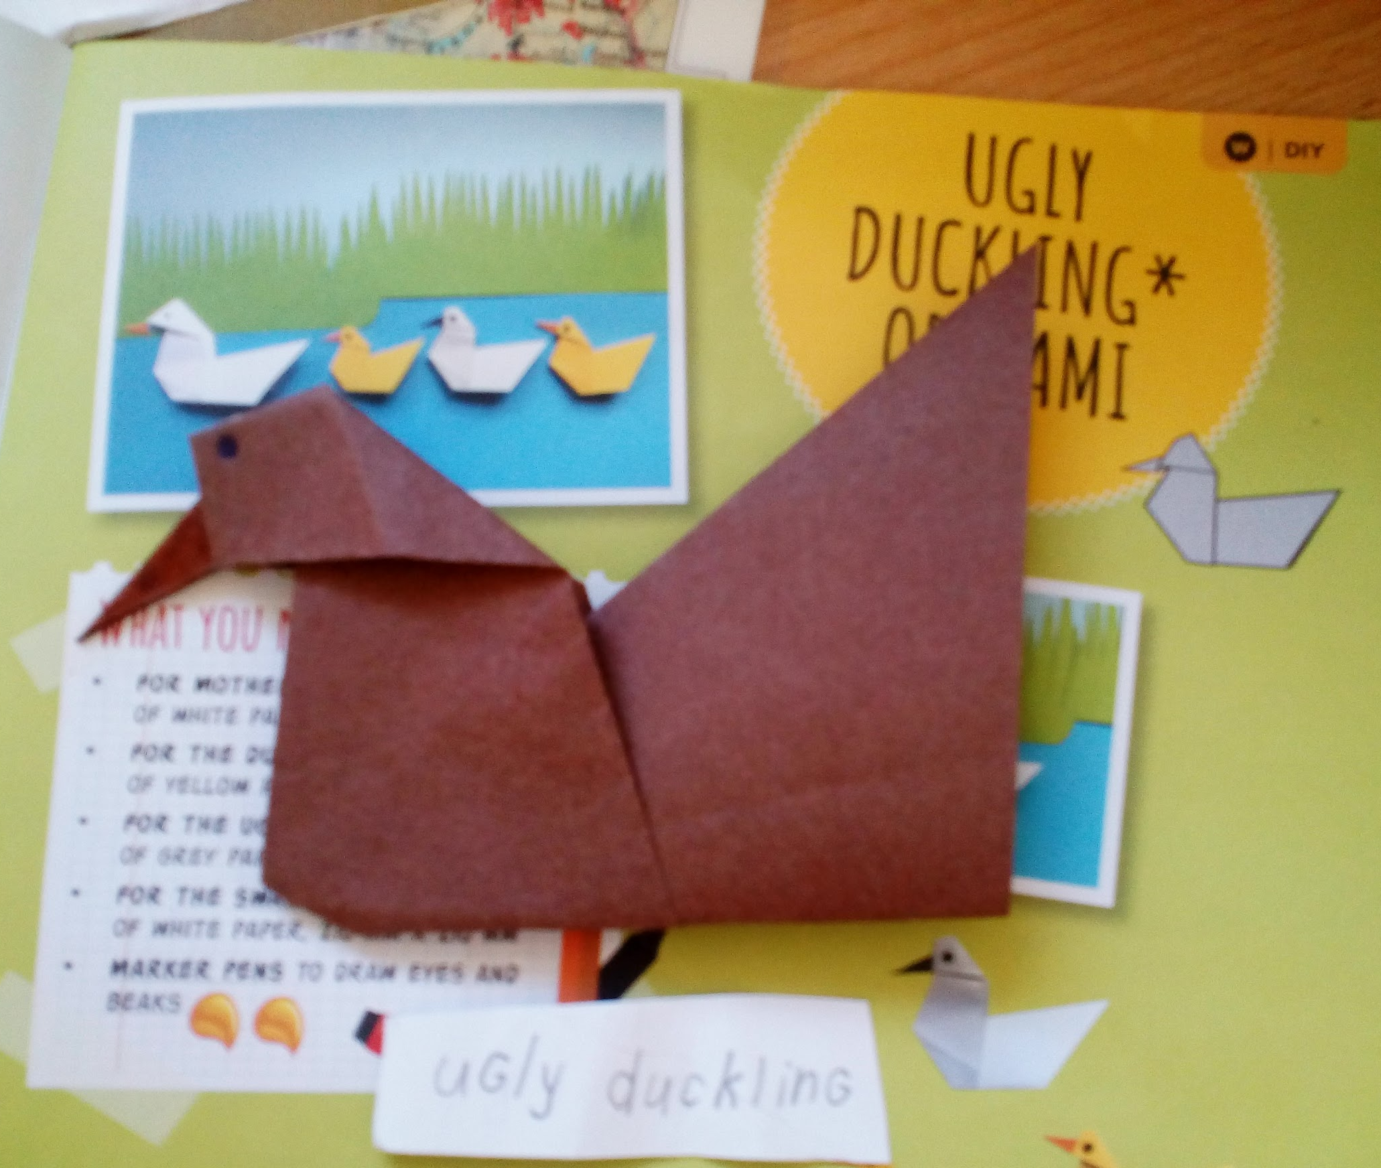
Ugly Duckling origami by EVE

Slide 16
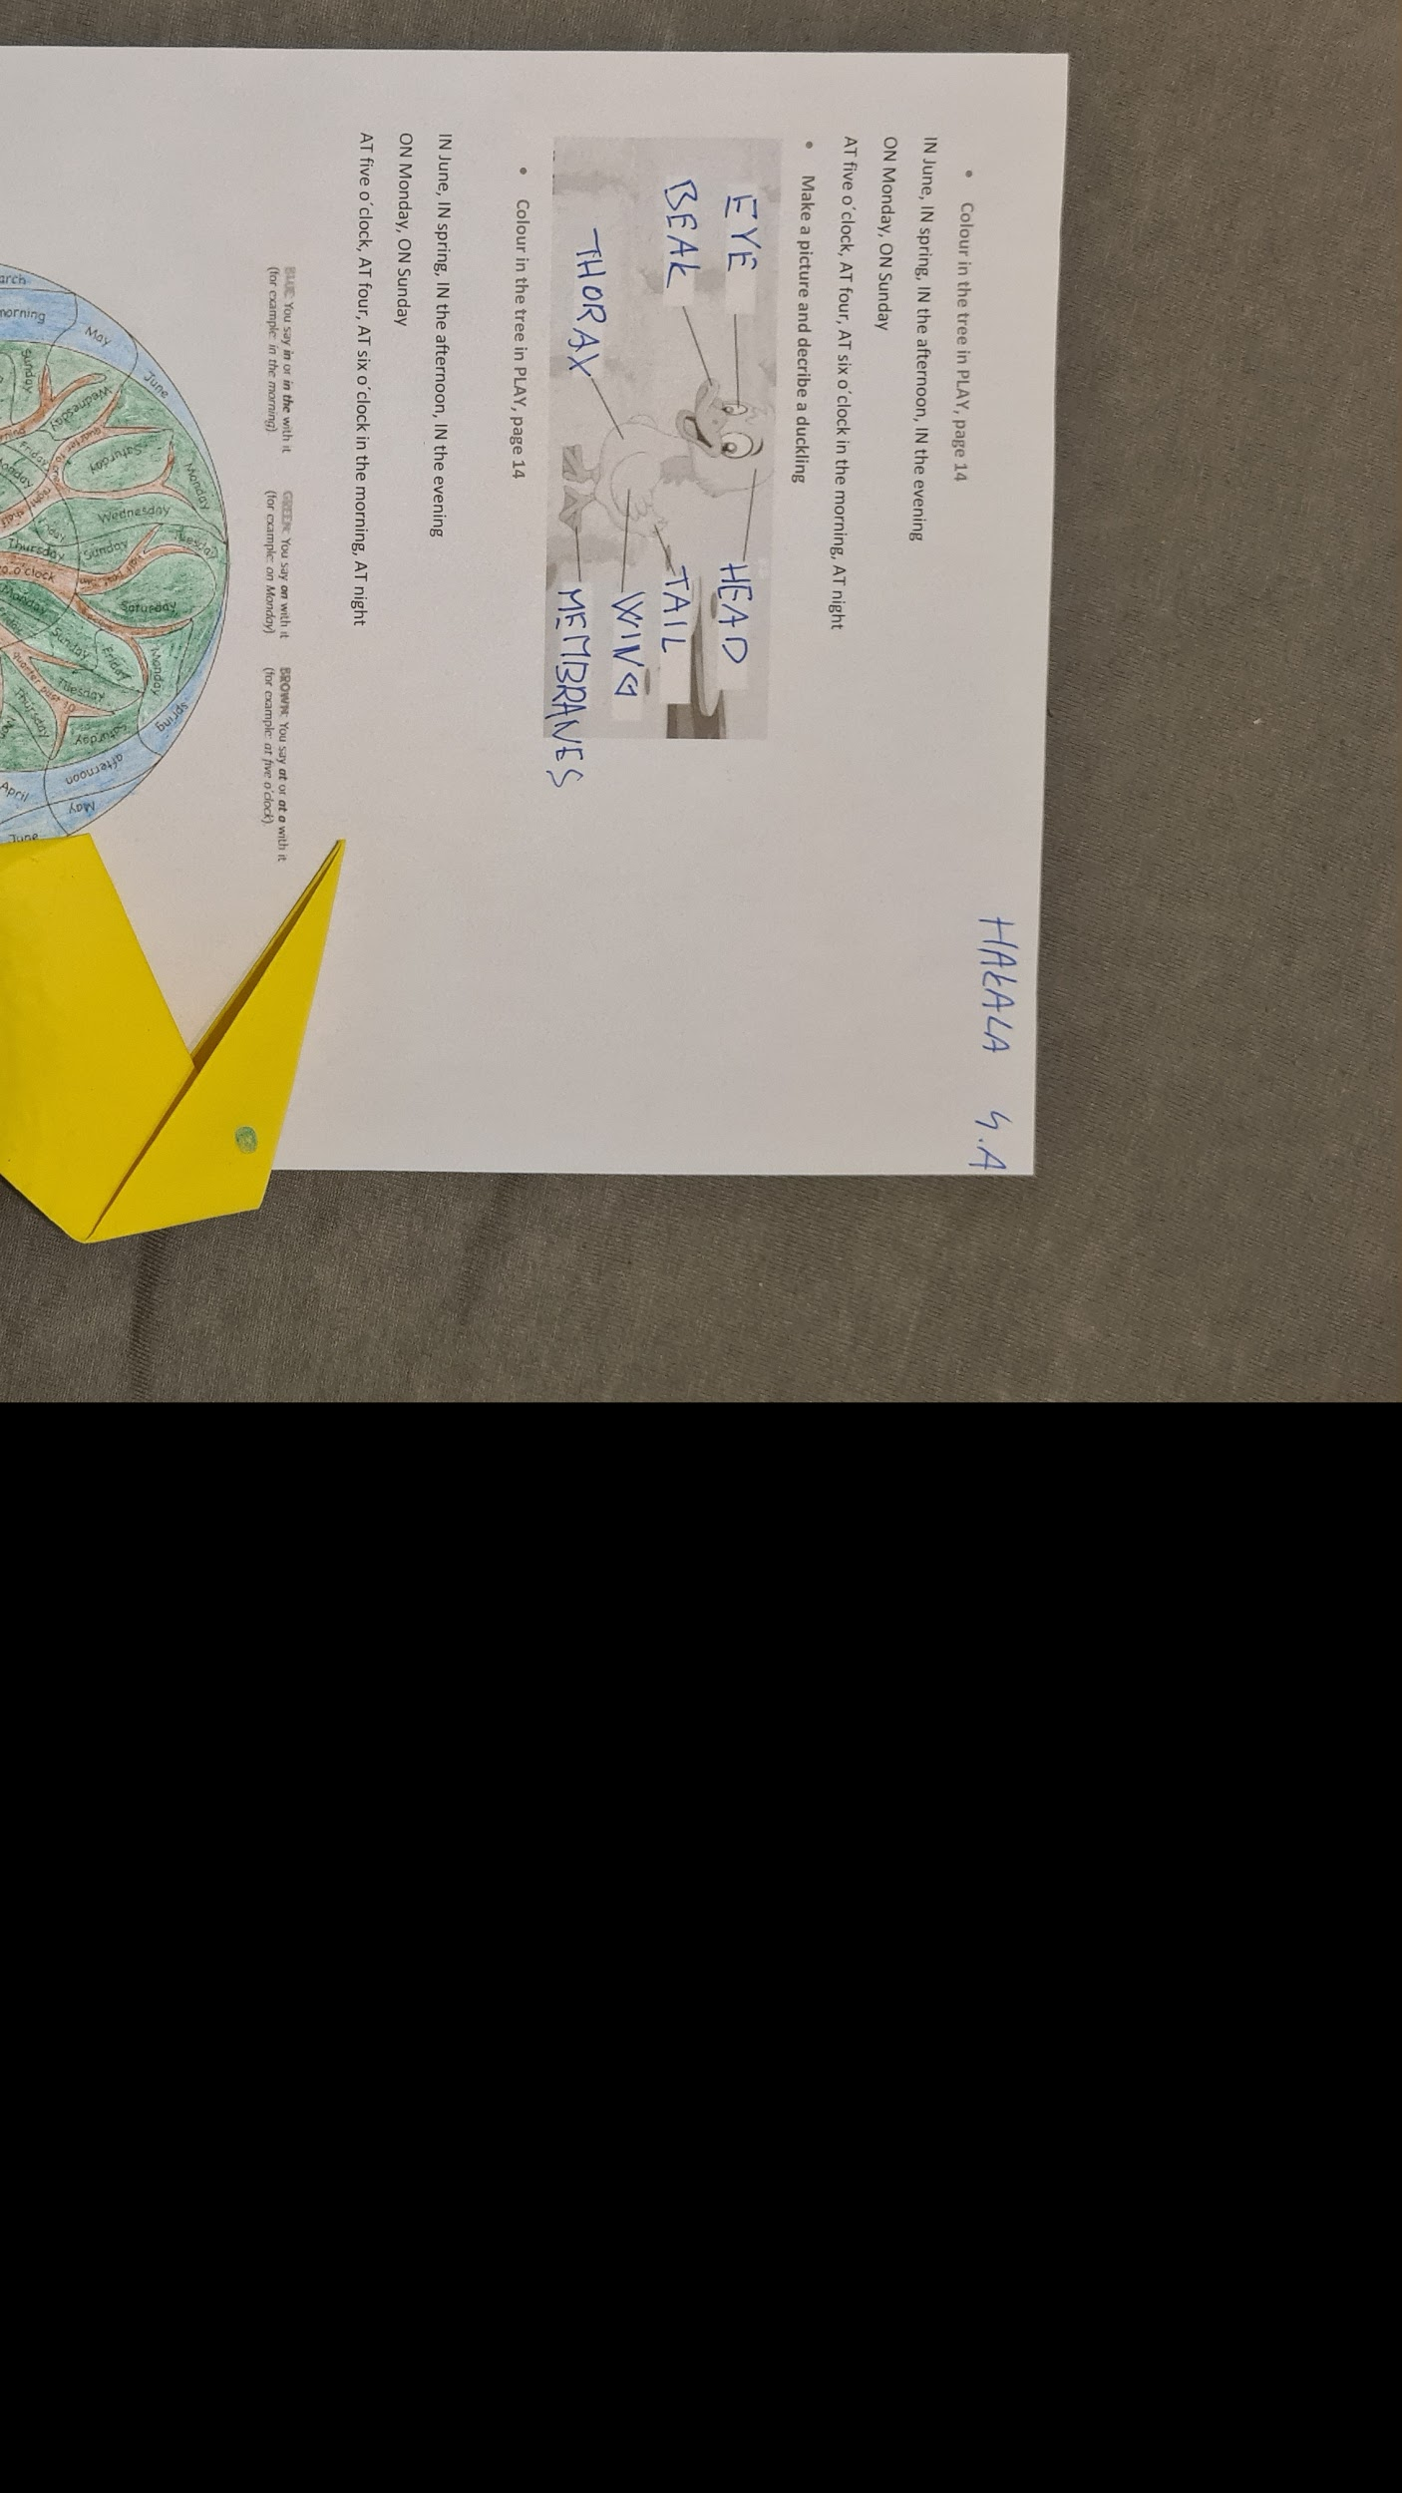
Martin Hakala

