Slide 1
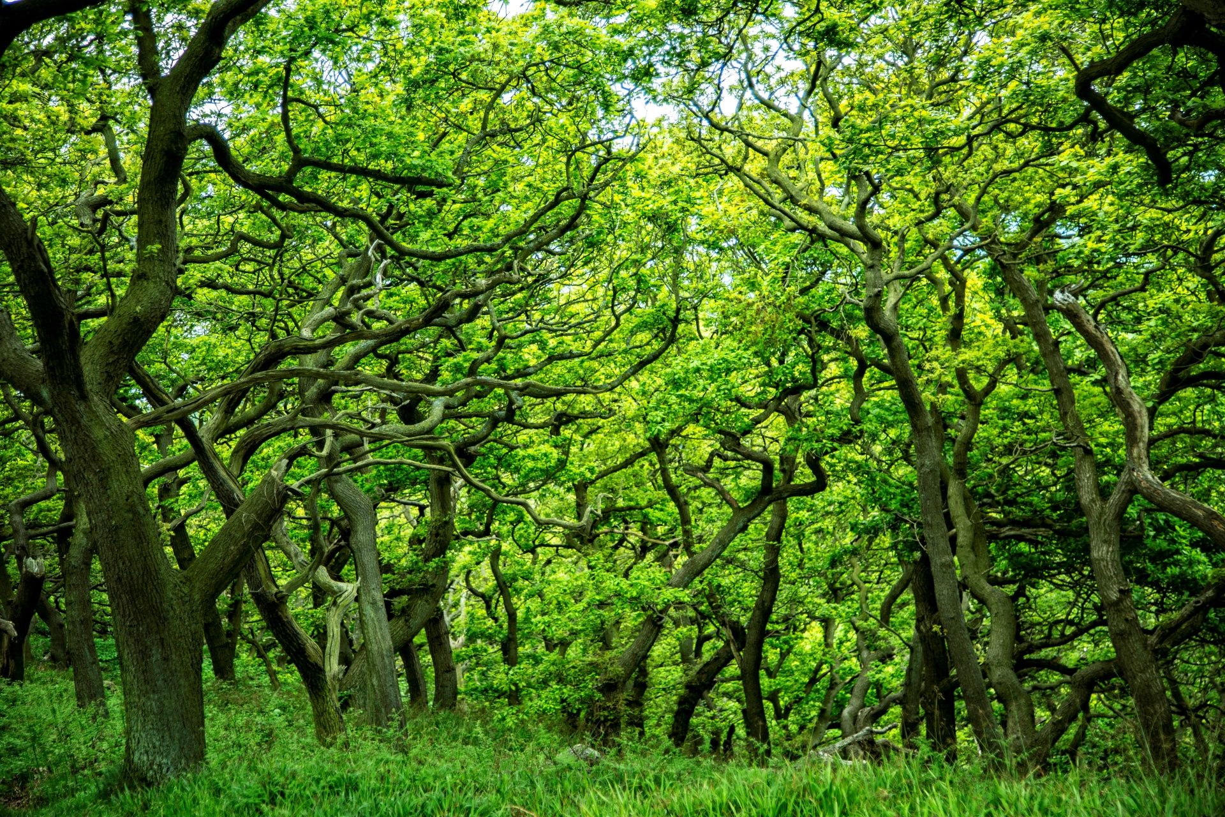
Forest project

Slide 2
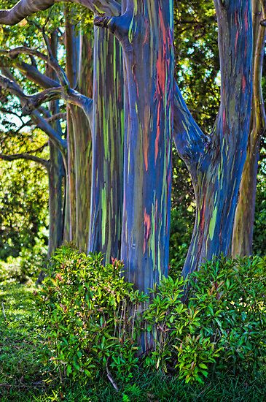

Slide 3
ese
eucalyptus tree
in Indonesia

Slide 4
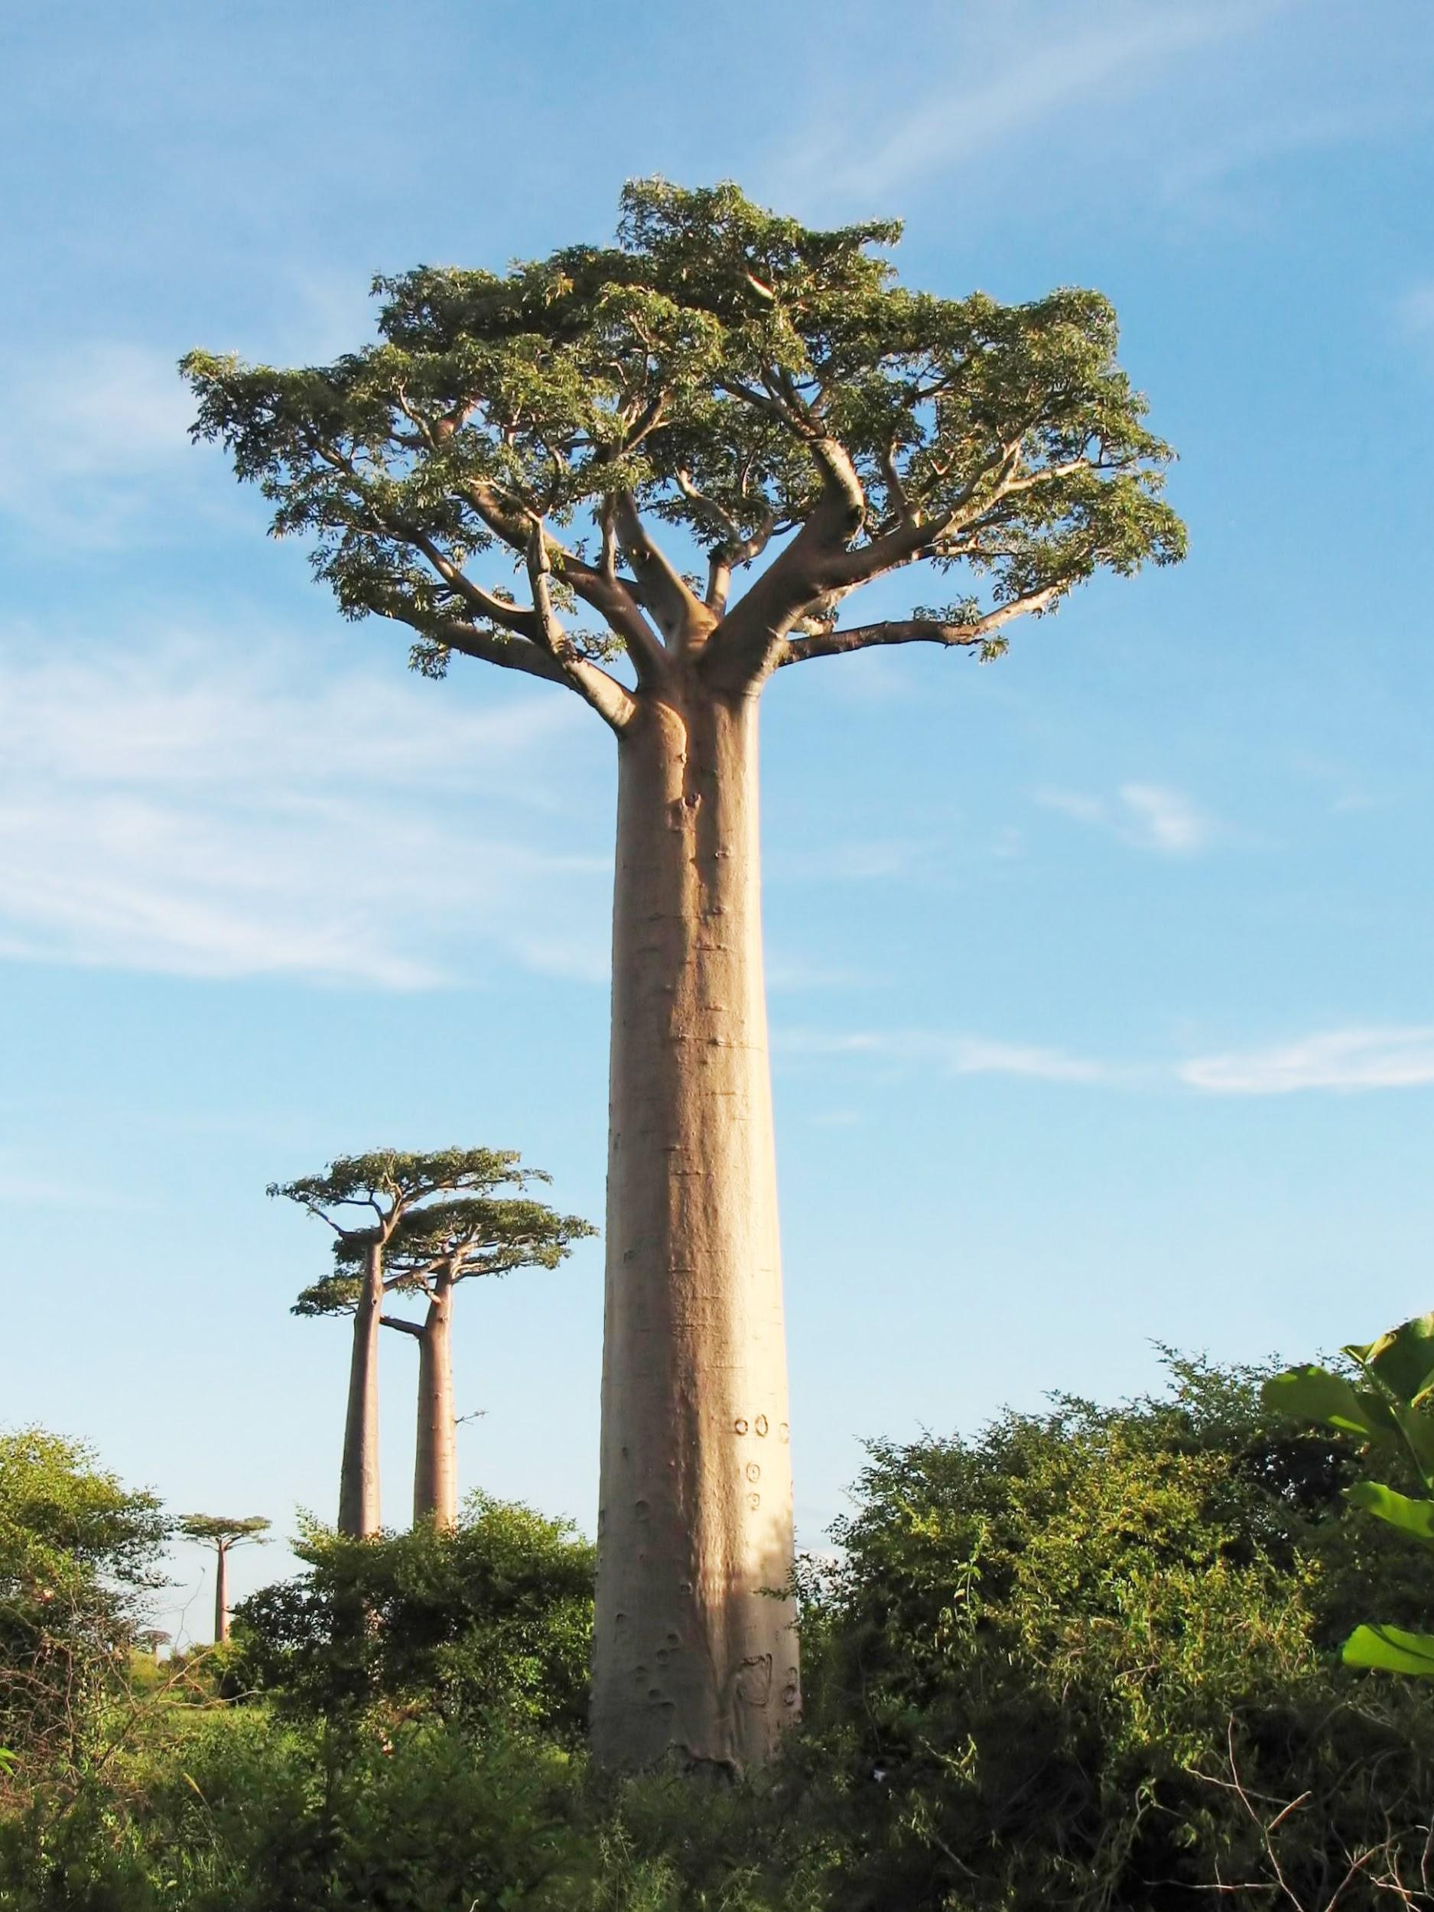

Slide 5
Baobab tree

Slide 6
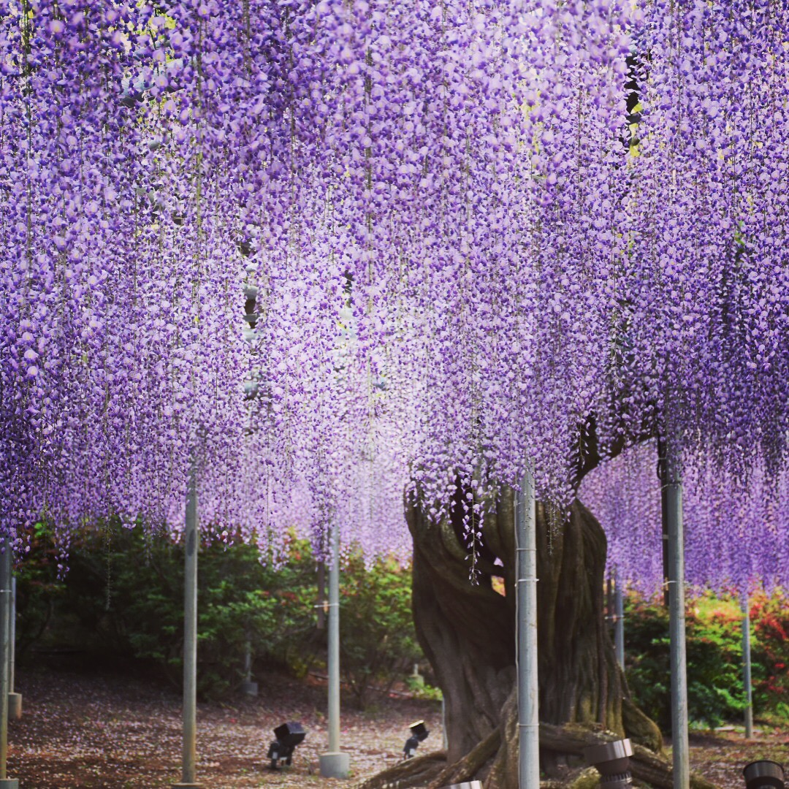

Slide 7
wisteria in Japan
1500 years old

Slide 8
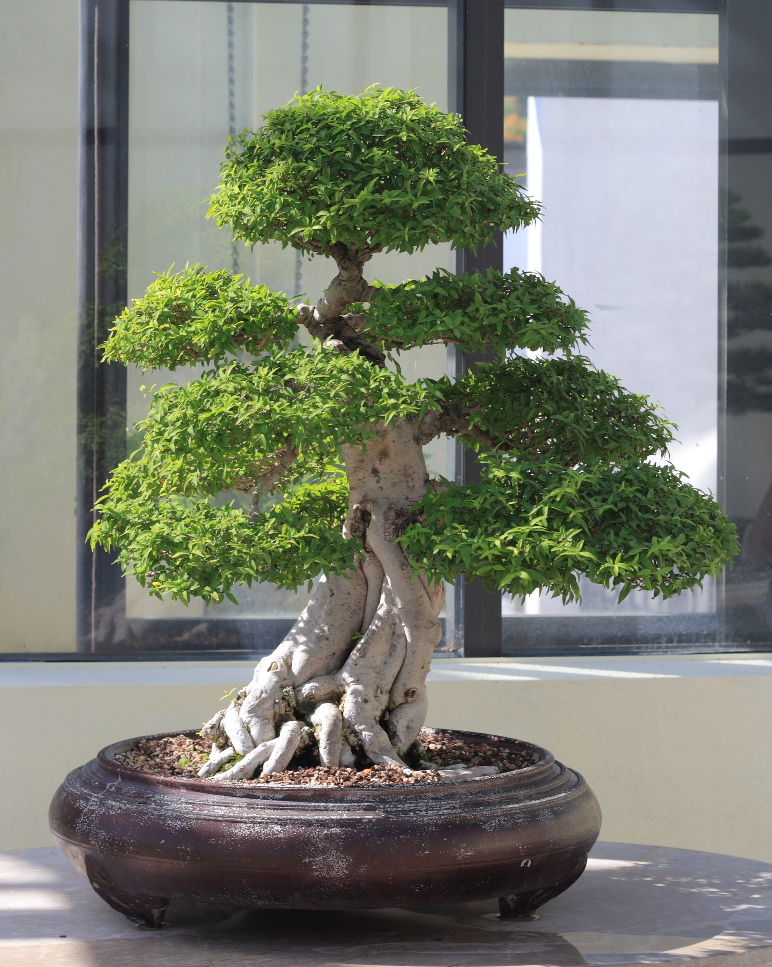
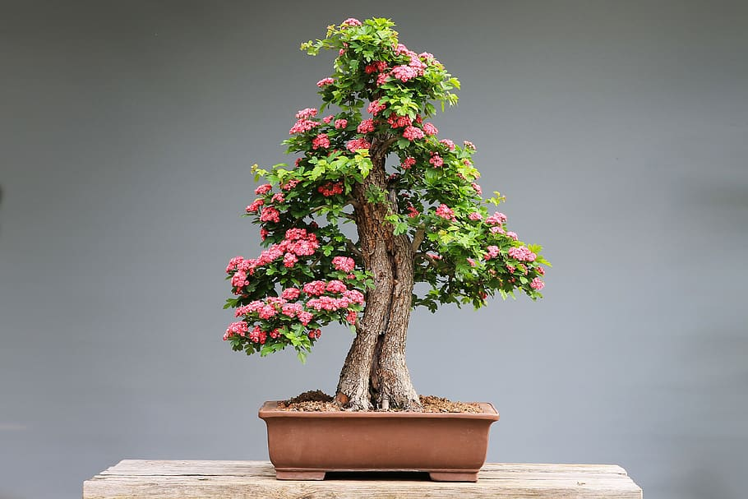
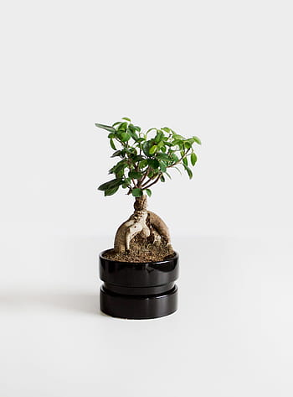
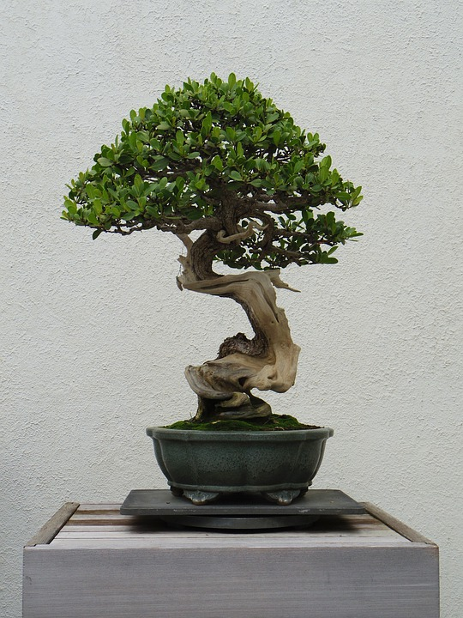

Slide 9
bonsai
art from Japan

Slide 10
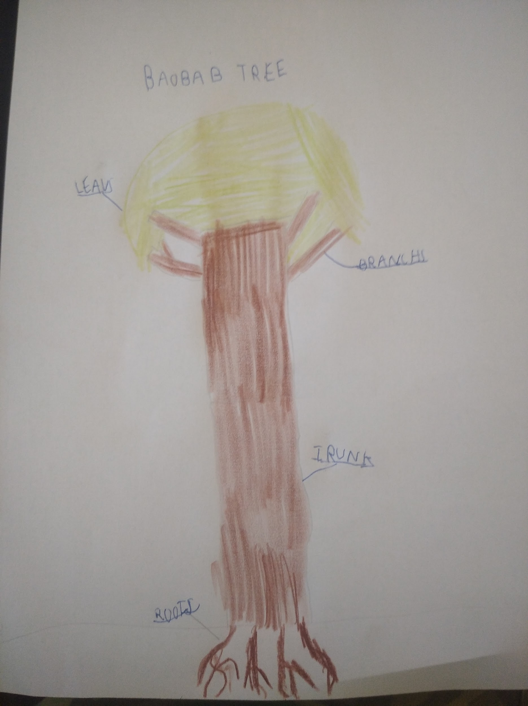
Parts of a tree
by HONZA

Slide 11
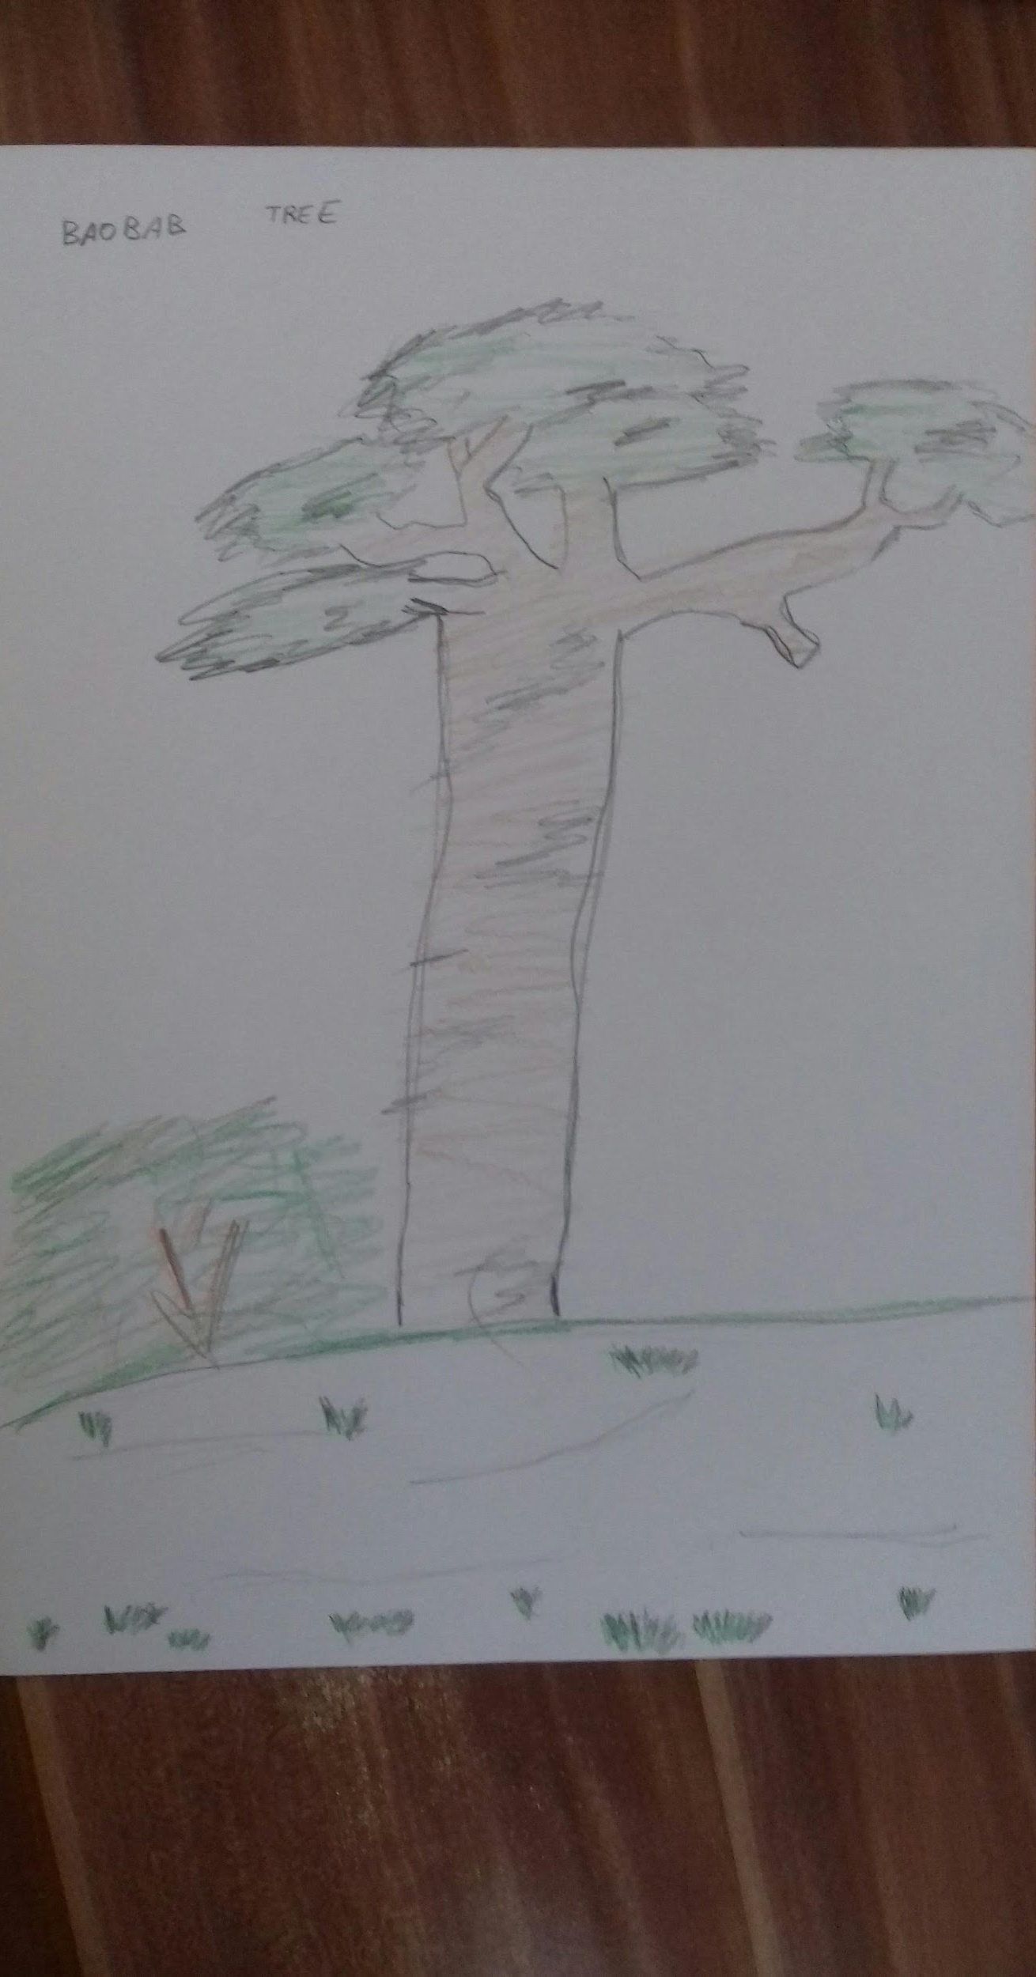
a tree
by DAVID

Slide 12
thank you

