Slide 1
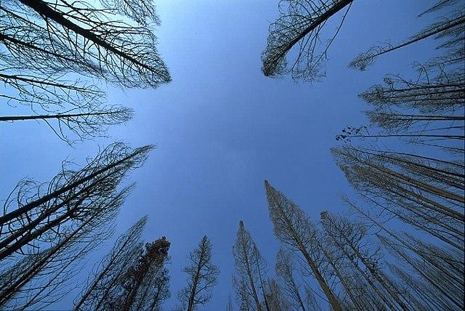
TREES by 5. B

Slide 2
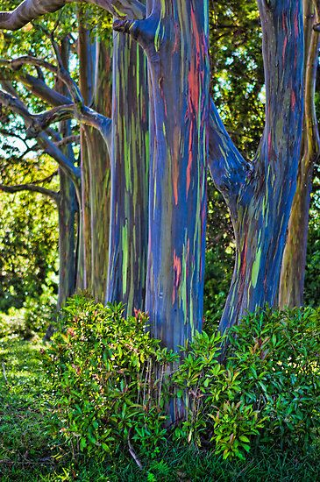

Slide 3
ese
eucalyptus tree
in Indonesia

Slide 4
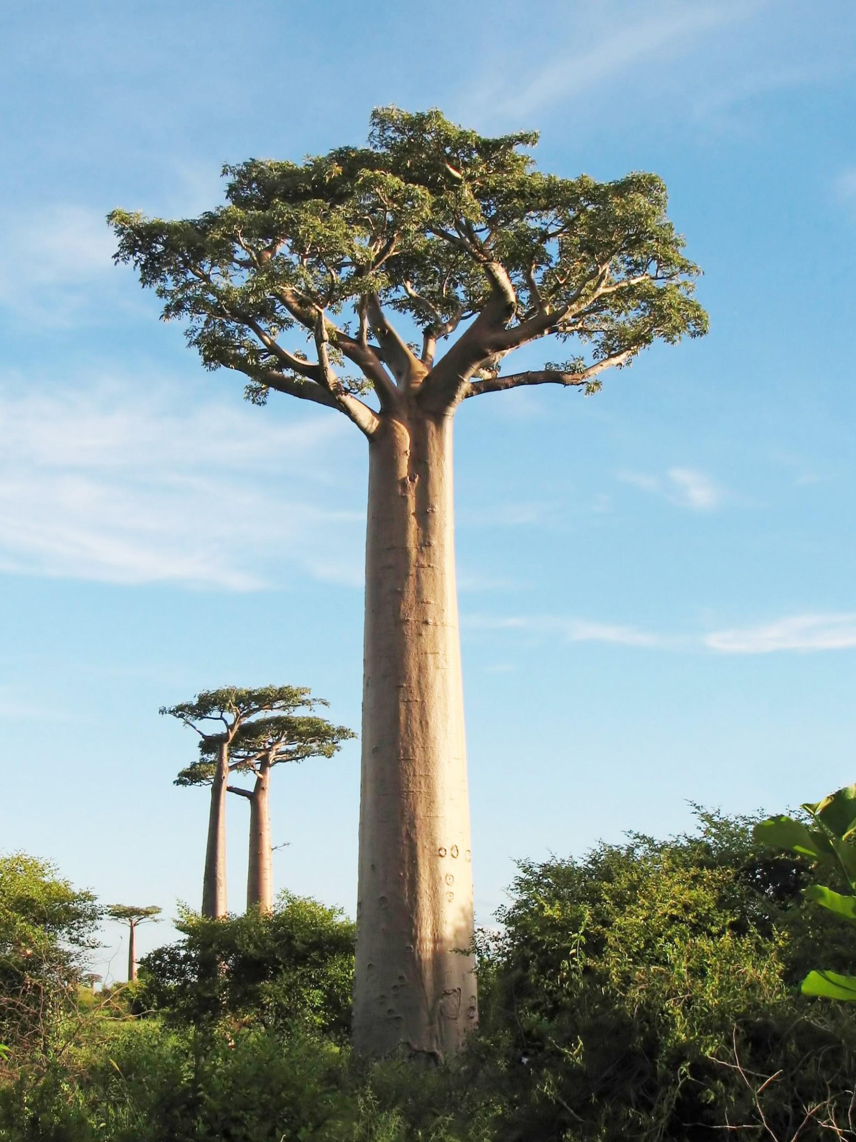

Slide 5
Baobab tree

Slide 6
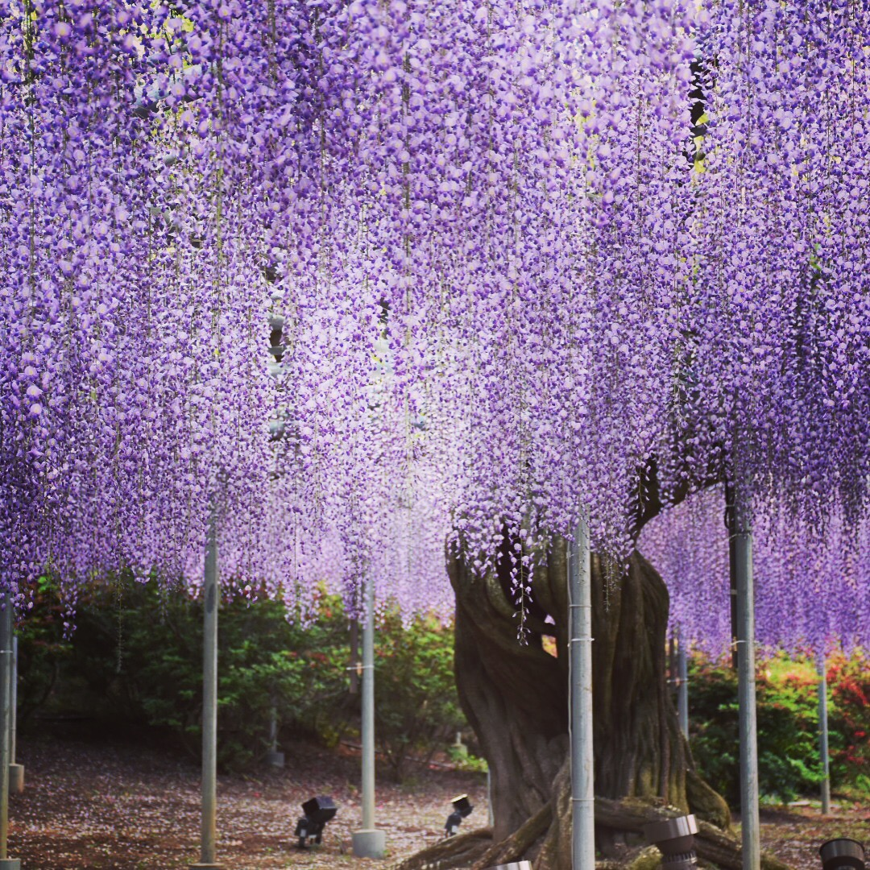

Slide 7
wisteria in Japan
1500 years old

Slide 8
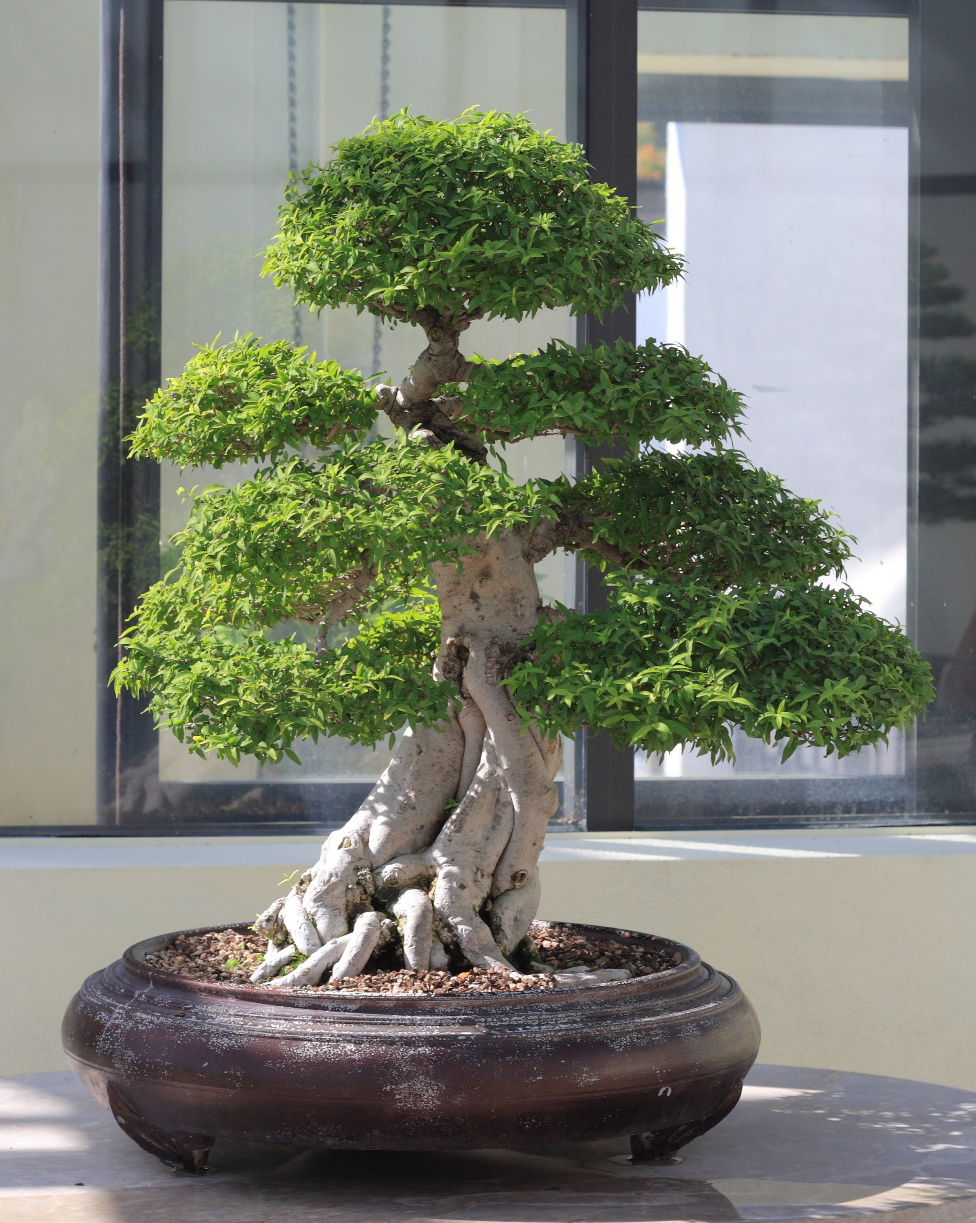
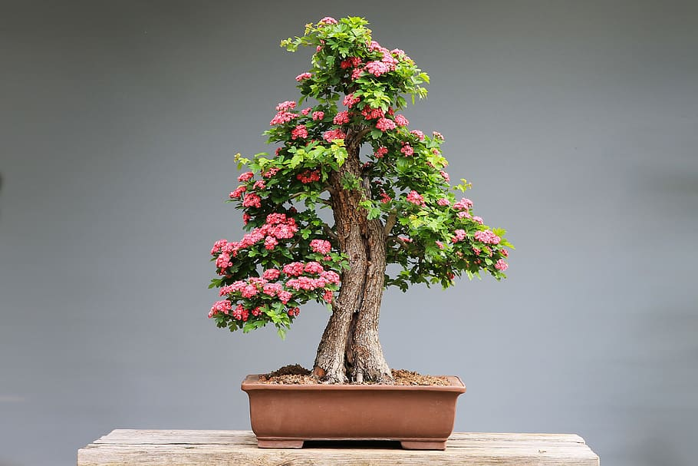
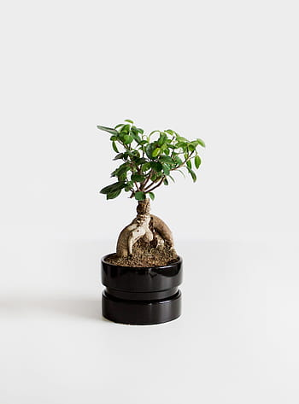
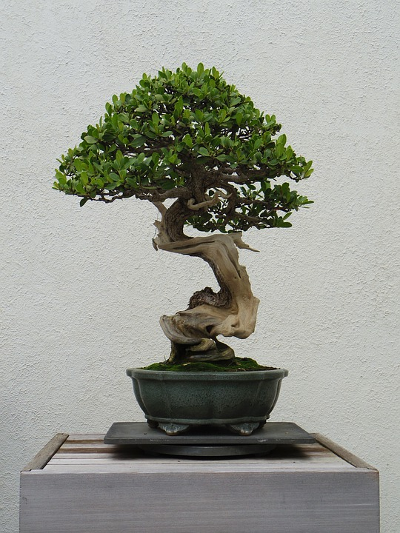

Slide 9
bonsai
art from Japan

Slide 10
DIY by HONZA

Slide 11
DIY by DAN

Slide 12
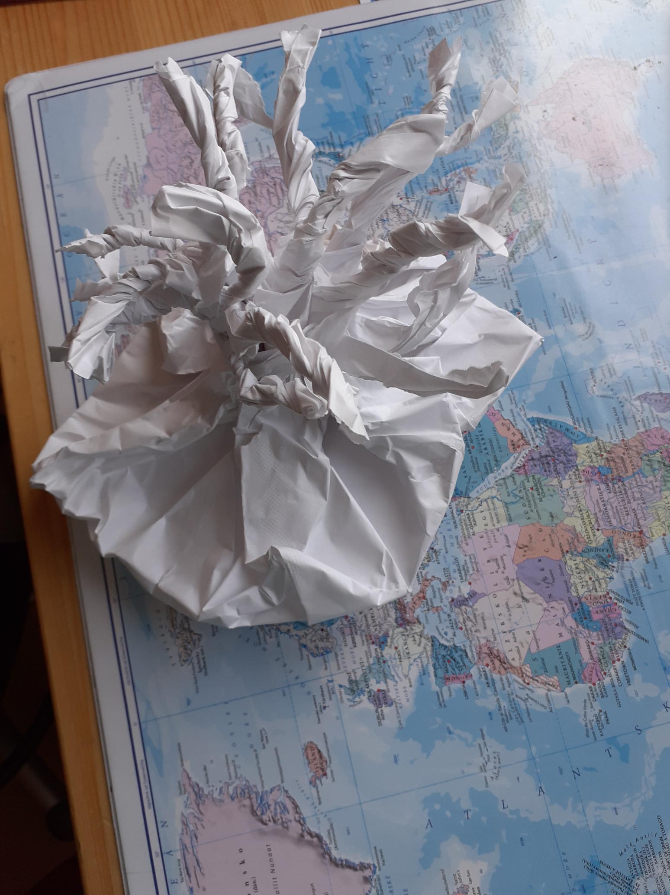
… and another view

Slide 13
listening and writing activity by TOM
A trip to the rainforest
1) The children feel excited about their trip.
2) Rainforests are very important.
3) There are a lot of animals and plants there.
4) It rains for two hundred days every year.
5) It’s dark because there are a lot of very tall trees .
6) We can also get fruit from the rainforests, like avocados.
7) Maria is scared of the monkey because they are very noisy and loud.
8) The people of the forest are called Yanomami. They don’t go shopping.
9) The Yanomami can help Pablo.
10) People use the plants to make medicine for the sick people.

Slide 14
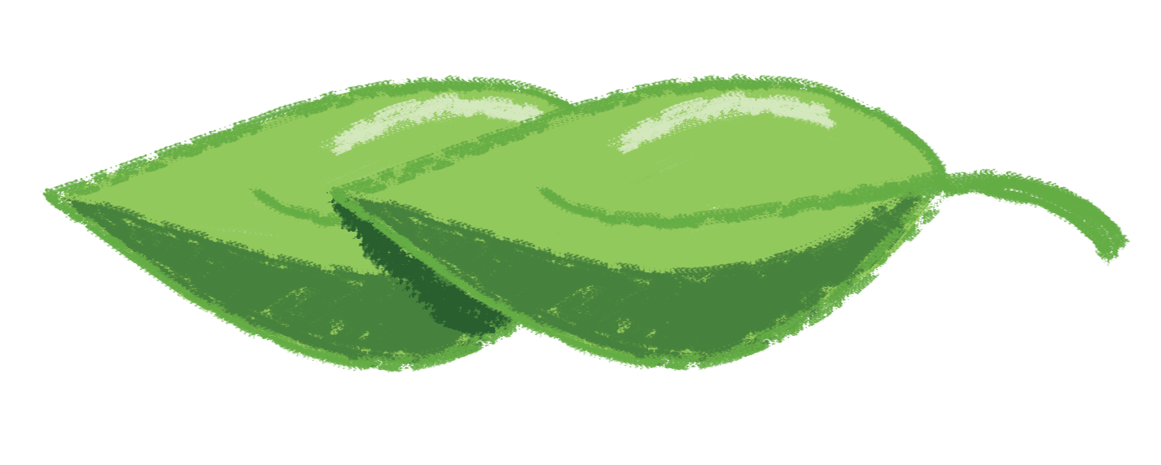
thank you

