Slide 1
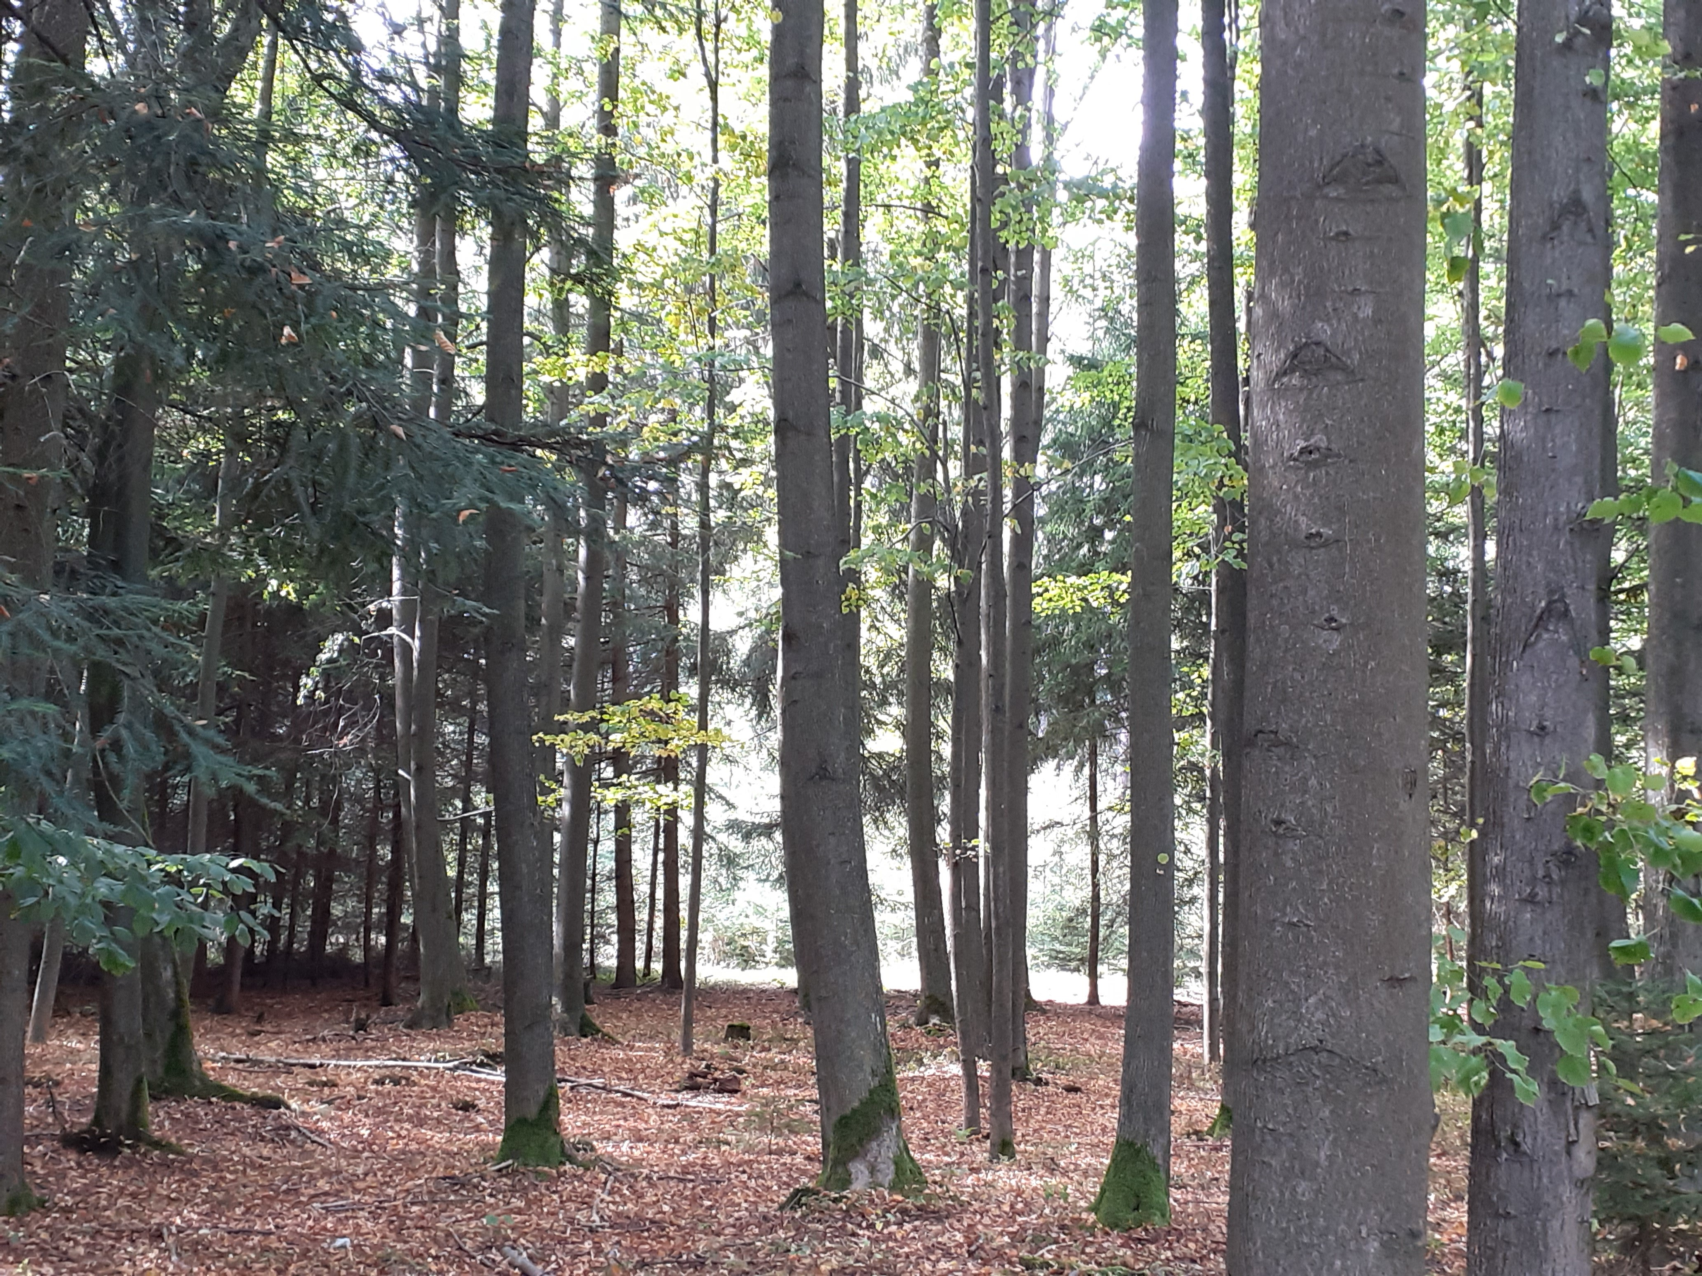
WHAT ARE FOREST ANIMALS DOING

Slide 2
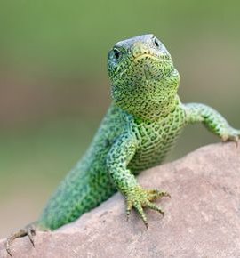
The lizard is basking.

Slide 3
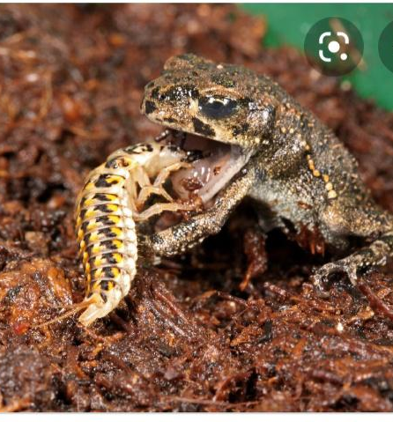
The frog is eating another animal.

Slide 4
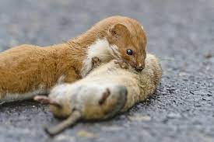
The weasel is eating a mouse.

Slide 5
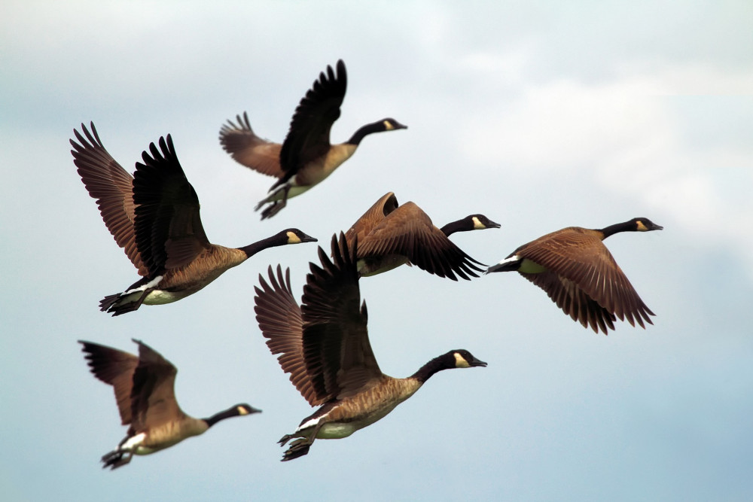
Wild geese are flying only in a group.

Slide 6
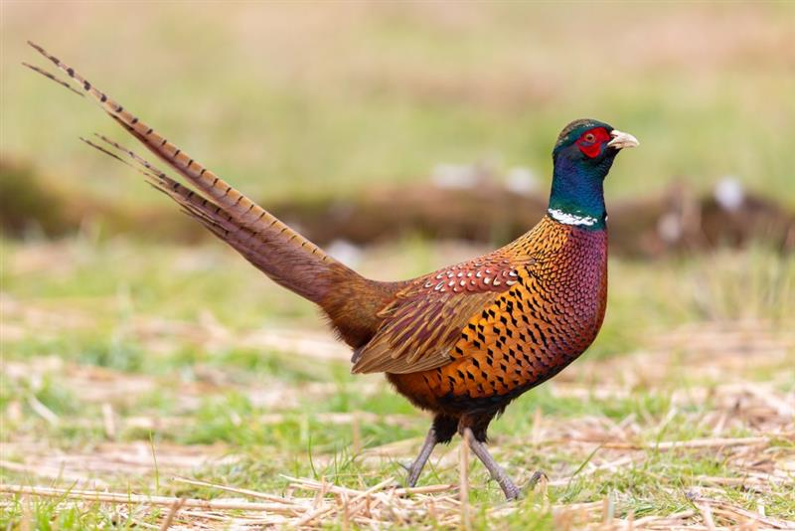
The pheasant is fighting for his love.

Slide 7
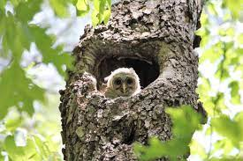
An owl is camping in the middle of the tree.

Slide 8
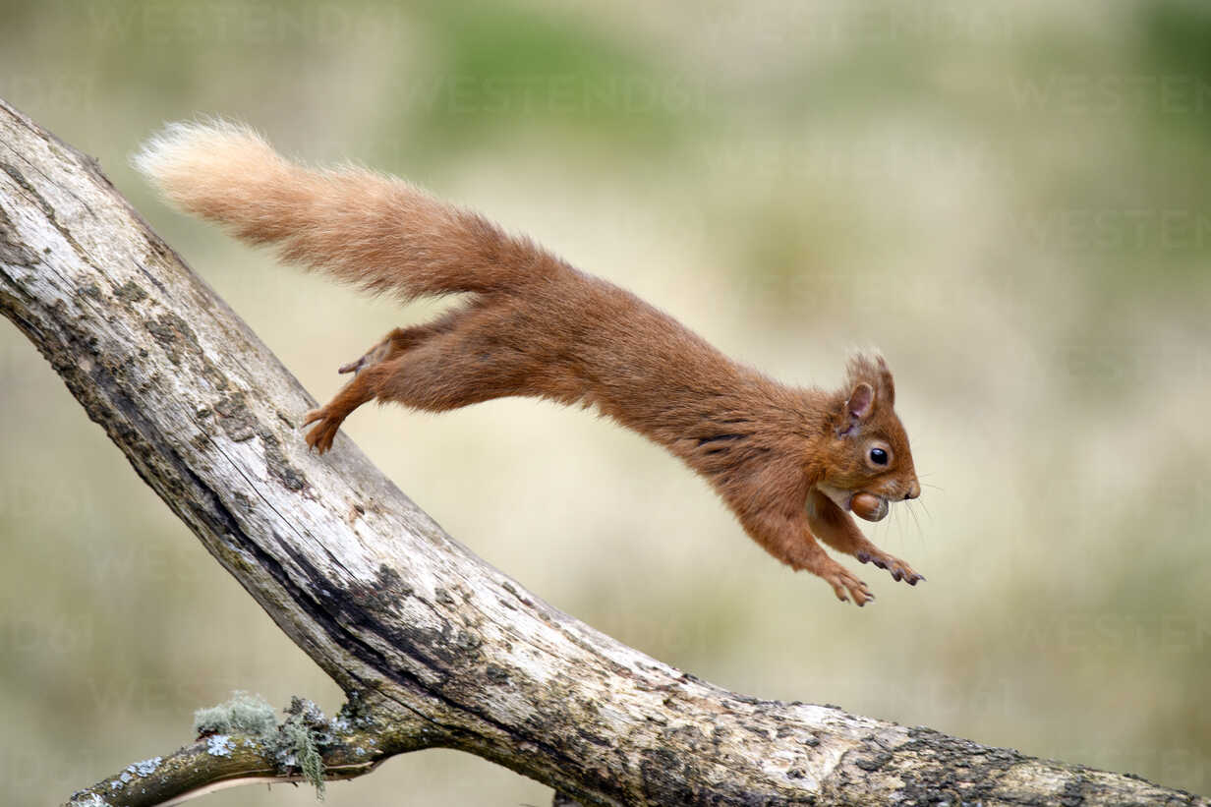
A squirrel is jumping on tree branches.

Slide 9
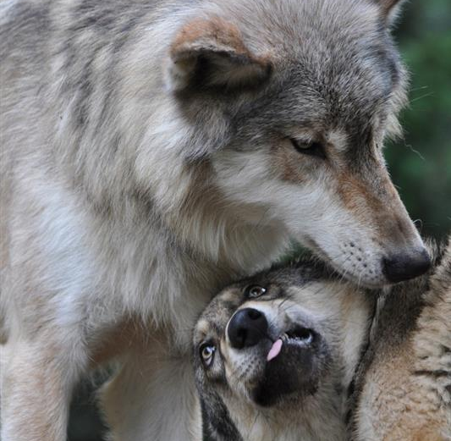
Wolfs are meeting.

Slide 10
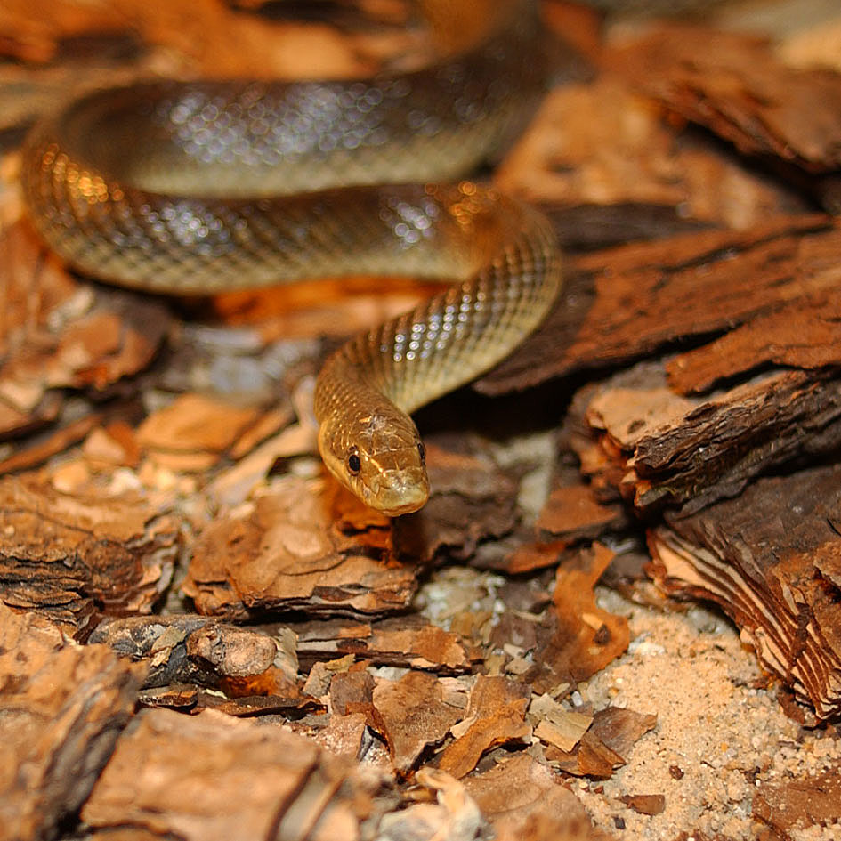
The snake is crawling right now.

Slide 11
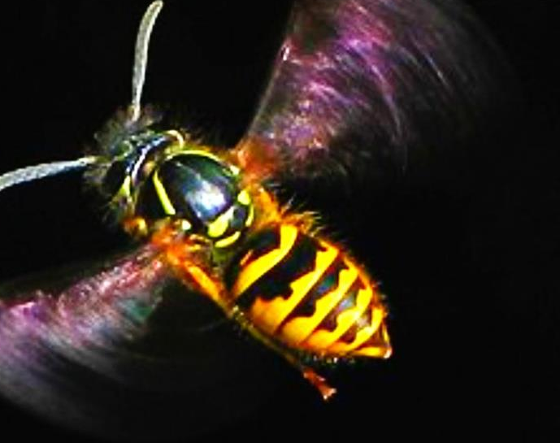
The wasp is stinging.

Slide 12
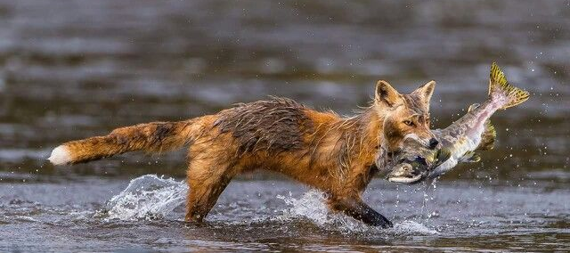
The fox is hunting.

