Slide 1
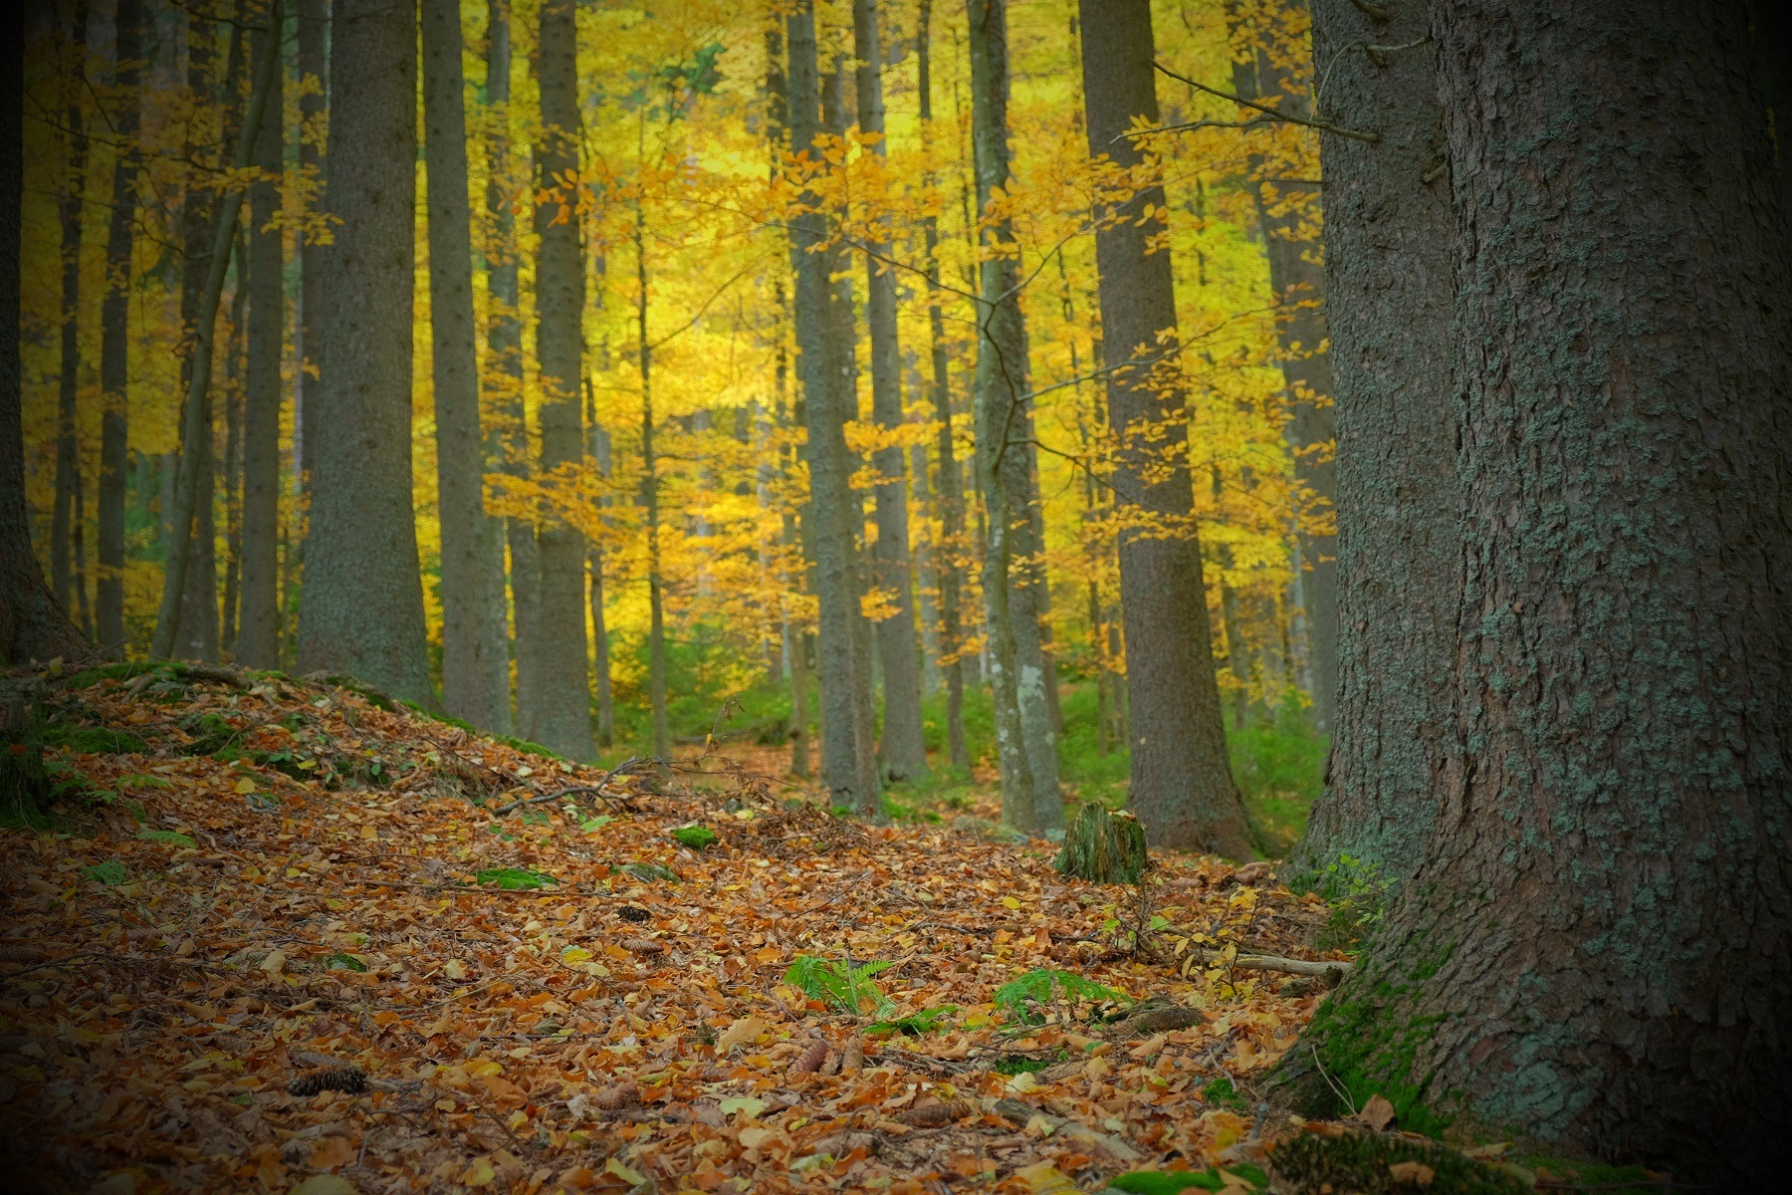
PROJECT FOREST
MAKI
ALEX
MARI
FÍĎA
KLÁRKA
KIKI
KUBA
DÁDA

Slide 2
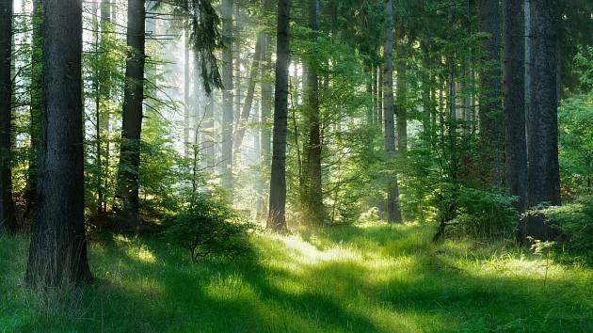
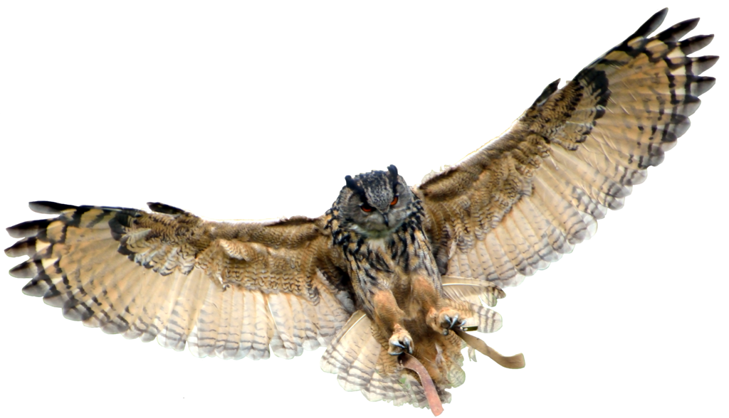
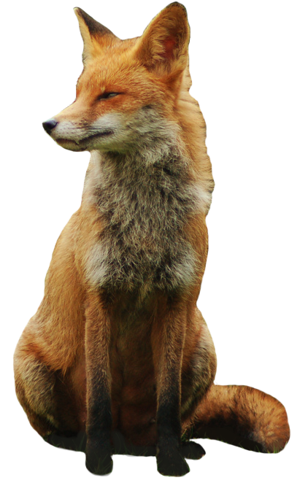
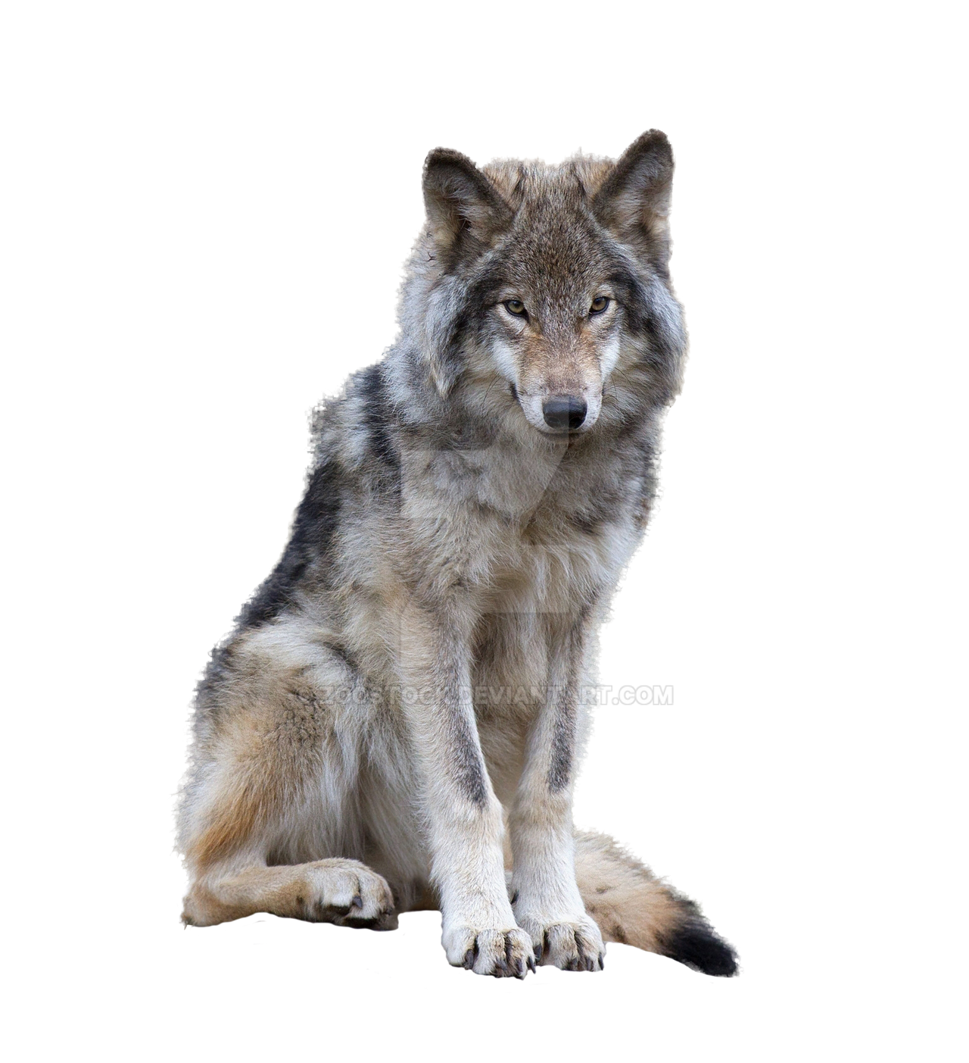
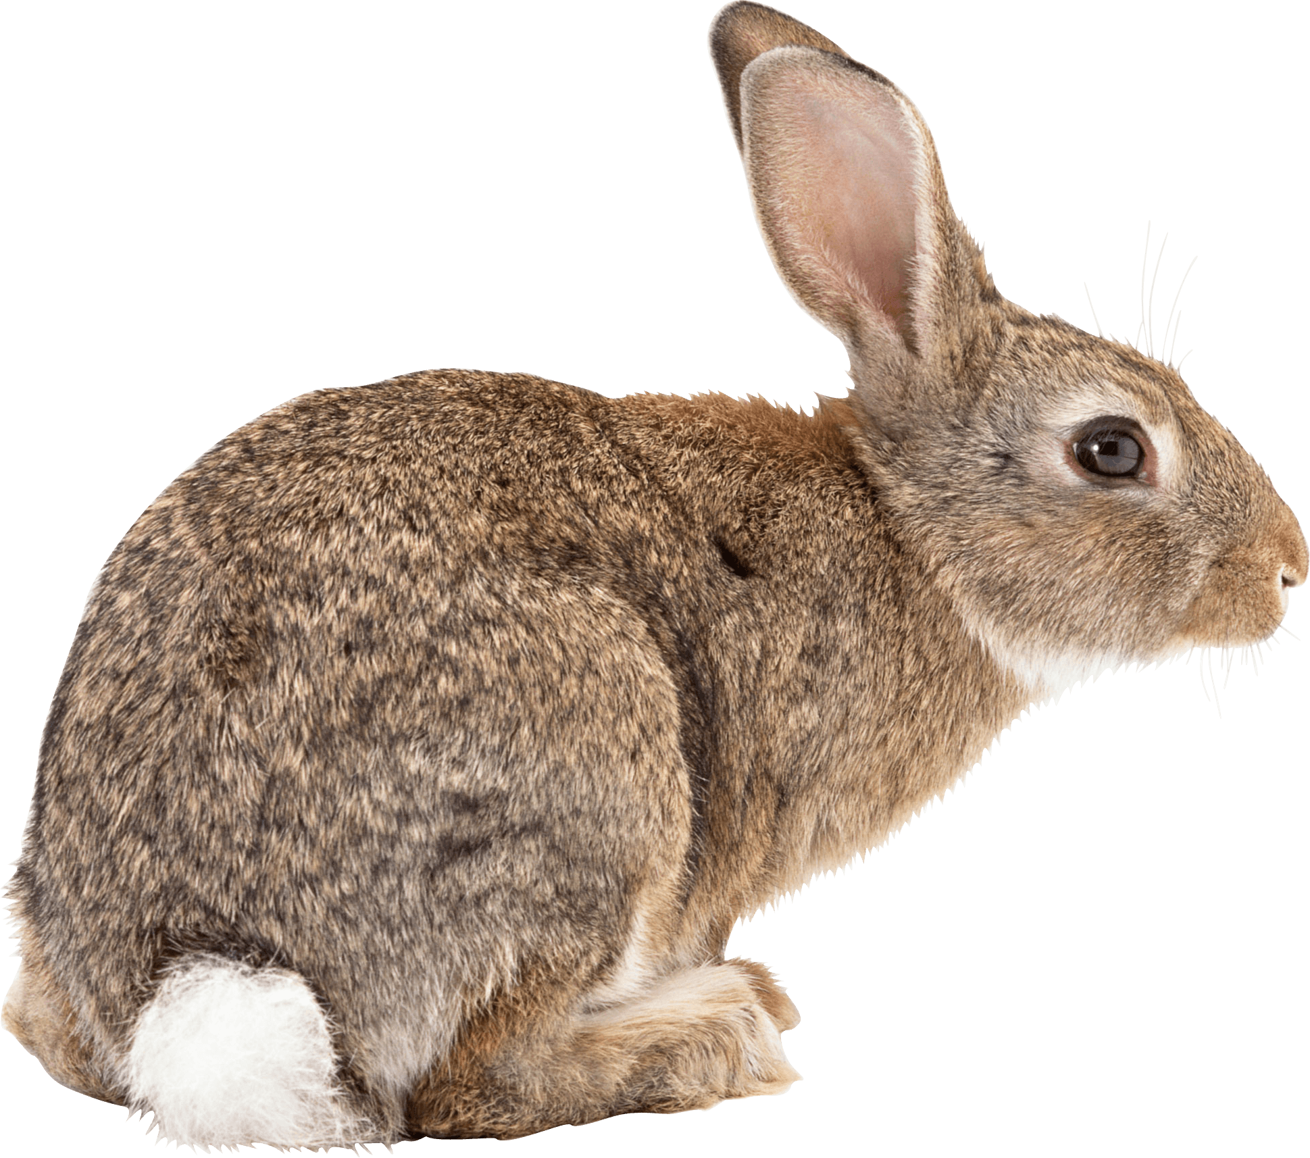
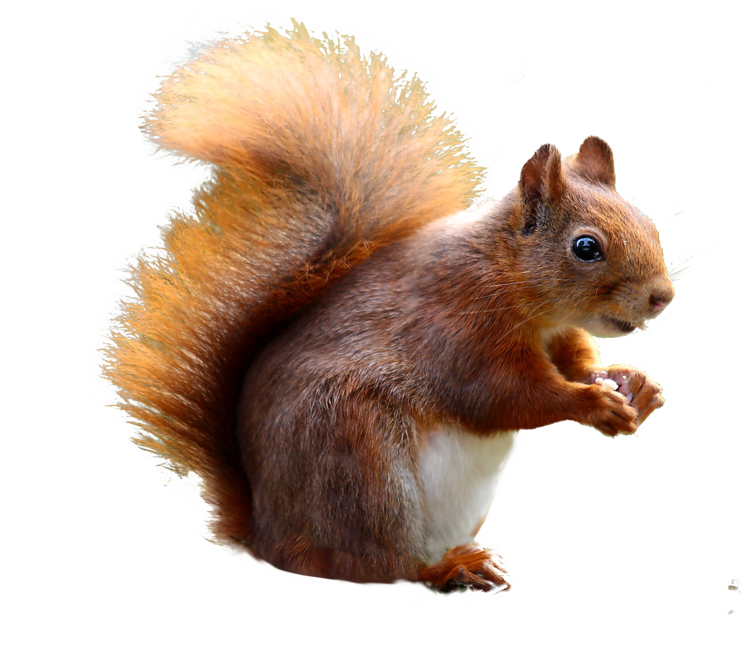
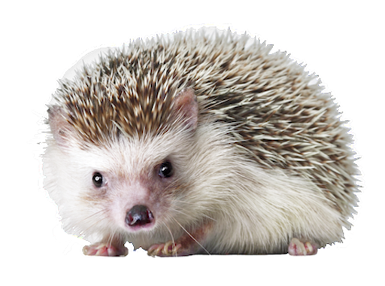

Slide 3
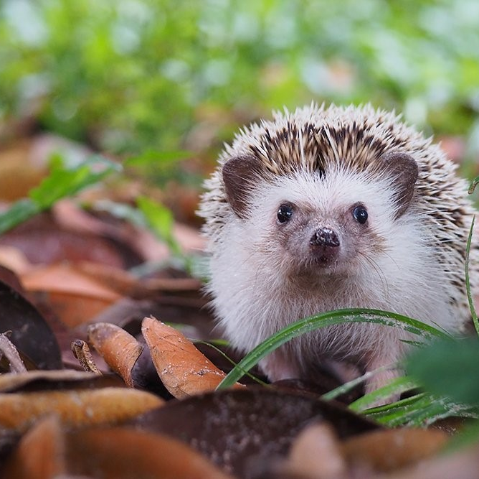
HEDGEHOG - KLÁRKA
My animal is hedgehog.
It is brown.
It is small.
It has got spines.
It lives in the forest.
It can run fast but it can’t swim.
It eats earthworms.
It sleeps in winter.

Slide 4
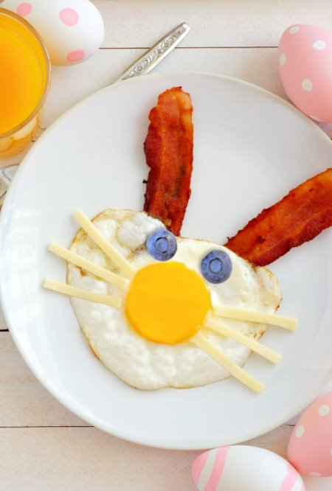
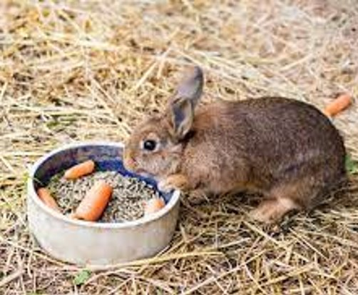
RABBIT - KIKI
It has got two long ears, two eyes, long whiskers.​
It has brown, white, blaKIKI PREZENTACE PREZENTACE gray.
It has got two long ears, two eyes, long whiskers.​
It has got short body, two short and two long legs. ​
It has got short tail and short neck.​
It is furry. It is brown, white, black, gray.

Slide 5
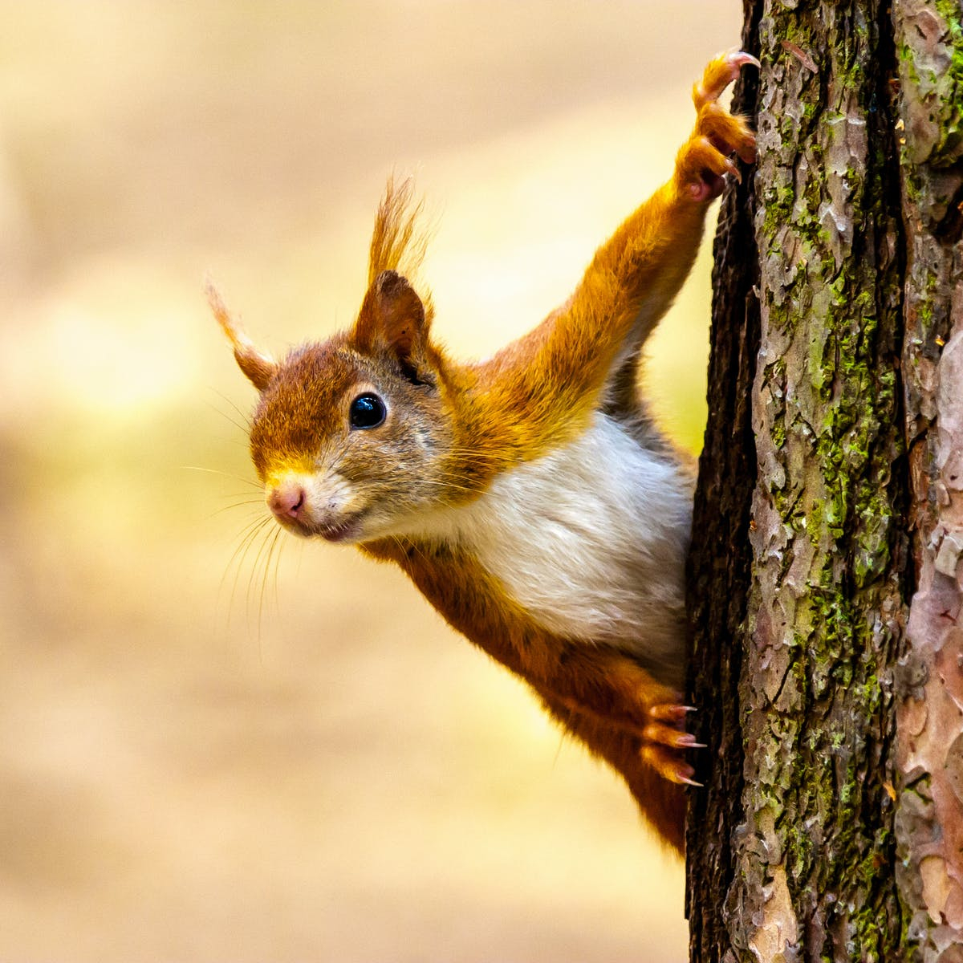
SQUIRREL - MARIČKA

Slide 6
WOLF – KUBA, FÍĎA
My animal is wolf.
The wolf eats meat for example: deer and pig.
Measures around 70cm.
It is grey and compassion black.
The wolf has 4 legs and 1 tail 1 head 2 eyes and 2 ears and 1 nose.
The wolf can run very well and thus gains its prey.
The wolf can't climb in the middle he can't fly.
It lives in the forest.
IT DOESN´T SLEEP IN WINTER.

Slide 7
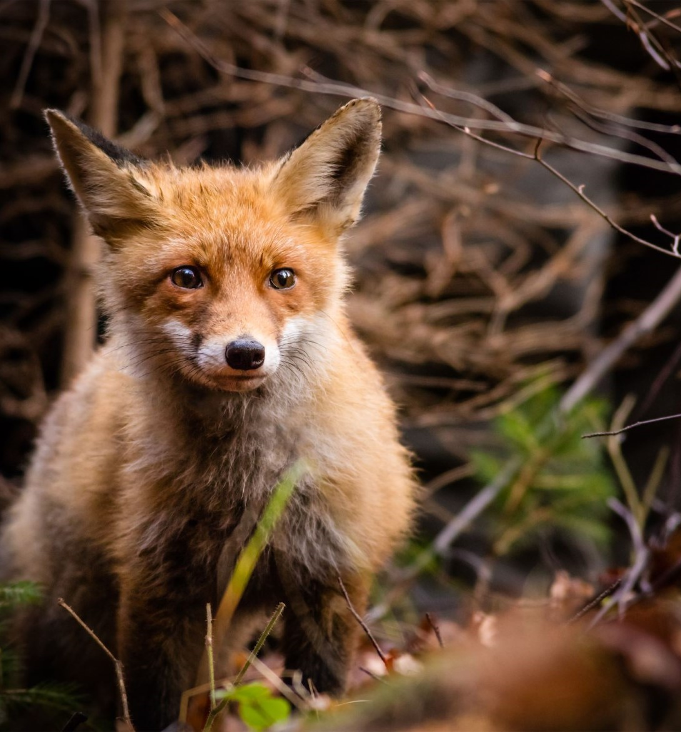
FOX Maki
A fox is an animal, and it lives in forest. It looks like a dog.
It has red hair and a long tail. It is a quite small. It eats mice and birds. A polar fox also exists. It is all white and it lives in the north.

Slide 8
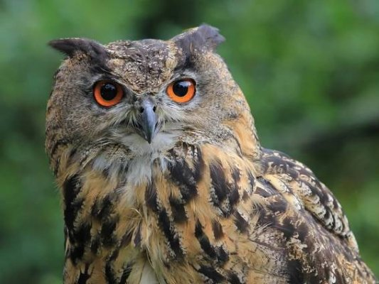
OWL Alex, Dáda
My animal is owl.
It’s brown.
It’s big.
It has got claws.
It eats mice.
It lives in forest.
It has got wings.
It sleeps at night.

Slide 9
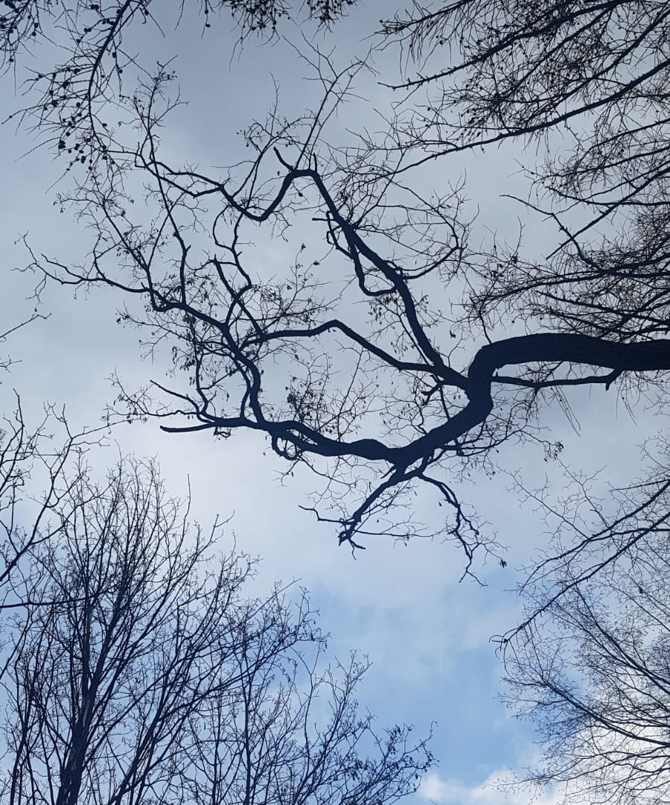
WINDOWS TO FOREST

