Slide 1
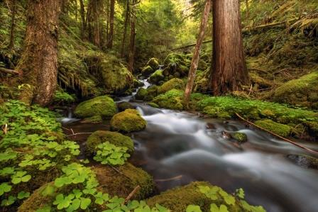
FOREST AND WATER
VIKI AMÁLKA AMI
PETR KIKIN ÁŇA

Slide 2
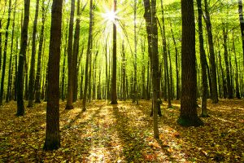
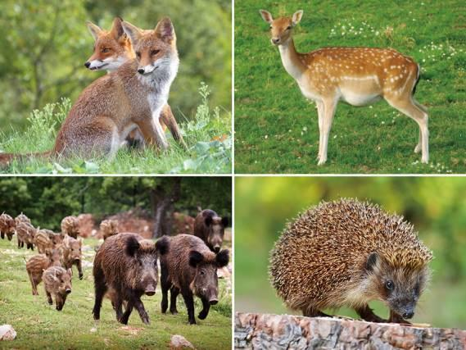
FOREST VIKI, AMI
ANIMALS IN CZECH FORESTS
BEAR WOODPECKEN DEER
FOX FAWN WILD BOAR
OWL MOUSE HEDYCHOG
HARE LYNX

Slide 3
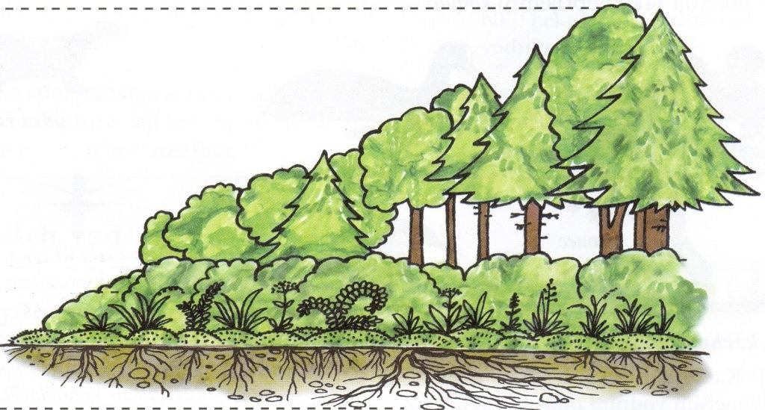
FOREST FLOORS
TREE FLOOR
SHRUB FLOOR
HERBAL FLOOR
MOSSY FLOOR
ROOT FLOOR

Slide 4
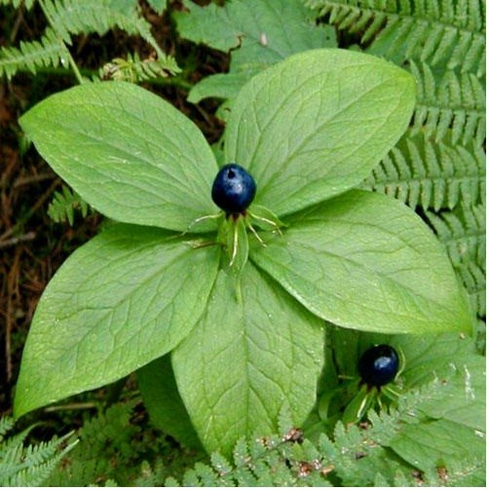
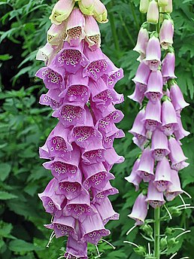
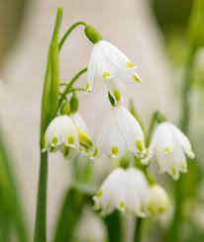
FOREST PLANTS
In the forest grow many plants, for example: Spring snowflake and Crocus. Some plants are edible, but many plants are toxic! For example: Crow’s eye fourleafed or red yew. The edible plants are cranberry Blueberry or cranberry Cranberry.

Slide 5
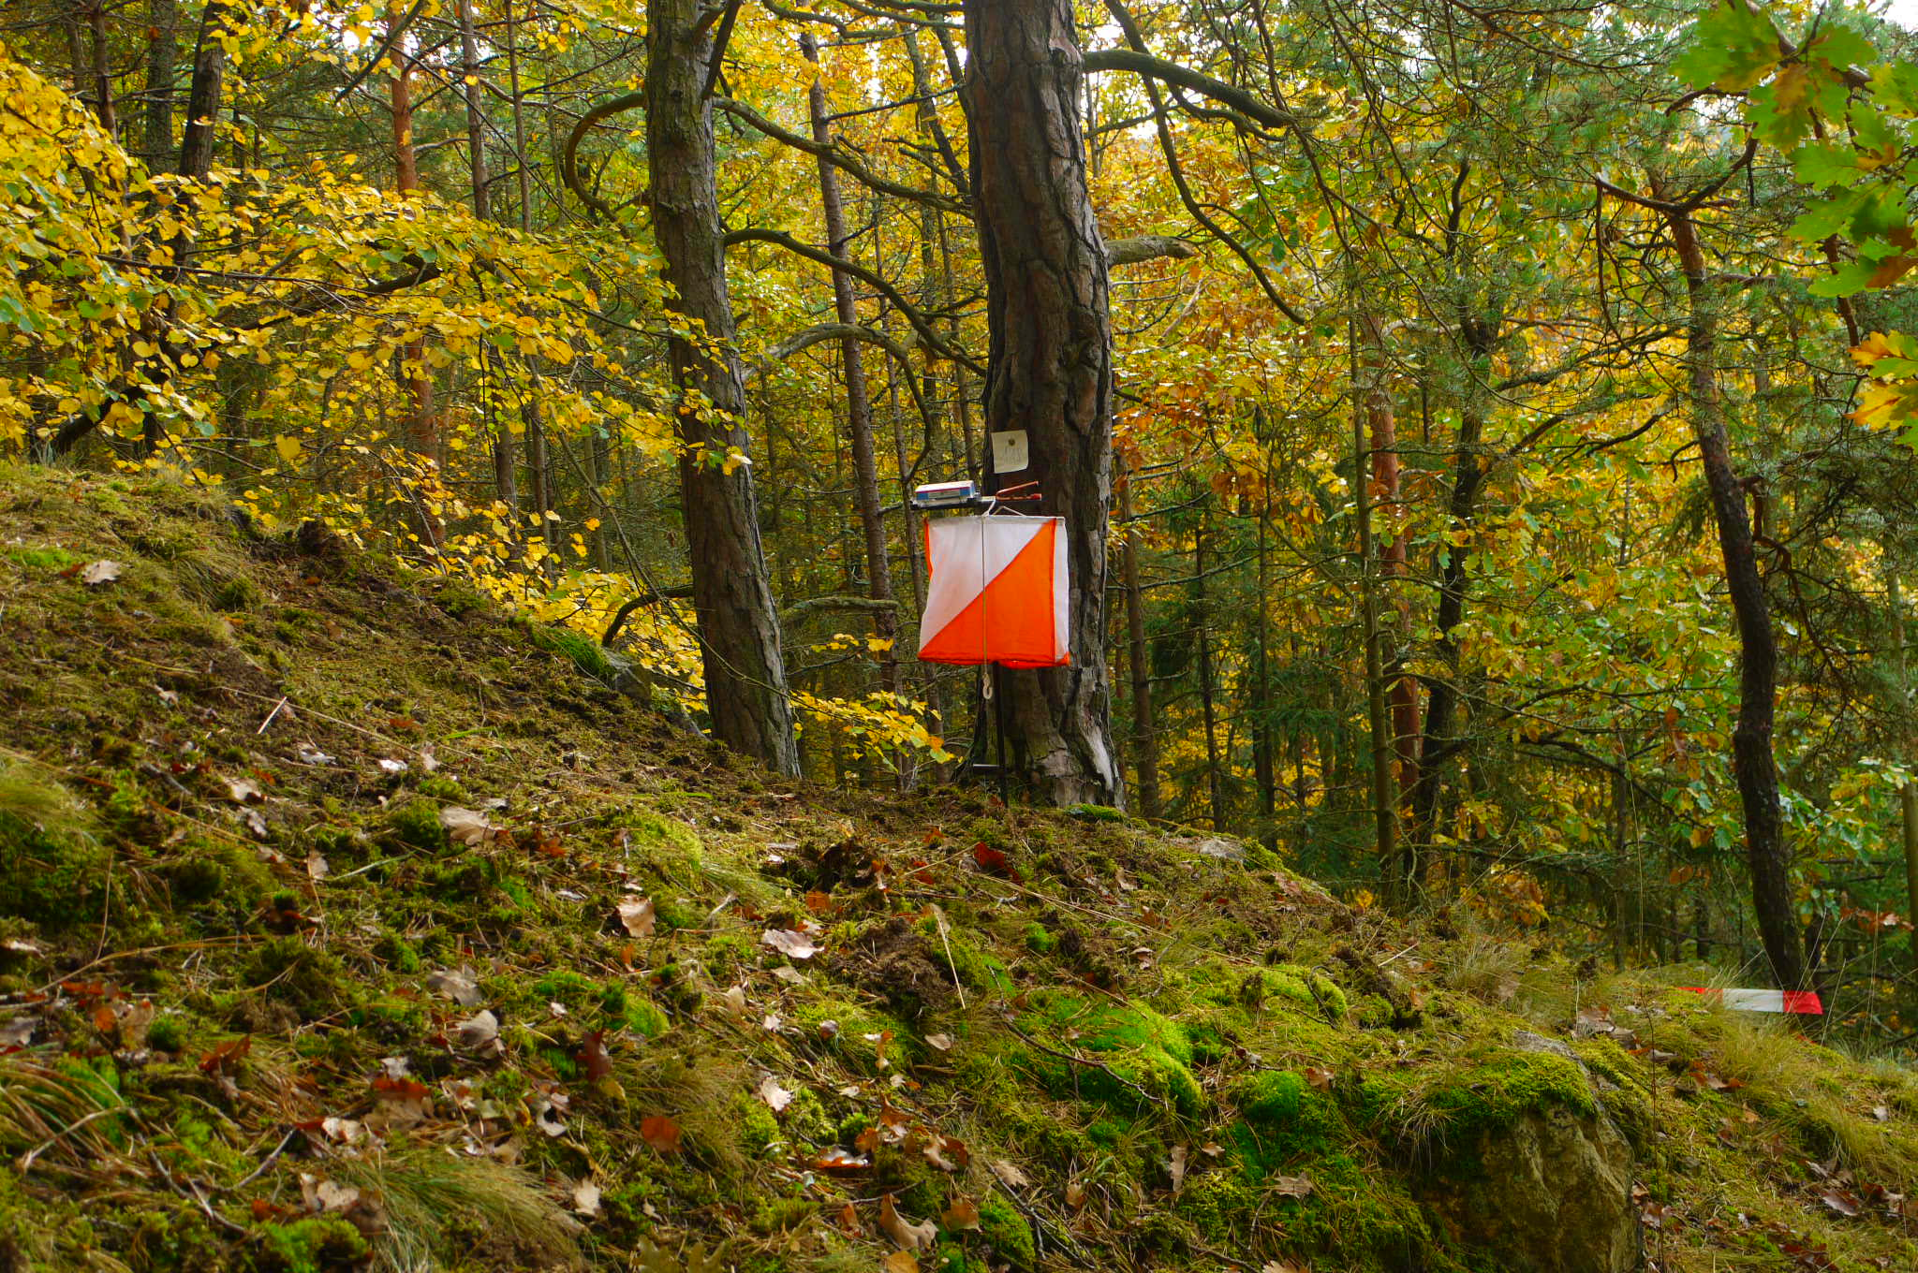
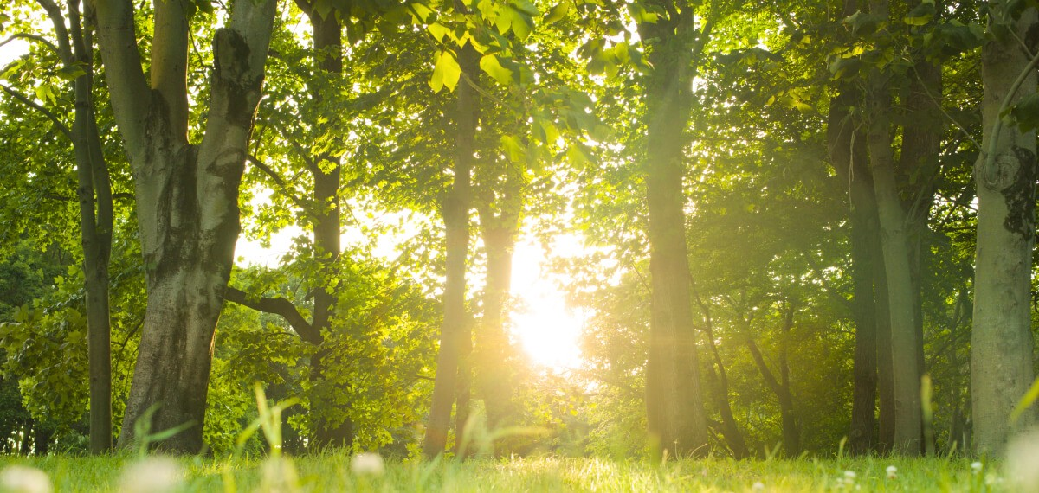
ORIENTEERING
Orienteering is forest activity. People walk at the habitat.
At the habitat people give stamp on paper.
BEAUTIFUL PLACE OF WALK
Forest is a beautiful place of the walk. In the forest is clean air. Trees give air for the whole world.
Forests and water are very important.

Slide 6
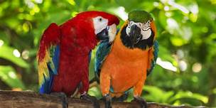
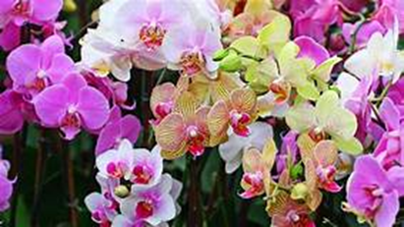
FOREST - AMÁLKA, ÁŇA
There are three kinds of forest: coniferous, leafy or mixed. Trees are very important because create oxygen which people breathe since the forests are cut there is less oxygen on the planet but more wood and highways. In the forest live animals and growth plant. Animals in the forest are: bears, wolfs, deers, insect, hare. Plant in the forest are: strawberies, raspberies, blueberies, snowdrops, daisy, mashrooms.
Animals in the rain forests: parrots,monkeys, snakes, cheetach, jaguar, crocodiles, Plant in the rain forests: vines, orchids

Slide 7
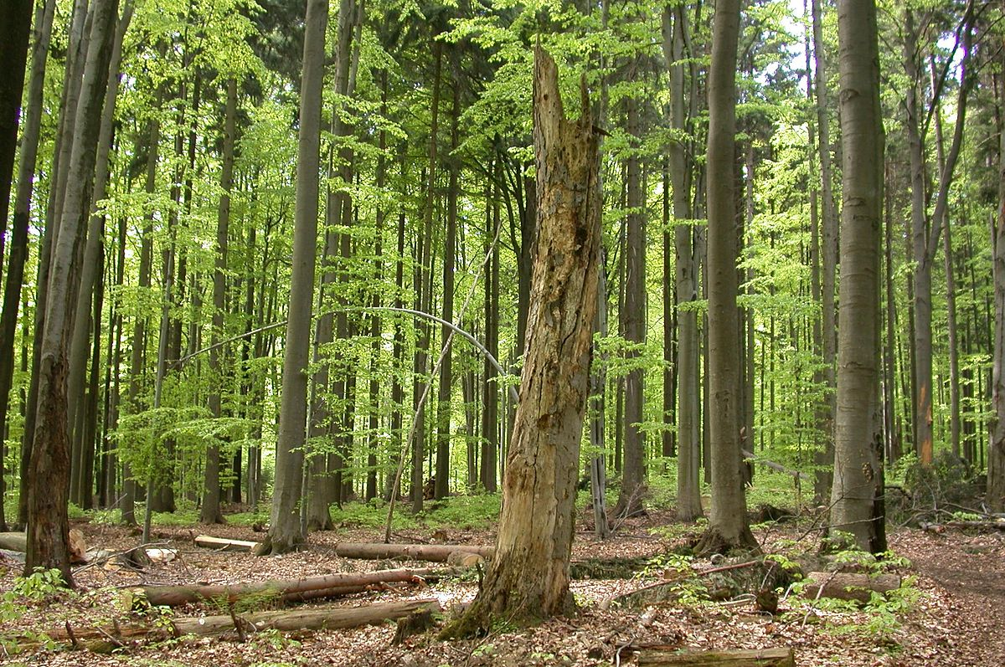
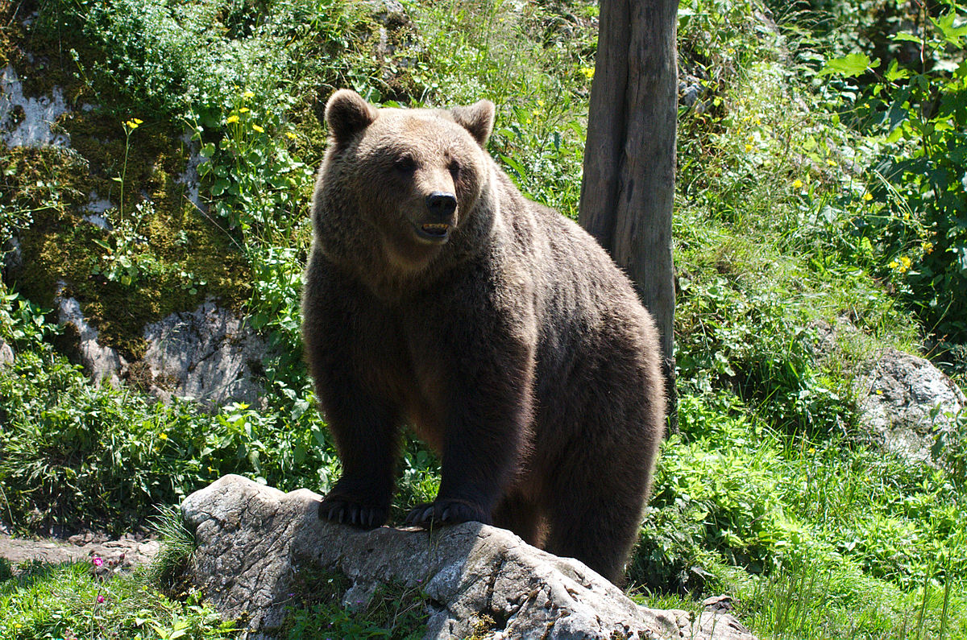

Slide 8
KIKIN, PÉŤA

Slide 9
