Slide 1
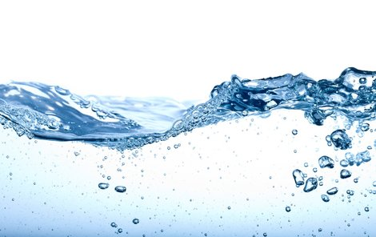
PROJECT WATER – 3.B
TONDA
MAJDA
MÍŠA
ESTERKA
FANYNKA
EMMA
MIRI
HEDVI
PÉŤA
SOFI
MARŤA
VIKI
NELLINKA

Slide 2
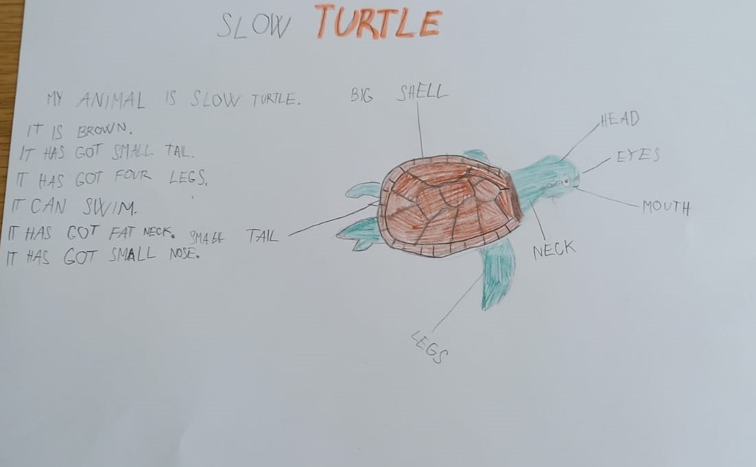
TURTLE-MÍŠA

Slide 3
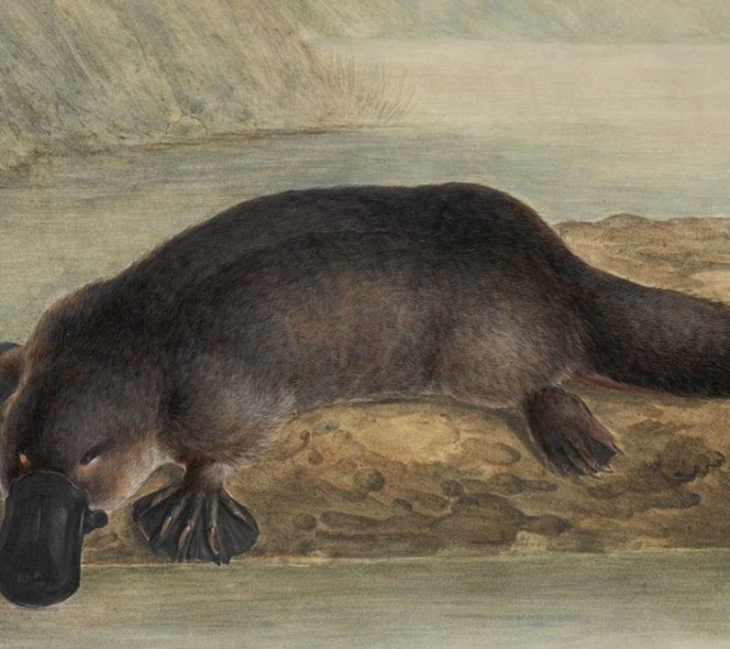
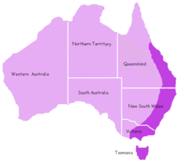
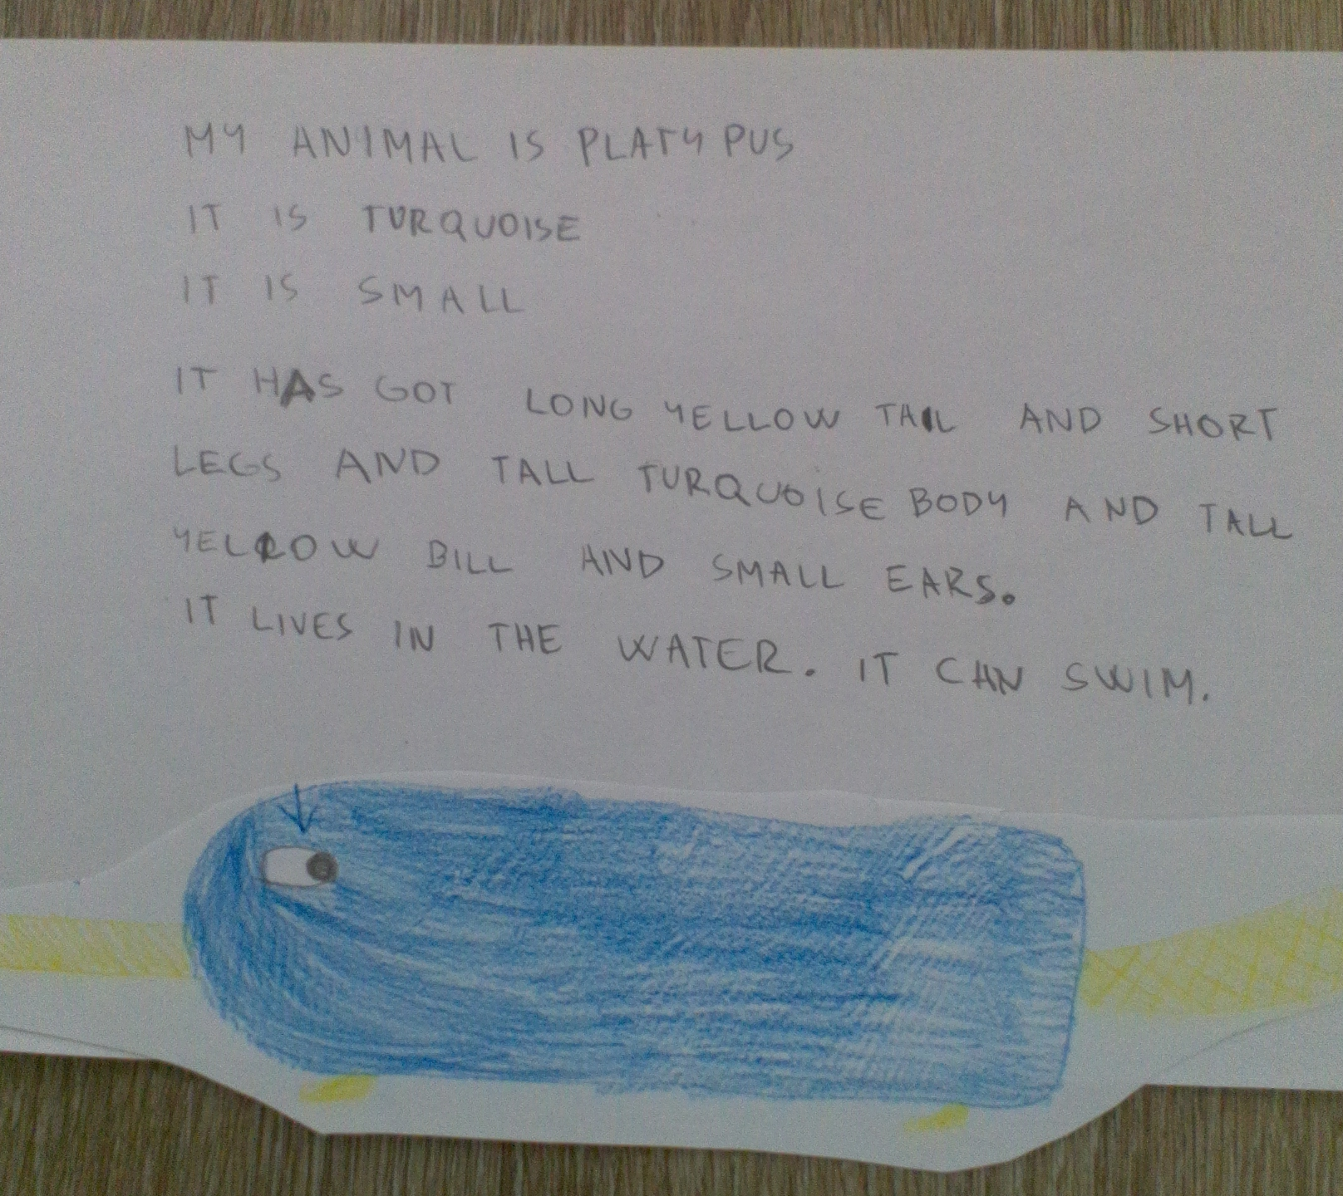
PLATYPUS - FANYNKA

Slide 4
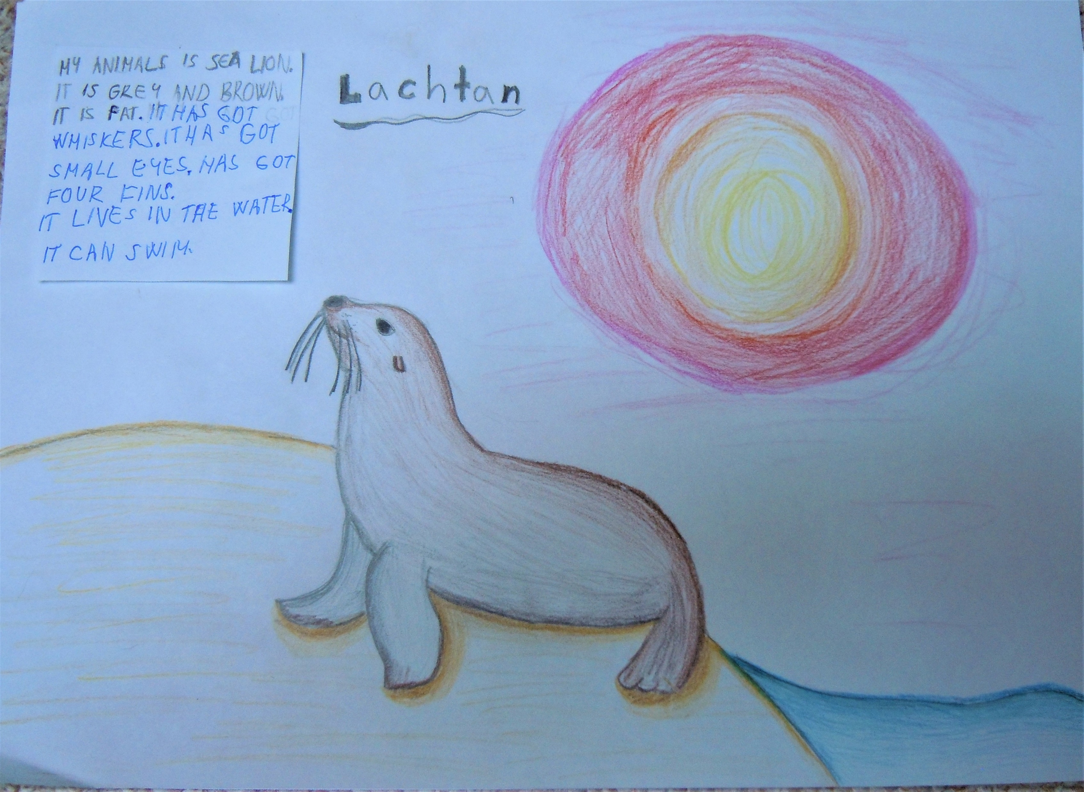
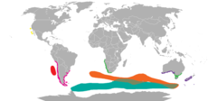
SEA LION - MIRI

Slide 5
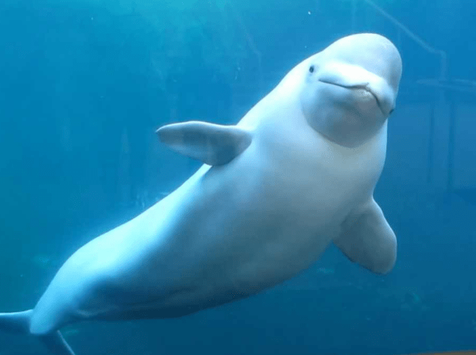
WHALE - MAJDA
IT IS WHITE.
IT IS QUITE BIG MAMMAL.
IT CAN SWIM.
IT HAS GOT ONE BIG HEAD WITH TWO SMALL BLACK EYES, TWO FINS ON THE BODY, TWO FINS ON A TAIL AND SHARP TEN TEETH IN BIG PINK MOUTH.
IT HASN´T GOT SCALES.
IT IS FAST.
ITS WEIGHT IS 1 600 KG.
IT IS A CARNIVORE.
IT LIVES IN WATER NEAR ANTARKTIDA.

Slide 6
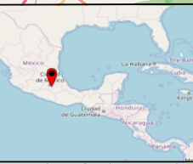
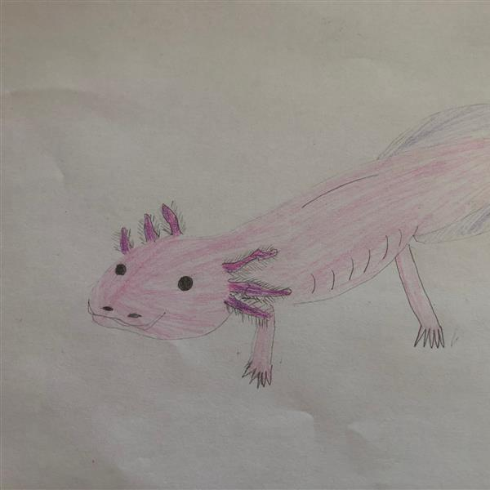
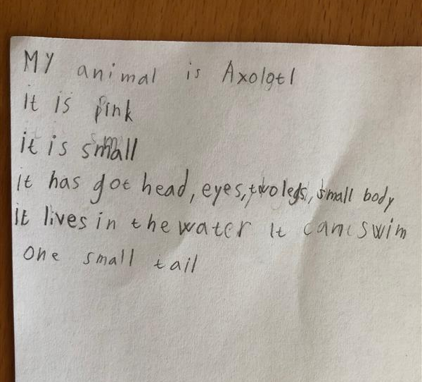
AXOLOTL - SOFI

Slide 7
FROG - ESTERKA

Slide 8
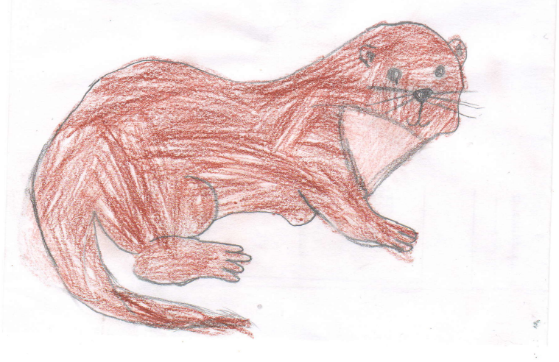
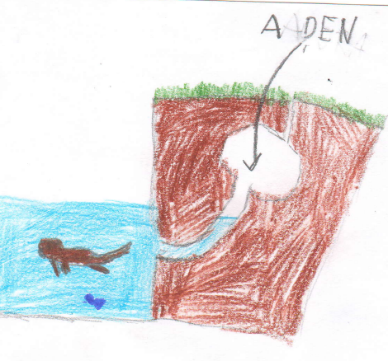
OTTER - TONDA
My animal is an otter.
It is brown.
It has got sharp tooth and it is a carnivore.
I it has got brown fur.
It has got long tail and short and small claws.
It lives in the river.It can swim.

Slide 9
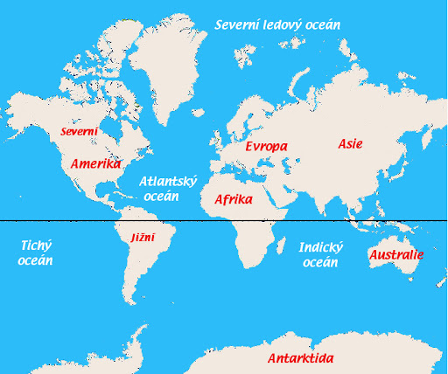
SHRIMP - MARŤA

Slide 10
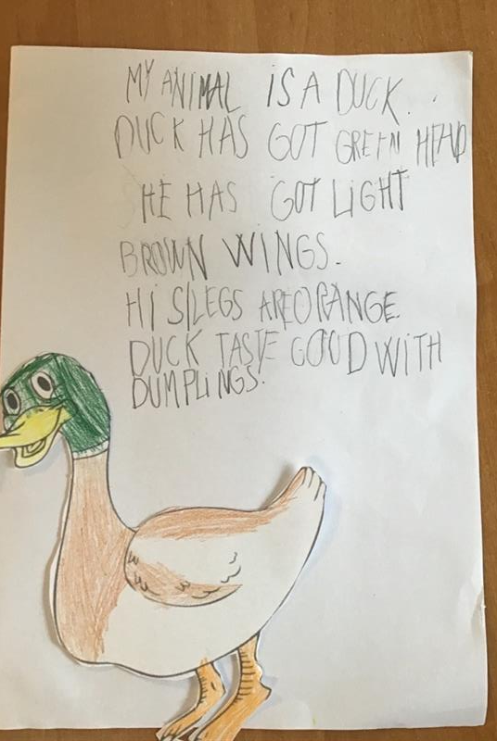
DUCK - VIKI

Slide 11
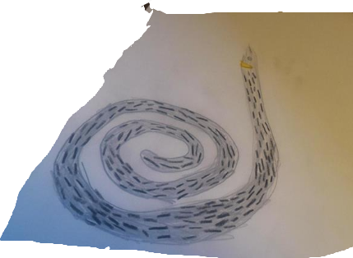
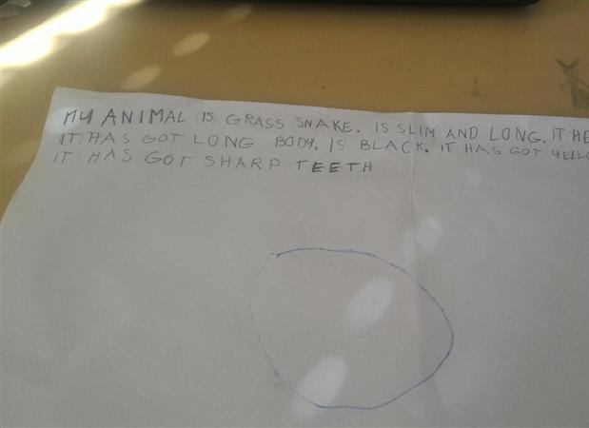
GRASS SNAKE - HEDVI

Slide 12
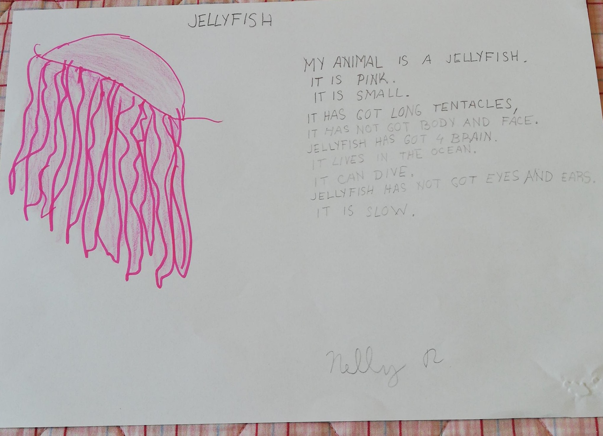
JELLYFISH Nelly

Slide 13
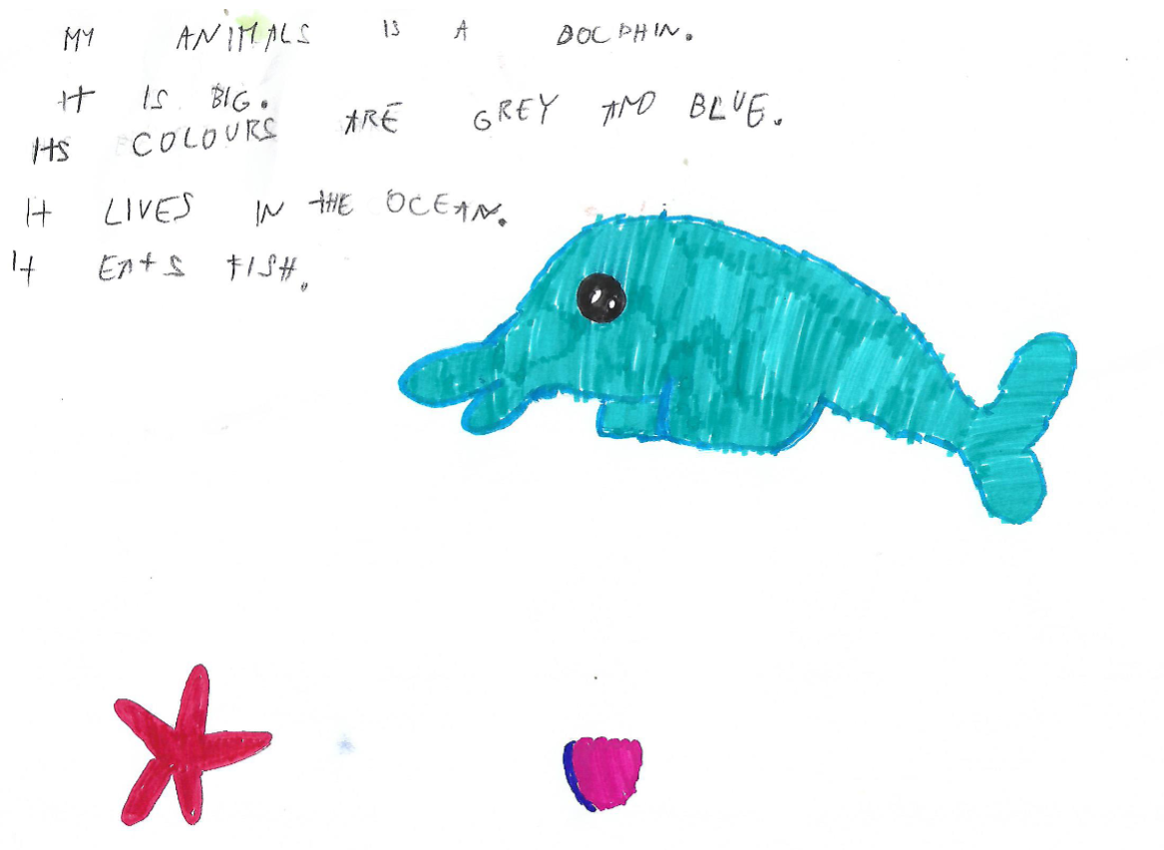
DOLPHIN Emma

Slide 14
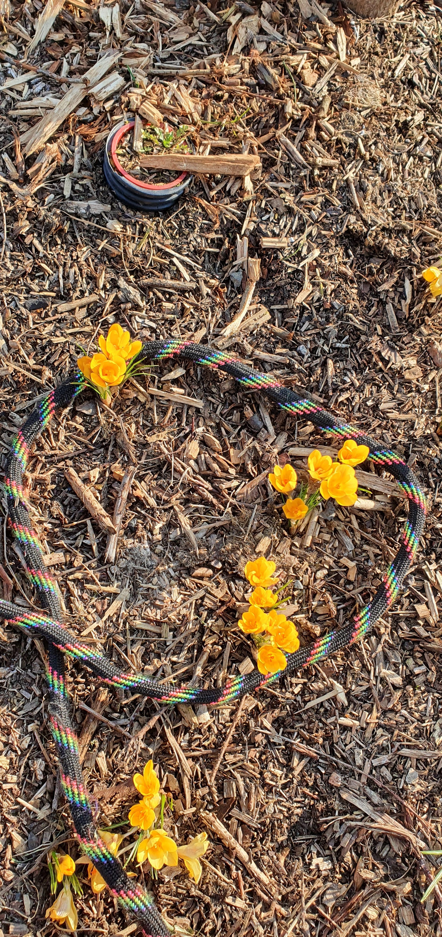
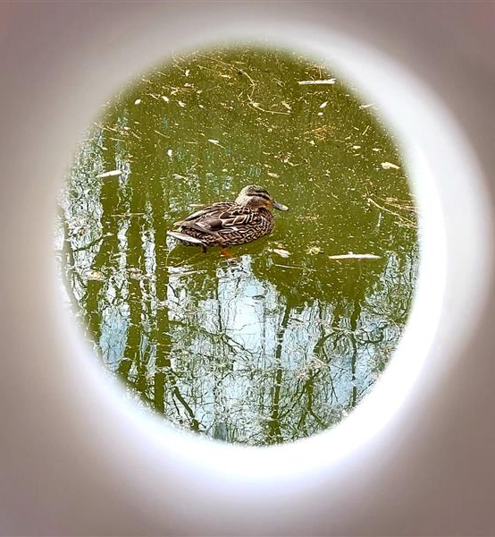
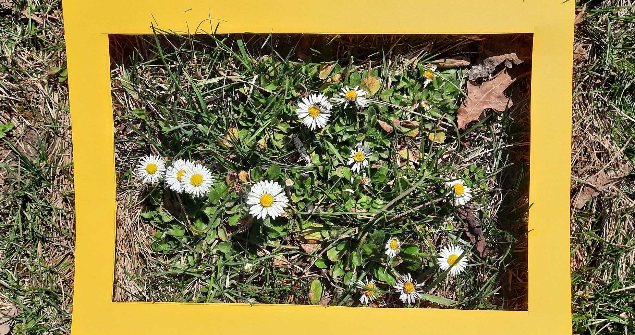
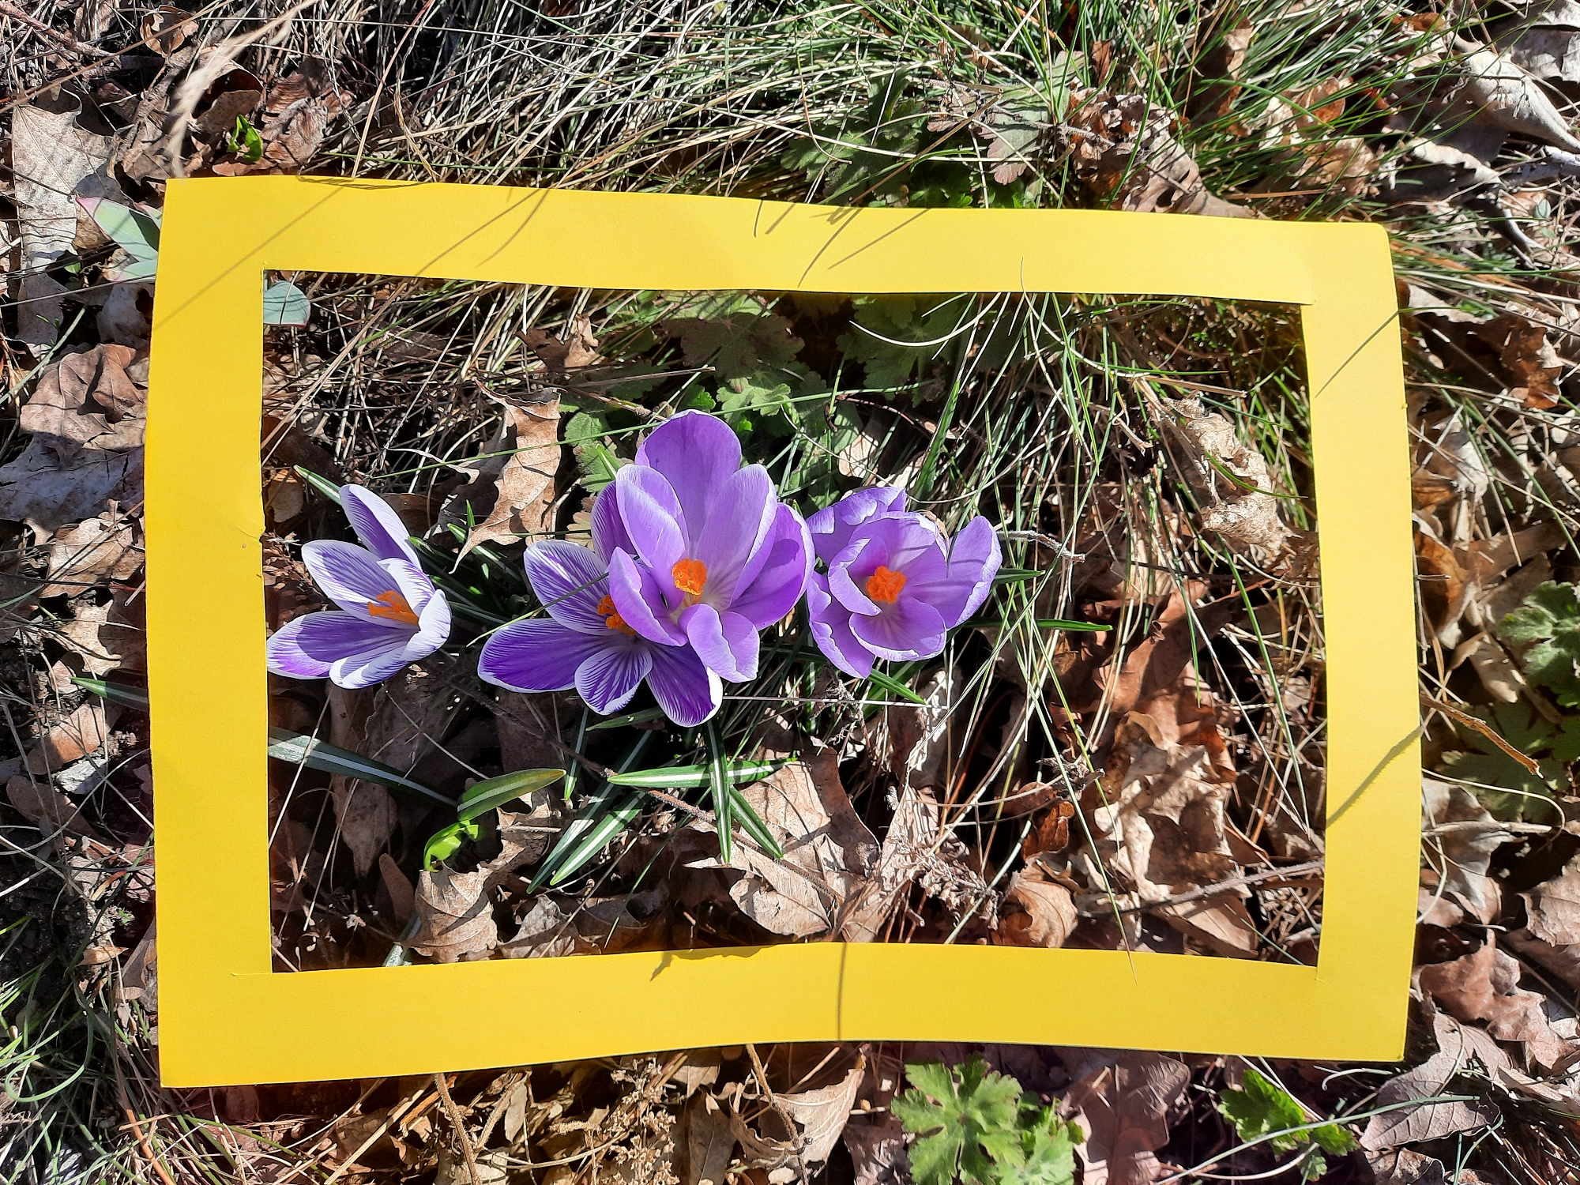
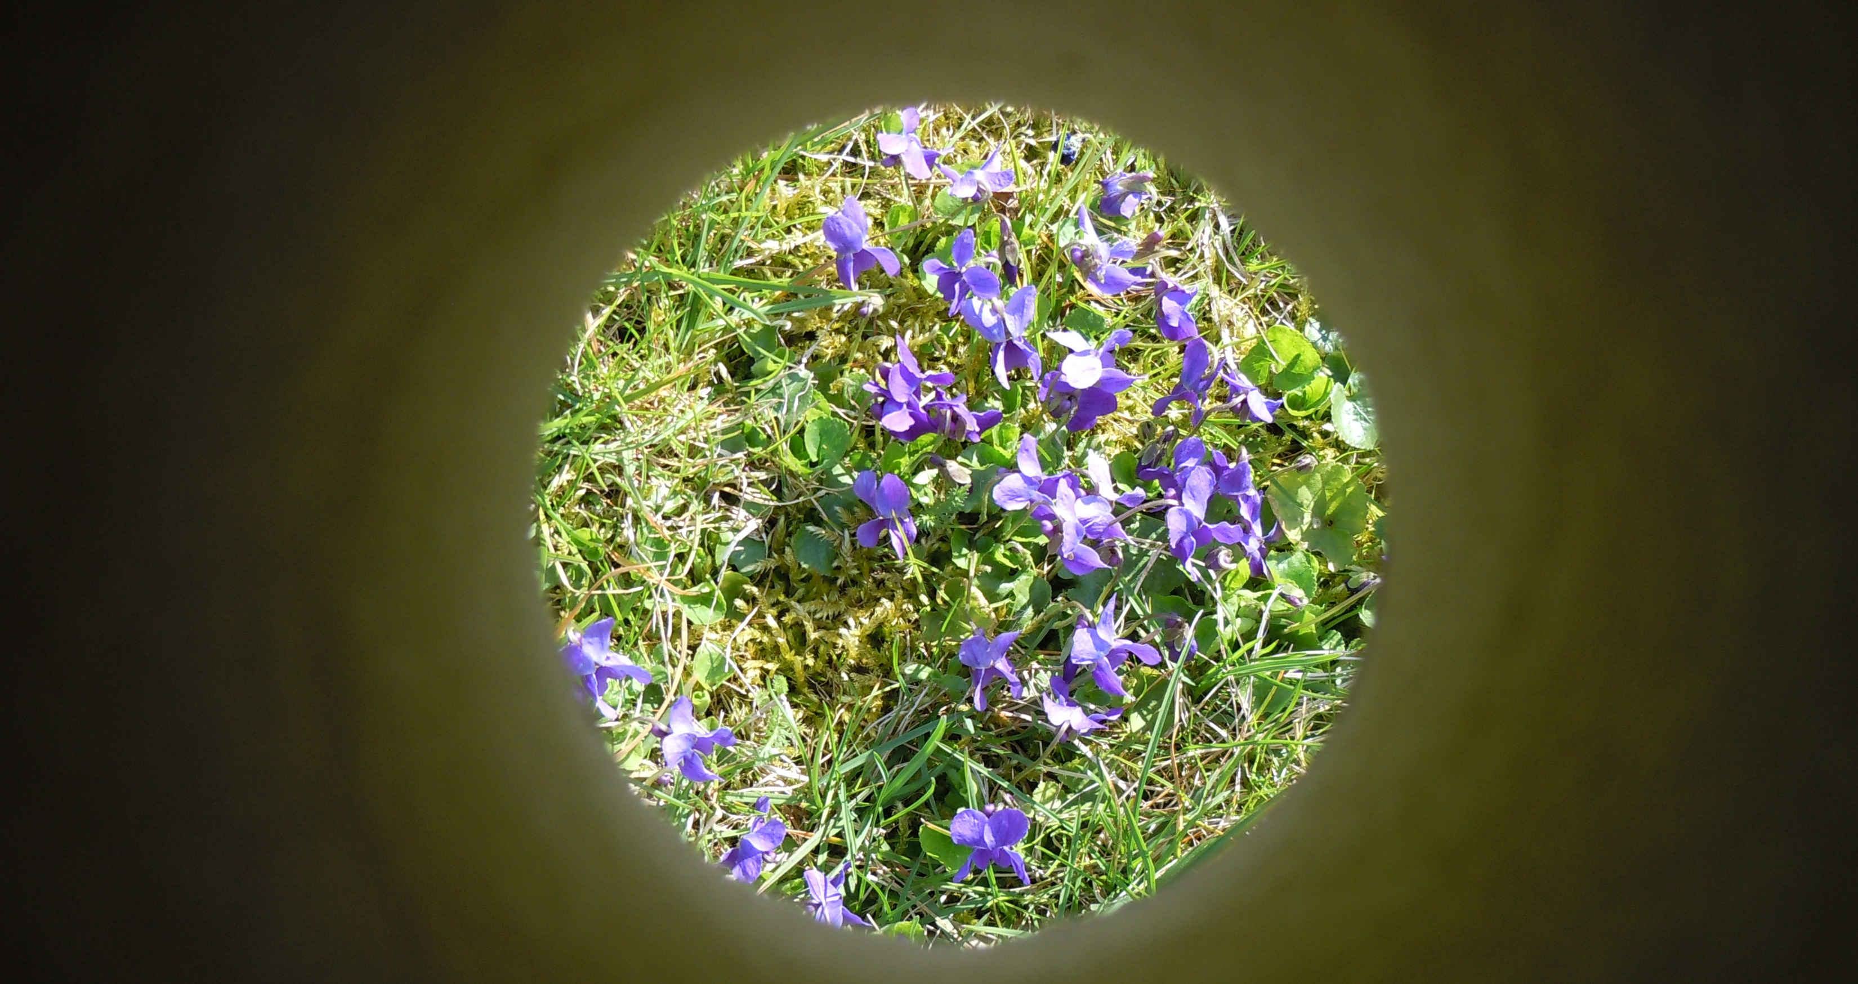
WINDOWS TO WATER

