Slide 1
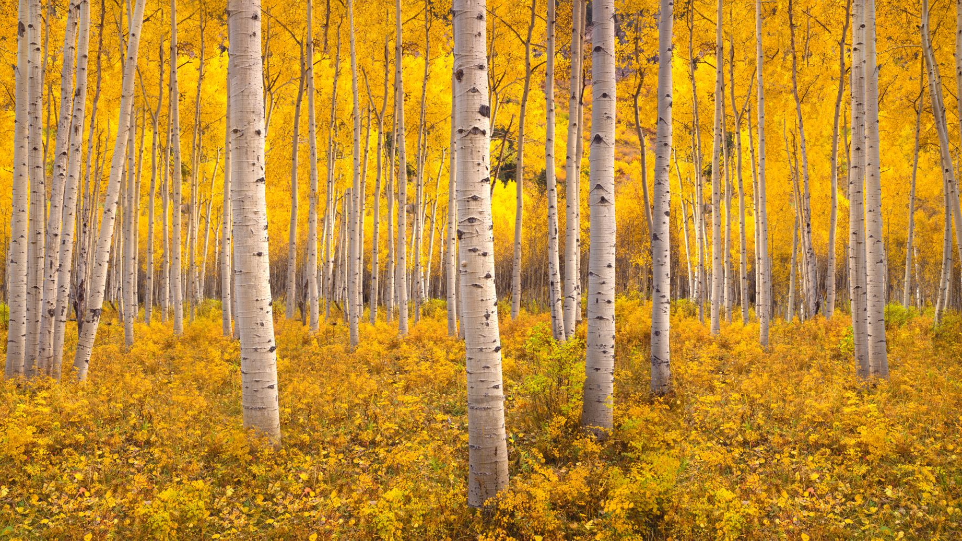
Welcome in our forest
4A and 4B classes draw and describe

Slide 2
Welcome in my forest! I am a hedgehog and I live here.
There is a fish. My friend fish is green. She loves water.
This is my friend – a snake. His name is Small tail.
There is a mouse, it is a girl. She is brown and black.
This is an anthill and a nice stream.
This is a bird, it is a boy. He loves worms and he is blue.

Slide 3
Hello, I am a bear.
My best friends are a fox and a rabbit. We are in a forest. We love our forest.
In our forest, there are plants and a pond.
There is dew in the morning. It is sunny in the afternoon. It is cold in the evening.

Slide 4
Welcome in my forest!
My friend – a bird – is above me. This bird is funny.
There is my friend – a beaver.
On the branch, there is my other friend – a squirrel.

Slide 5
Hello, I am a fox.
There are trees in my forest.
There is a bird.
There is a bear.
There are fish.

Slide 6
This is my forest.
There are two deers.
There is one stream.
There are birds.
There are six trees.
There is a fox.
There are hunters.

Slide 7
Hello, I am an owl and I will be your guide.
This is our forest. We have animals here and there are my friends – a fox and a snake.
We have a lot of trees here and there is the tall apple tree where I live.
It´s beautiful here. We have a pond and bushes with raspberries, we like it here.

Slide 8
Hello, I am an owl.
You can see fungi in this forest. You can also see stones, trees, flowers and a hare. There are also beautiful fish in the stream.

Slide 9
Hi. My name is Brumík. I am a black bear and I am your guide.
This is our forest. Here we have a fox family. The fox family has two children. One is named Bob and the other one is named Humi.
We also have a river in our forest. The river leads to the pond and we can drink from the pond.
I would like to show you the last thing. This is an anthill with over 200 ants. And that is the end of our tour.

Slide 10
I´m a fox and your guide.
There are my friends and a big tree in this forest.
There are animals and a stream too.
There are fish in the stream.
My best friend is a fish.
This fish is yellow and blue.

Slide 11
Hello, I am a bear. I live in the forest.
I have many friends.
My best friend is a fox. She´s orange. She lives in a den.
My next friend is a deer. He has got big antlers.
A squirrel is little and orange.
We are afraid of a snake. He has got a long tongue and sharp teeth.
There are flowers in our forest.

Slide 12
Hello, I´m a cat and my name is Baku. I´m brown and I have a very nice face.
This is my forest and there is a flock of birds in the forest. The flock of birds is black. This is a hedgehog. His name is Shoto. He is grey and quick. And this is an owl. Her name is Deku. She is green and happy.

Slide 13
Hello, I am a hare. Here you see my friends.
This is a deer. The deer is very big and he has got big antlers.
This is a fox. The fox is very smart.
This is a bear. This bear is very big and very dangerous.

