Slide 1
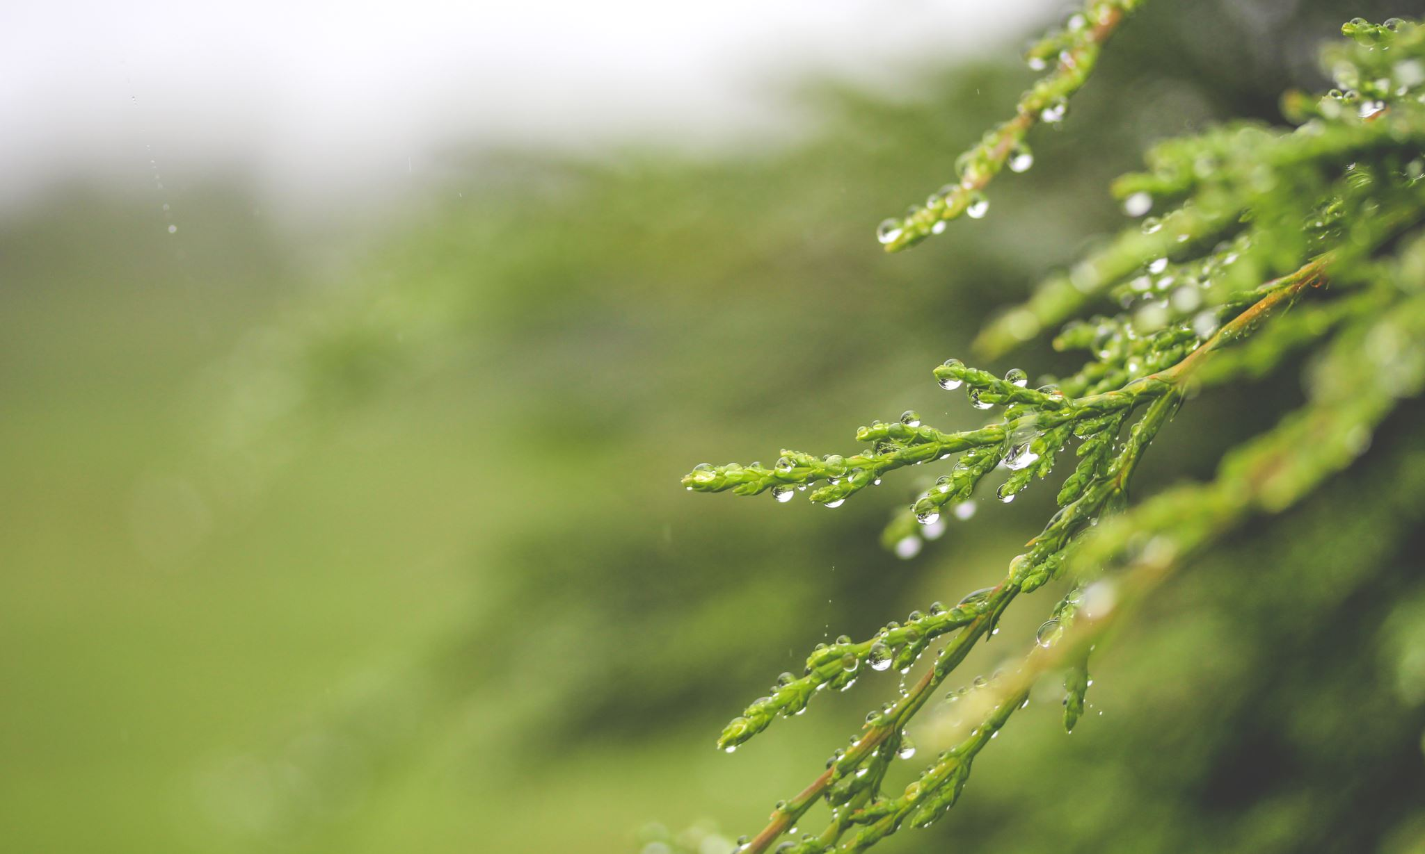
Water life

Slide 2
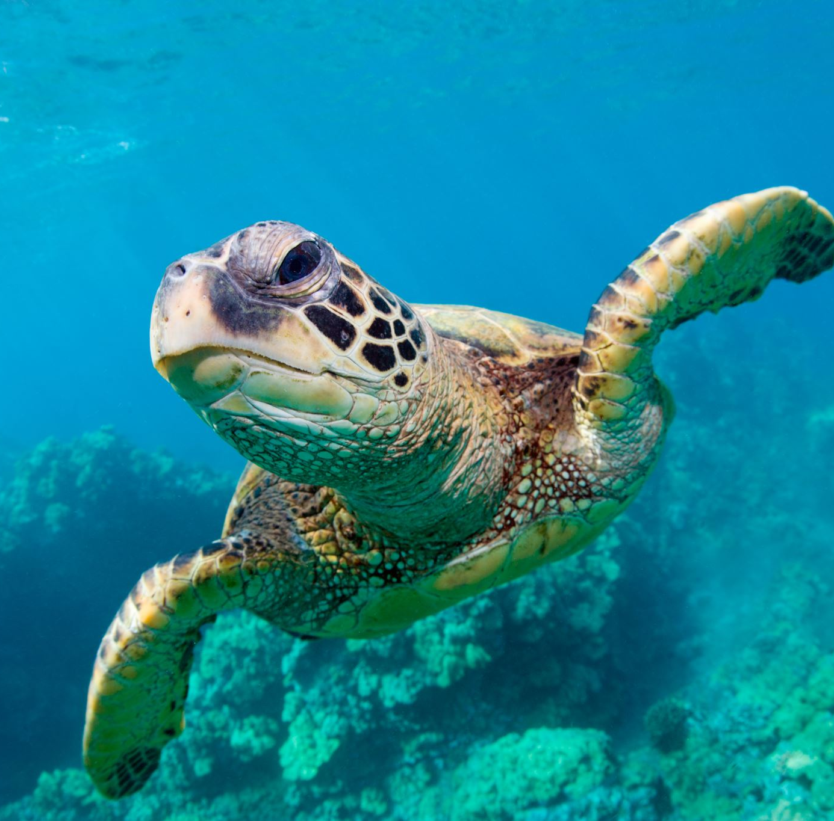
Sea
The sea covers a large area
Water in the sea is salty
We haven´t got sea in Czech Republic
We usually travel to the sea to other countries and states
There are many seas around the whole world
Sea is home for many animals, for example sharks, seahorses, stingrays and lots of other fishes
There are also many sea flowers, for example seaweed or corals

Slide 3
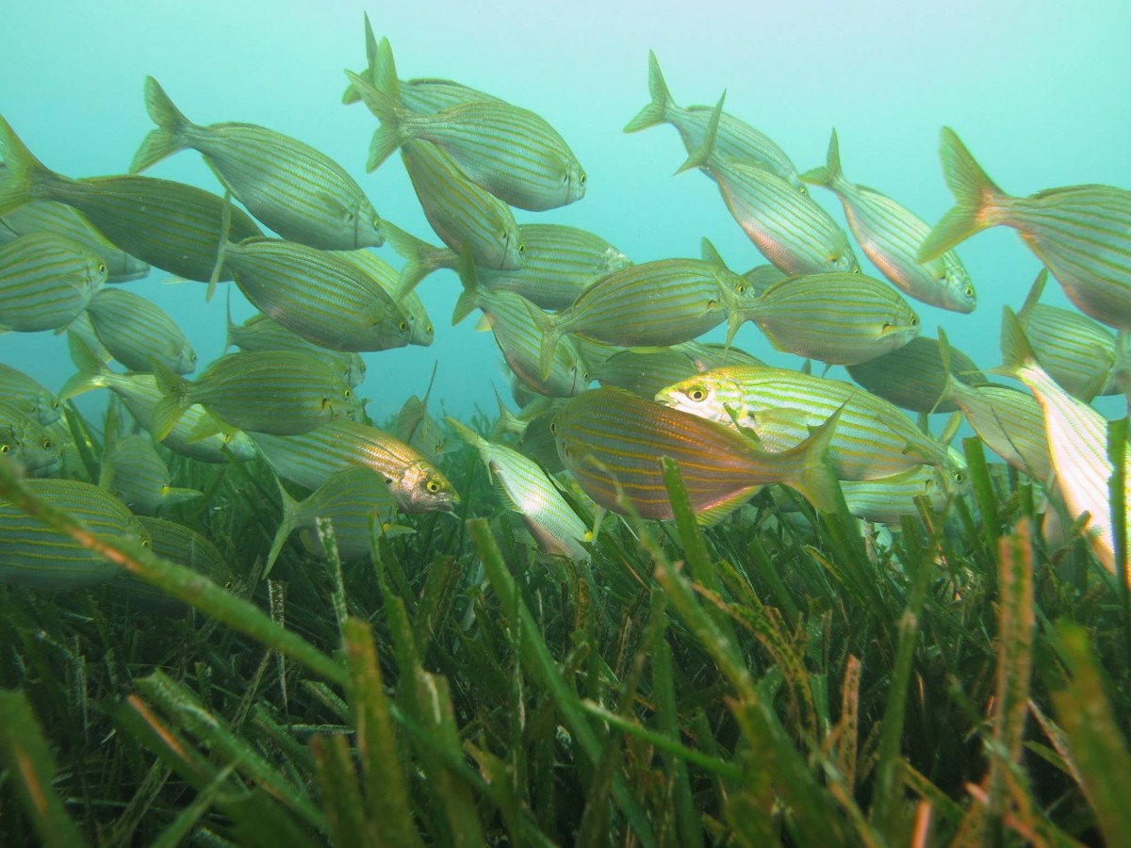
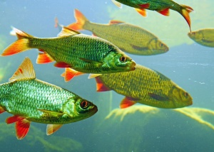
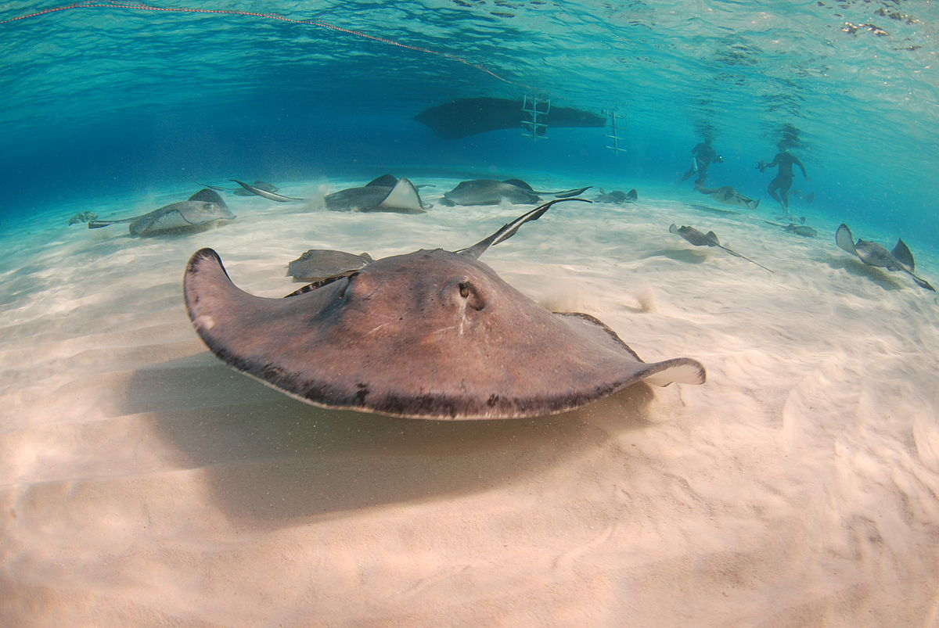
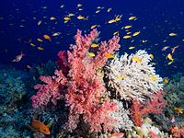
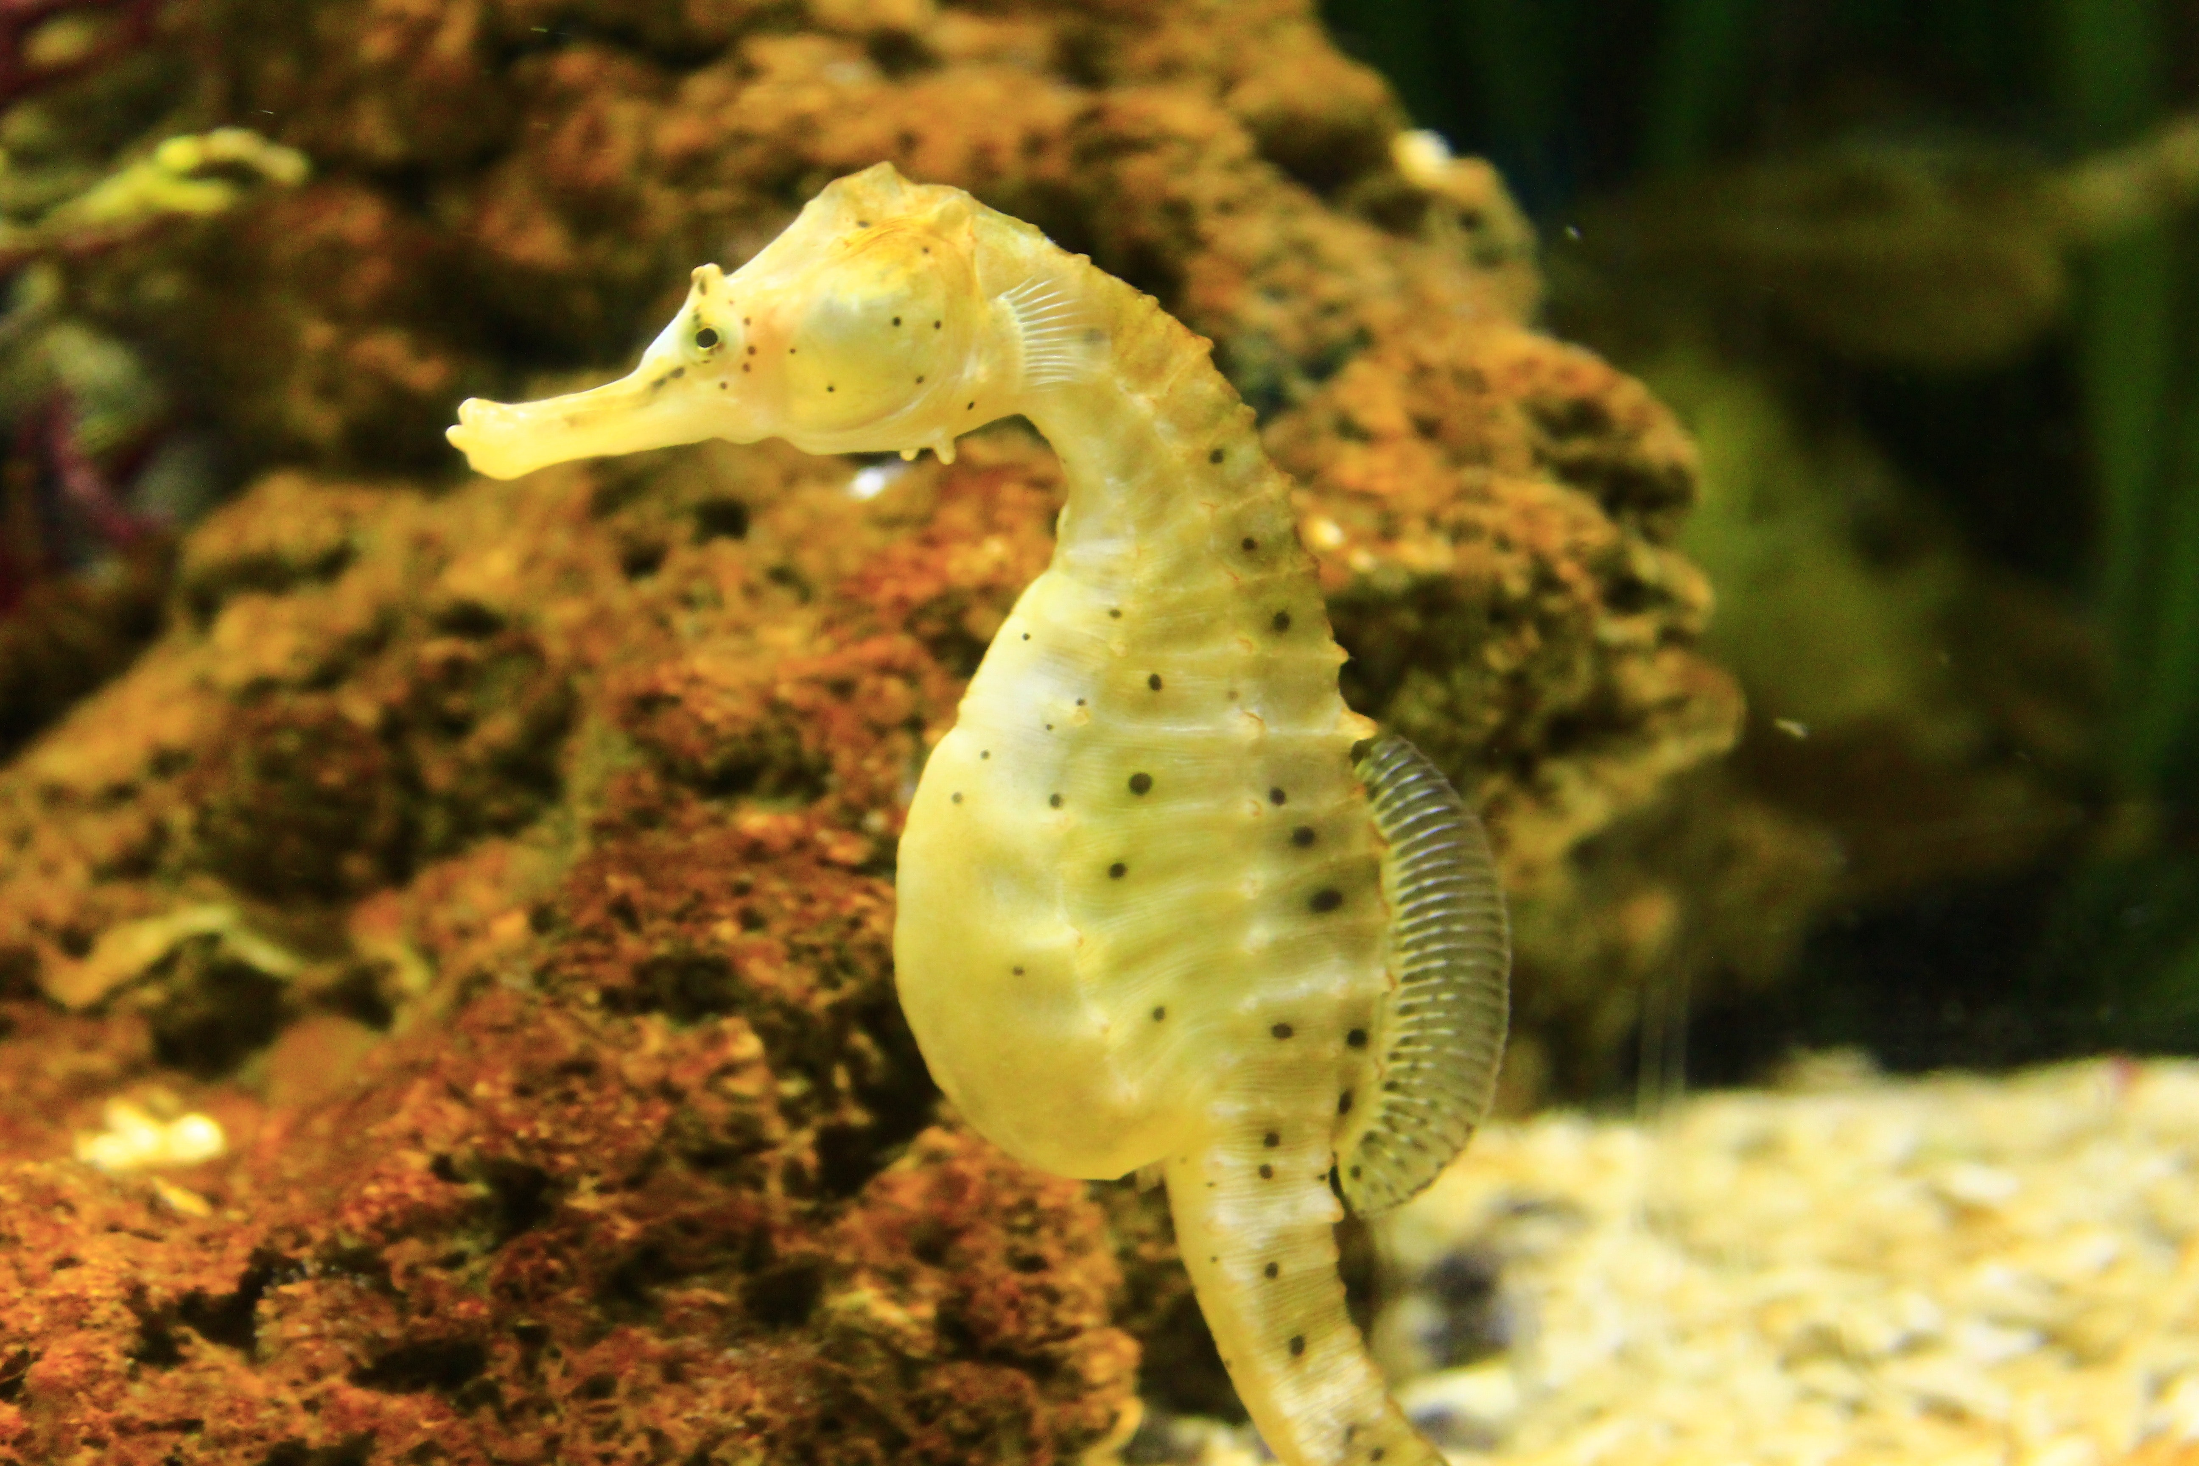
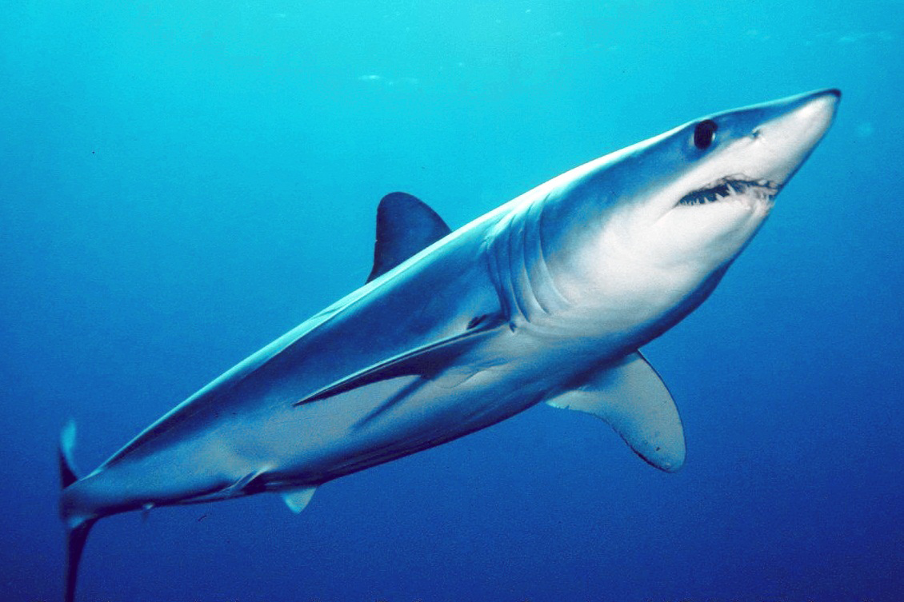

Slide 4
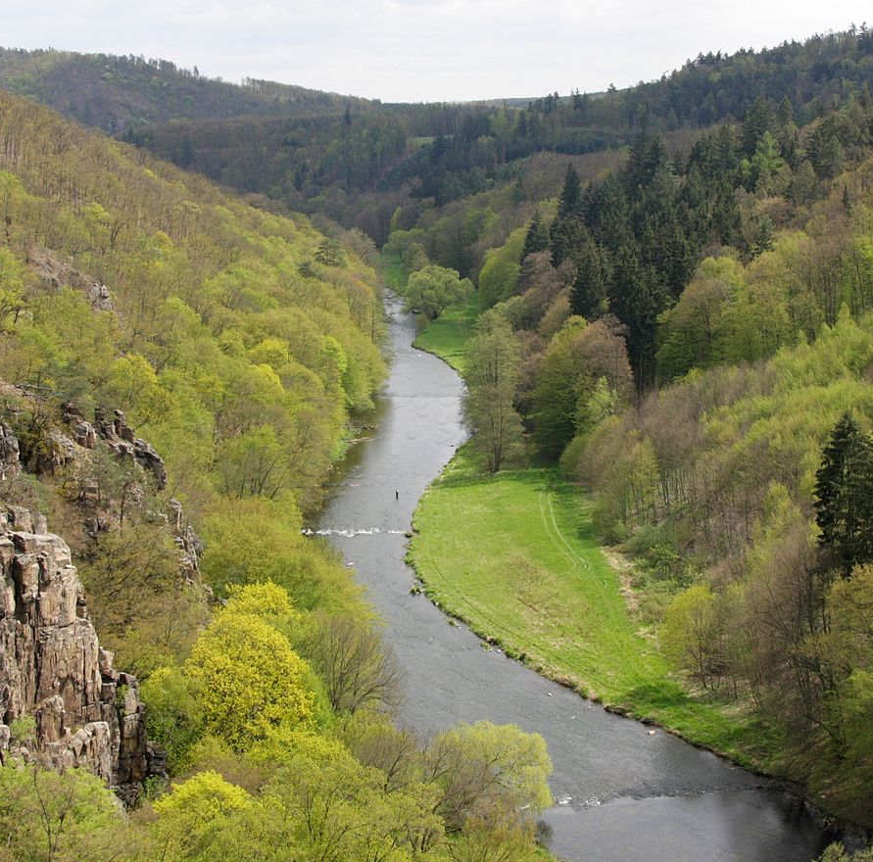
River
River is running water in nature
The water is fresh, not salty as in the sea
We have many rivers in Czech Republic
River is home for lots of freshwater animals like fish, snake, frog and we can see dragonflies so close too

Slide 5
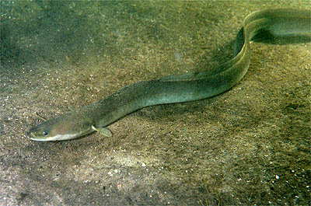
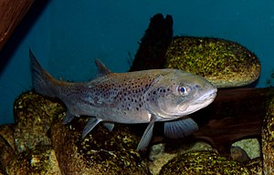
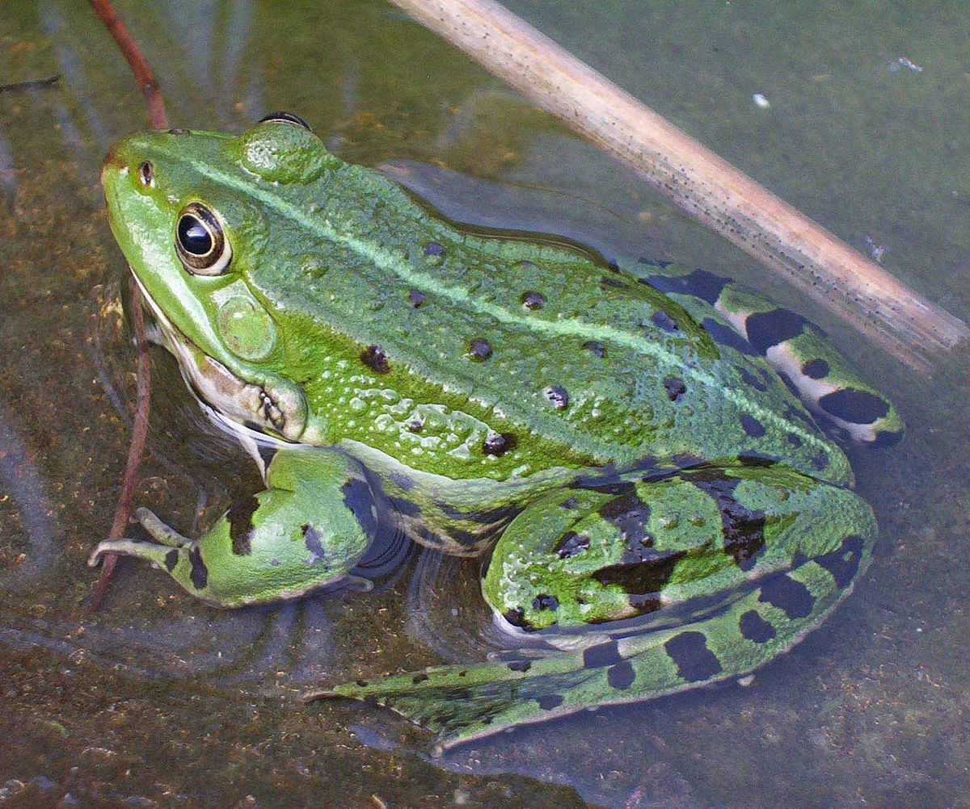
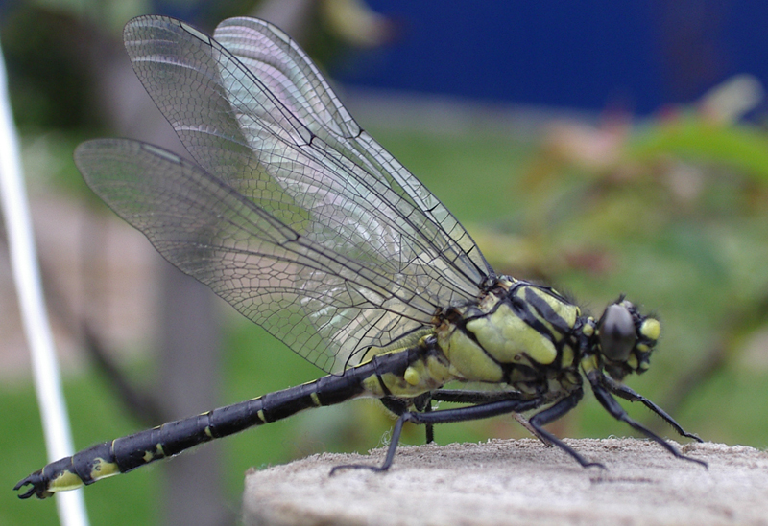

Slide 6
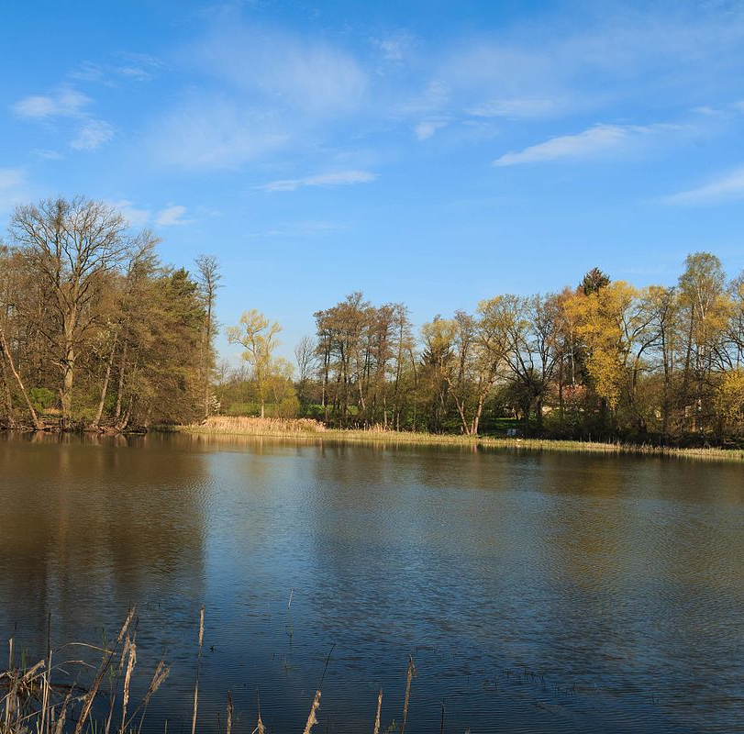
Pond
The pond is fresh stagnant water
It´s created by people, not by nature
The one of very known ponds is for example Třeboňský pond
Pond is home for carps for example and some other fishes like pike
Water lilies grow on the pond
And we can see ducks or swans too

Slide 7
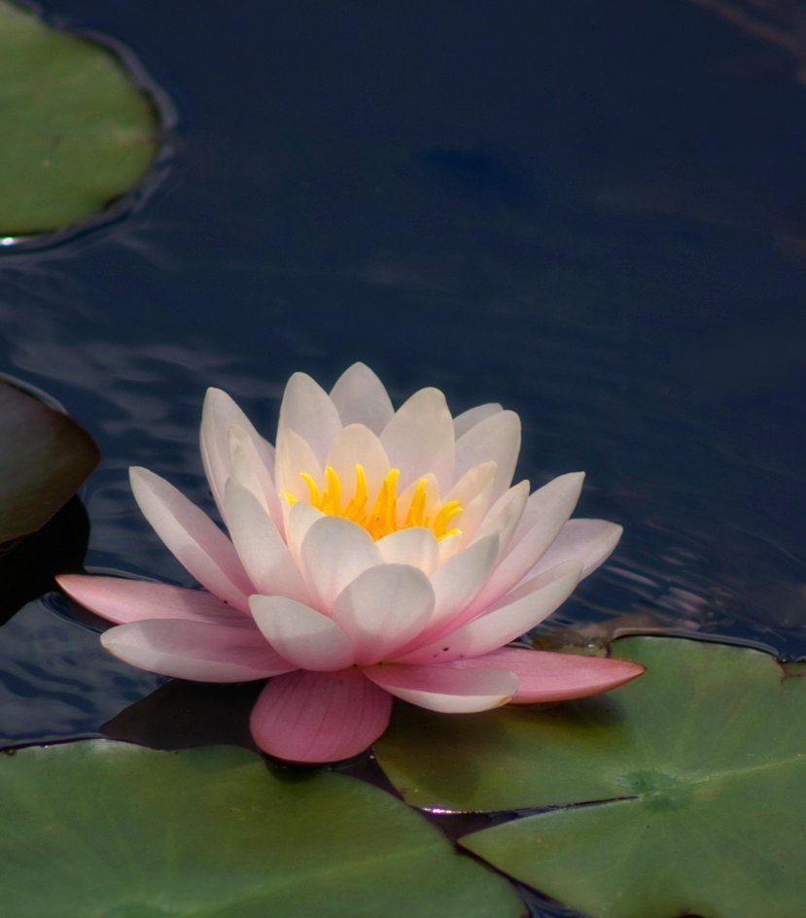
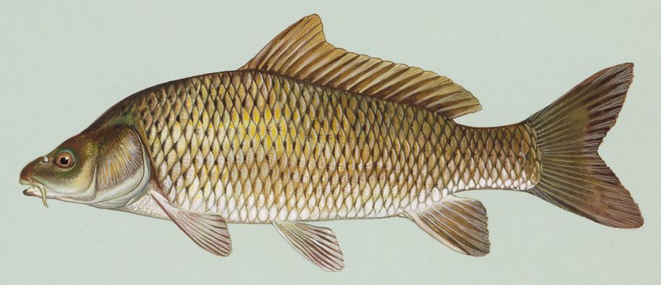
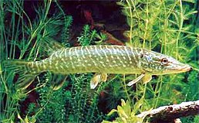
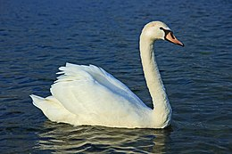
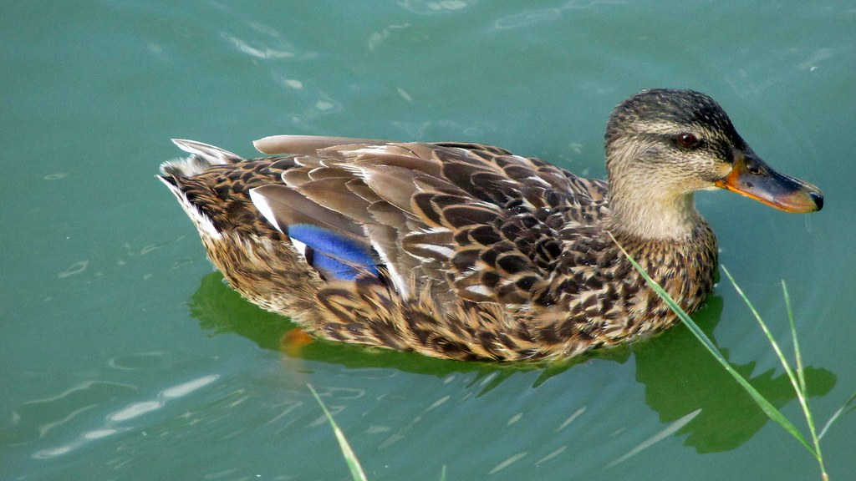

Slide 8
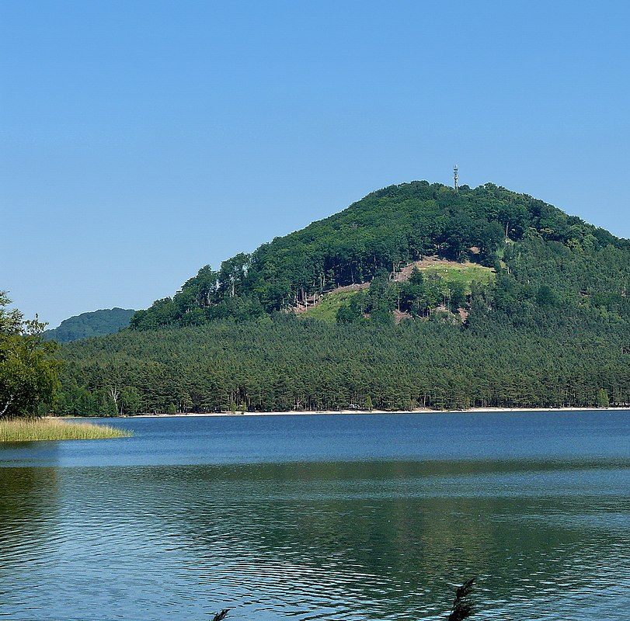
Lake
Lake is fresh stagnant water
It´s created by nature
We have lakes in Czech Republic, the main known is Máchovo lake

Slide 9
Ocean
The oceans cover 71% of the earth´s surface
We have five oceans on the Earth and they are: Pacific Ocean, Atlantic Ocean, Indian Ocean, Southern Ocean, Arctic Ocean

